Slide 1
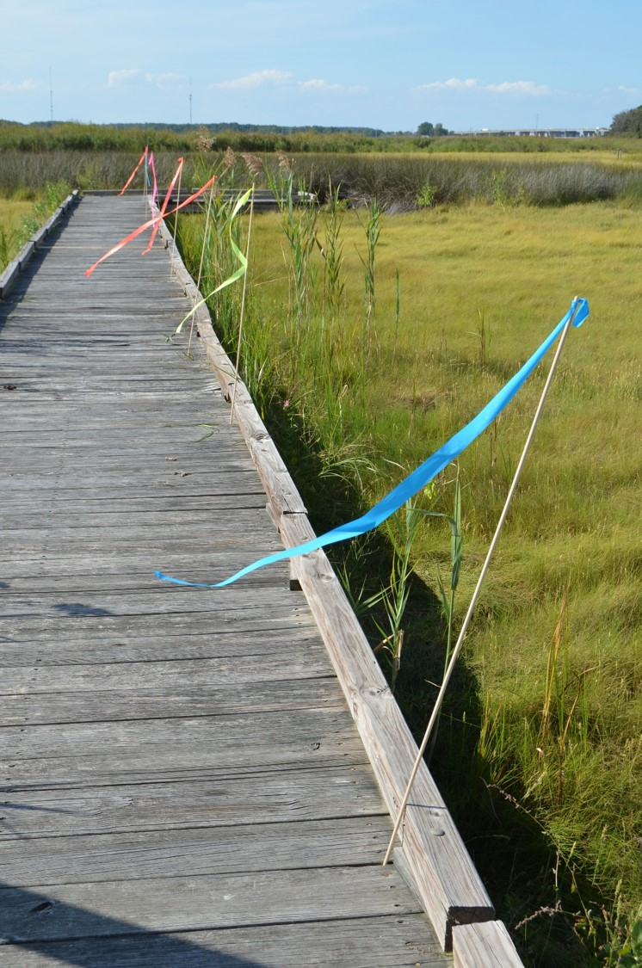

AREN Wind-Stick
Monitoring March Winds
Mission Challenge
Sallie M. Smith & Geoff Bland, AREN Project
NASA Goddard Space Flight Center
Objective: Participants will collect and analyze March Wind - Stick data to determine whether the proverb, March Winds roar in like a lion and go out like a lamb” is true at the location for the current year.
Q. Is it true that “March Winds ROAR in like a lion and leave like a gentle lamb?

Slide 2

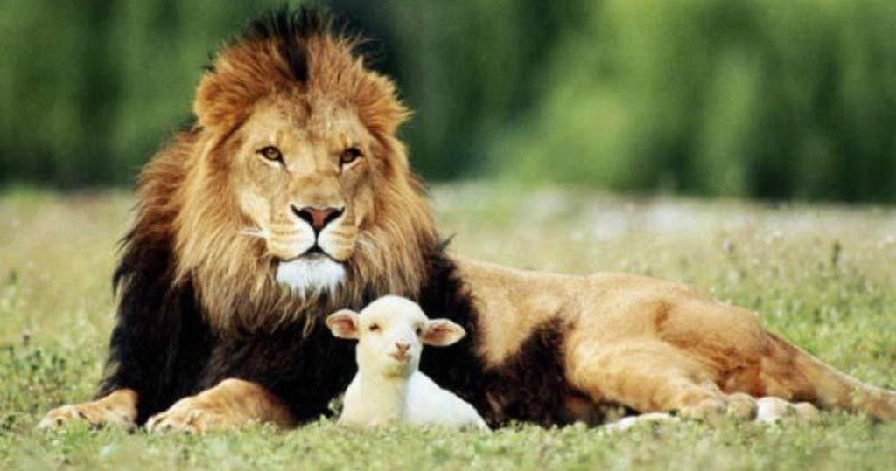


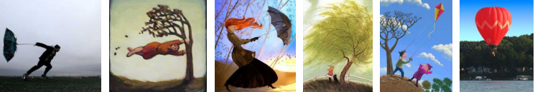
Engagement: Wind Weather Phenomenon
“March winds roar in like a lion and go out like a lamb.”

Slide 3
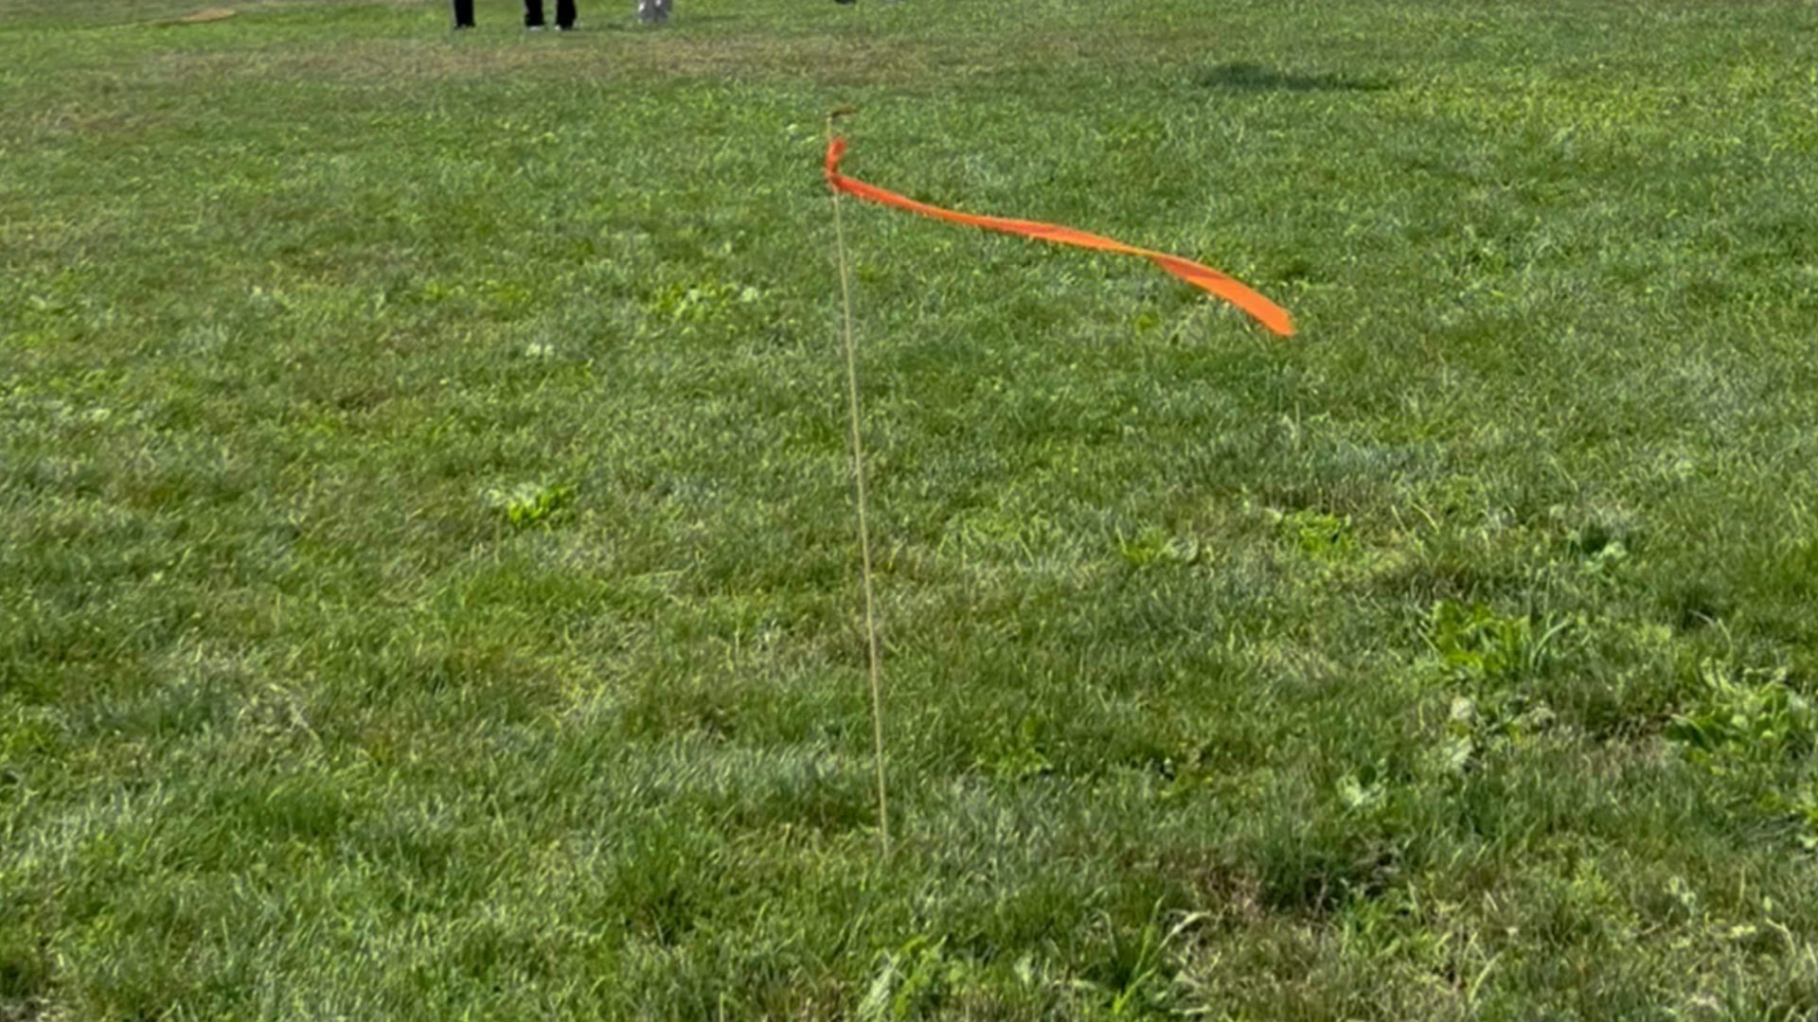
Explore: AREN Wind-Sticks
Focus For Viewing:
Q. What things can wind-stick observations tell us about the wind?
1. Wind Strength
2. Wind Direction
3. Wind Duration
Q. What information doesn’t a wind-stick provide about wind-strength?
4. Wind Gusts
5. Wind Variability
Wind Speed

Slide 4
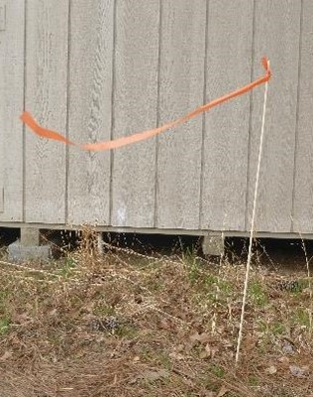
Elaborate: Make an AREN Wind-Stick
Procedure:
Materials: (Per Wind-Stick)
¼” diameter wooden dowel
30”colored ribbon tape
Measure and cut a 30” length piece of colored ribbon tape.
Tie the 30 inch ribbon tape to the top of the wooden dowel.

Slide 5
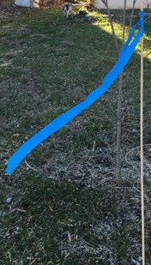
Wind Stick Field Observation Procedure
1. Place the AREN Wind Stick in an open area (recess playground, field, etc.) where the wind is not blocked either in the ground or through the lid of a closed copy box between two reams of paper to weigh the box down. 2. Once the Wind Stick is in place, observers should stand in a line, not blocking the wind and observe what the ribbon looks like when the wind blows it and draw observations anytime the ribbon changes for five observations. 3. The Adult Mission Leader should designate and note the start observation time. 4. Back in class, observers should review their drawings and sketch a copy of their strongest ribbon movement in the last “highest” circle. 5. Students should sketch their highest wind stick observation onto the corresponding observation calendar date.

Slide 6

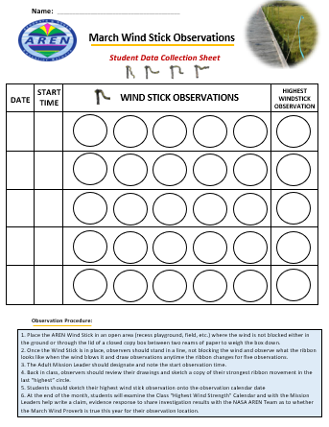
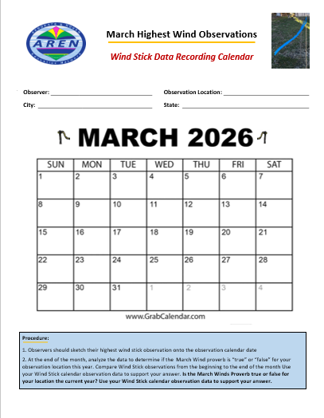
Elaborate: Conduct Wind-Stick Observations

Slide 7
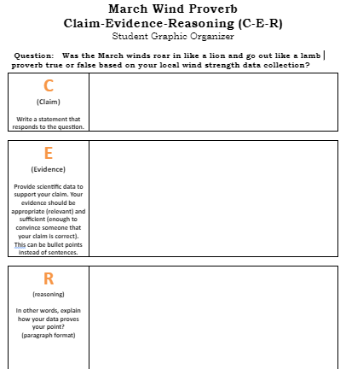


EXPLAIN: Claim/Evidence/Response

Slide 8

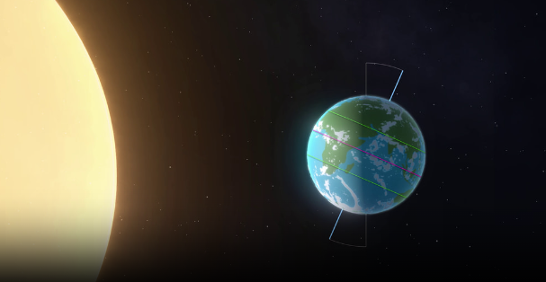
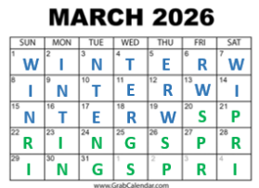
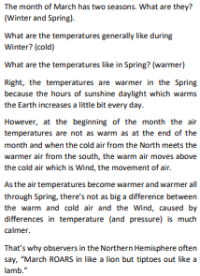
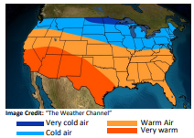
EXPLORE: March Wind Science

Slide 9
AREN Wind-Stick: Monitoring March Winds Resources
AREN Wind-Stick monitoring March Winds Mission Challenge
AREN Monitoring March Winds Challenge Presentation Slides
AREN Wind-Stick Observation Data Collection and Analysis Sheets

