Slide 1

FRUSTRATIONLESS FLYERS® KITE BUILDING INSTRUCTIONS

Slide 2

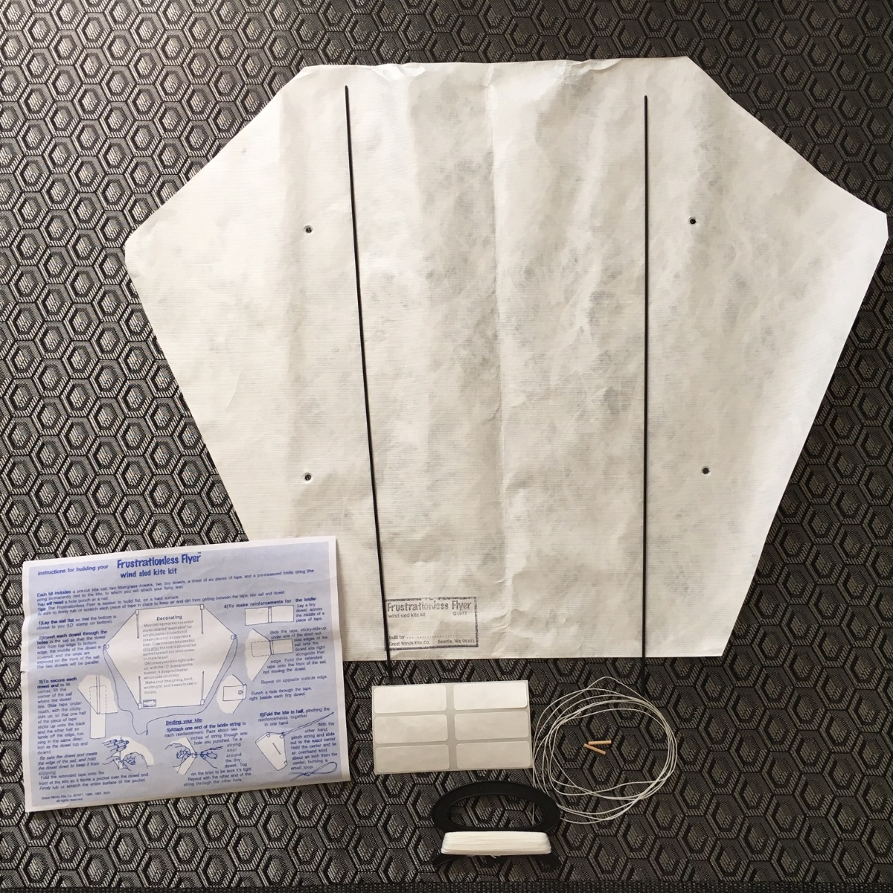
Frustrationless Flyer® – SLED KITE PARTS
Sail
(2) fiberglass
spars
assembly
Instructions
(2) wooden dowels
bridle line
(6) labels
kite Line on handle holder

Slide 3

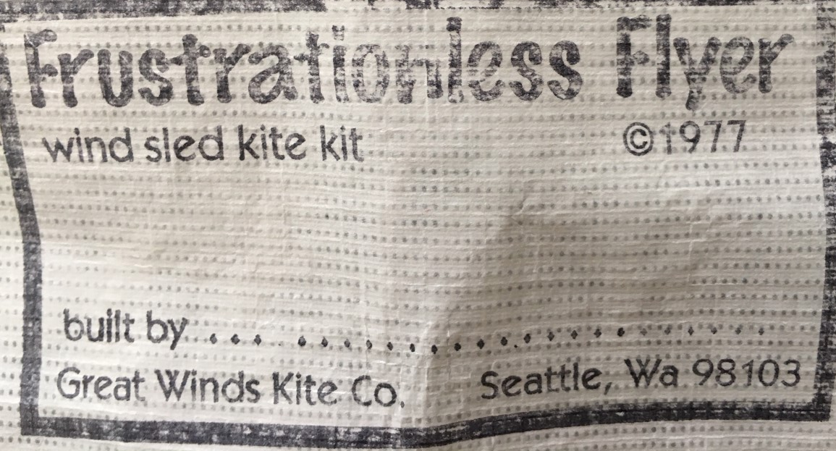
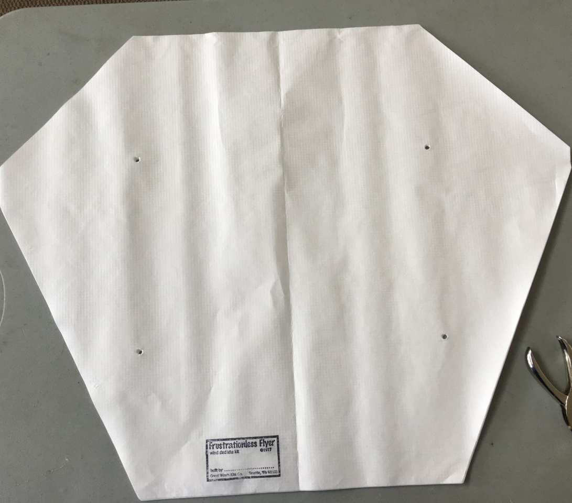
Building the Frustrationless Flyer® Sled Kite
1. Lay the sail flat on a table with the identification stamp at the bottom so you can see it.
Sallie Smith

Slide 4
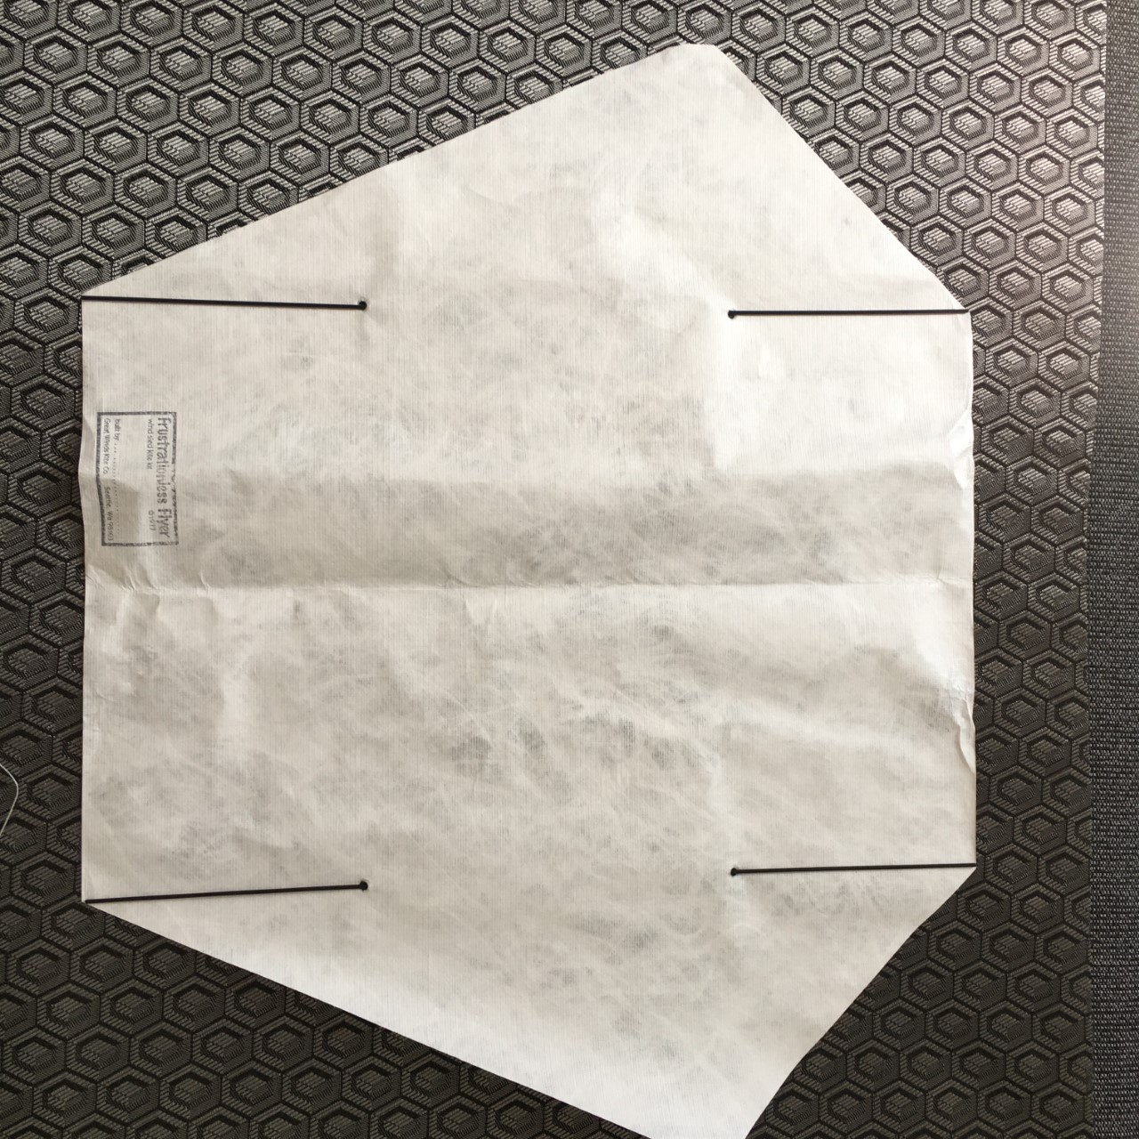
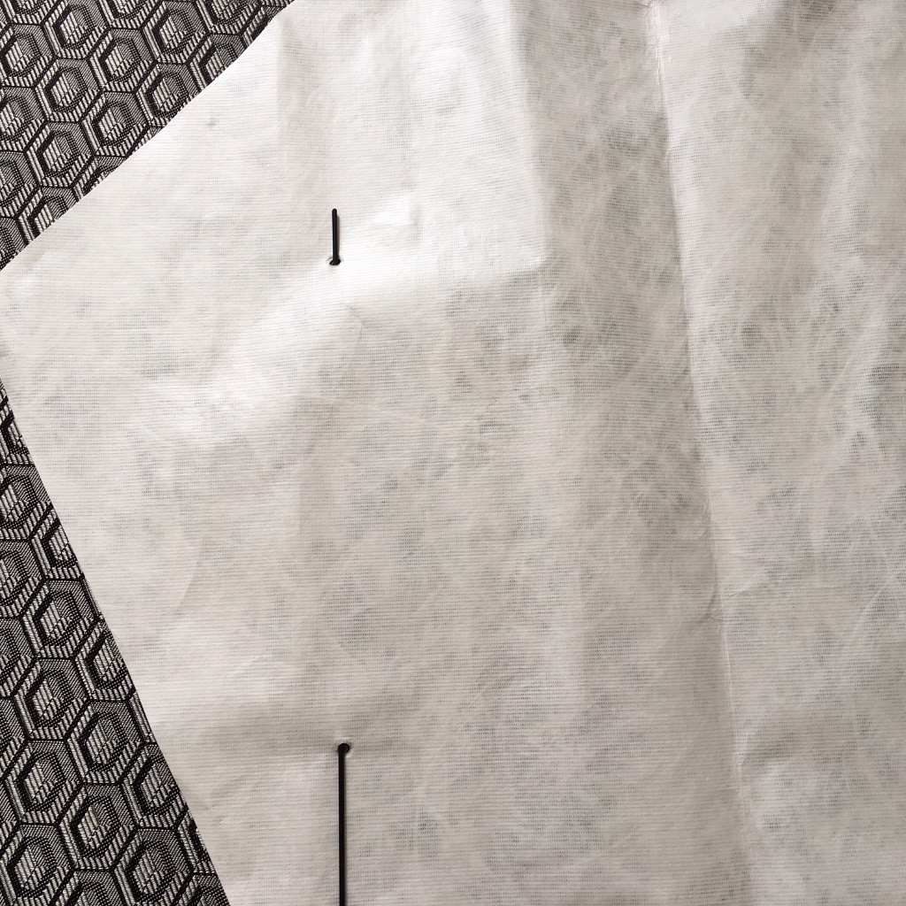
Building the Frustrationless Flyer® Sled Kite
2. Insert each spar through the bottom hole and out the top hole.

Slide 5
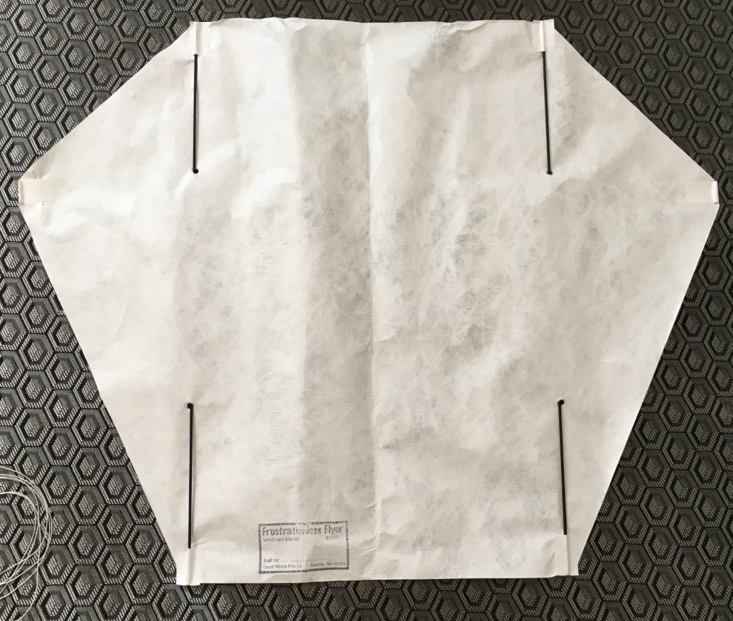

Building the Frustrationless Flyer® Sled Kite
4. Hold each spar in position and fold the label tape over it. Be sure to press the tape along the sides of the each spar.
3. Place a label, sticky side up, half way under the kite where each spar is located.

Slide 6

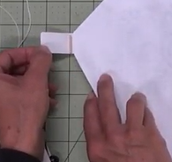
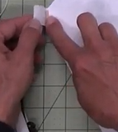
Building the Frustrationless Flyer® Sled Kite
6. Place half dowel label under the side of the kite making sure the dowel touches each side.
7. Fold over the label tape and firmly press along the sides of the wooden dowel to secure it in position.
5. Place a wooden dowel in the center of two labels

Slide 7
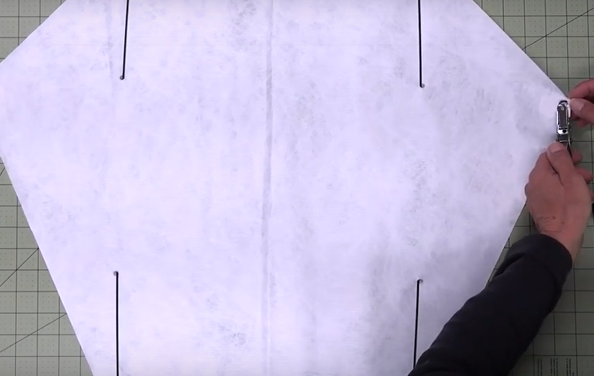
Building the Frustrationless Flyer® Sled Kite
8. Using a single hole punch tool, punch a hole in the center left and right labels right next to the wooden dowels

Slide 8
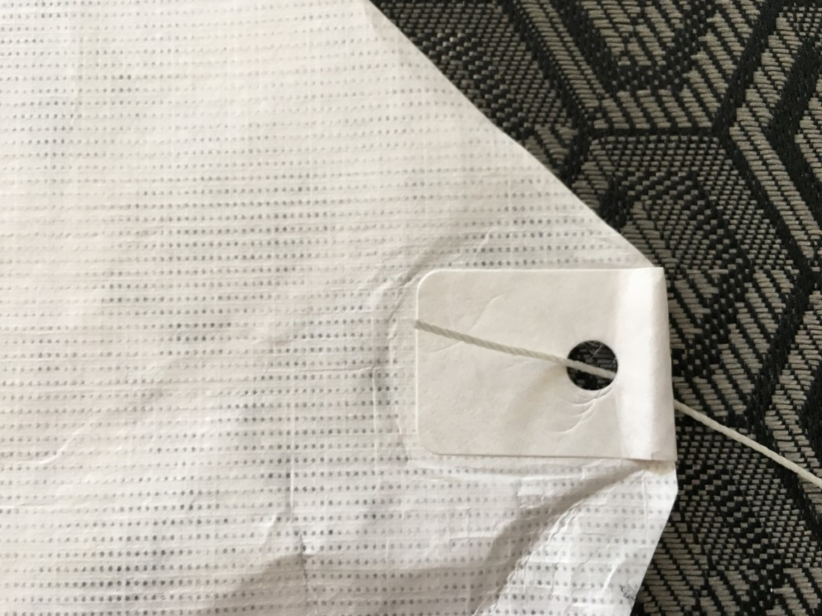
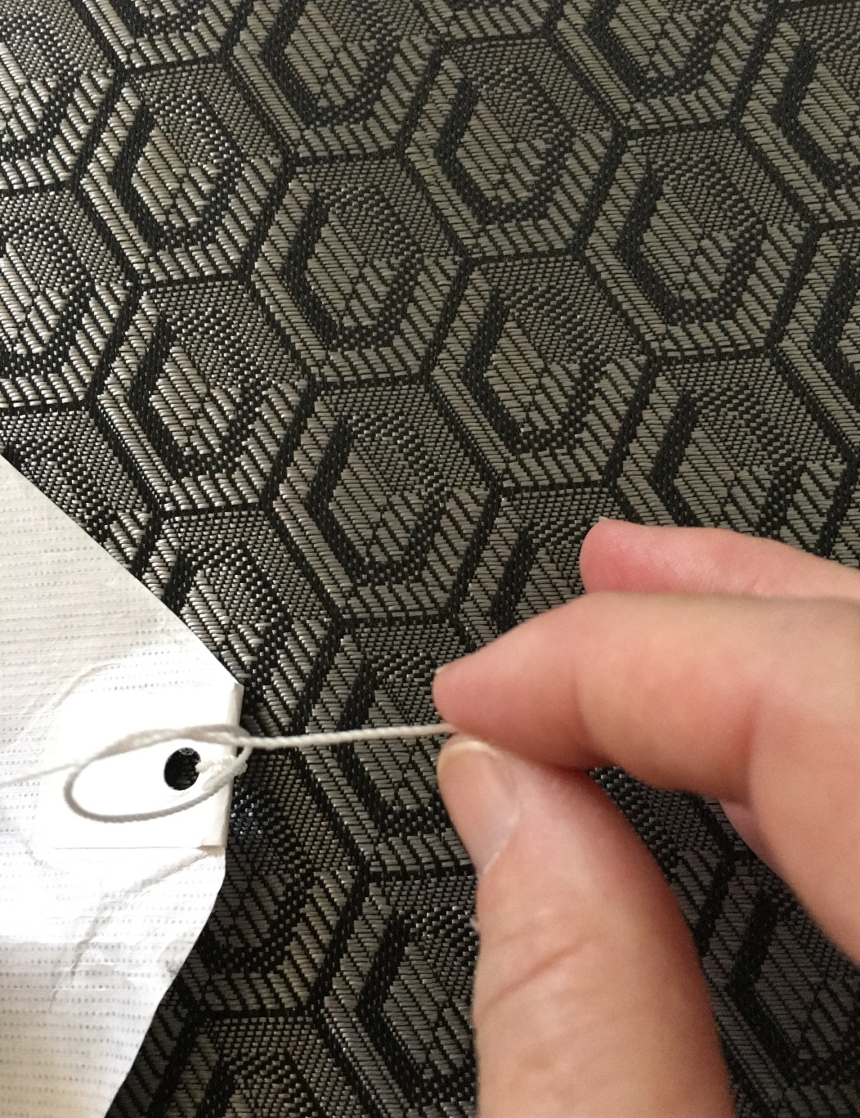
Building the Frustrationless Flyer® Sled Kite
9. Take each end of the bridle line and insert it through one of the holes and tie 3 overhand knots. Try to keep the bridle line long.

Slide 9
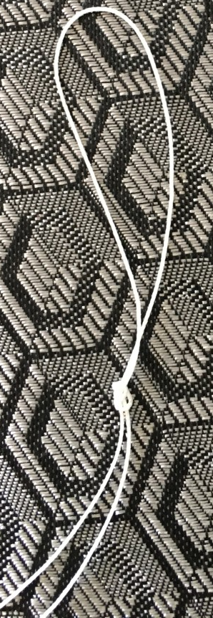
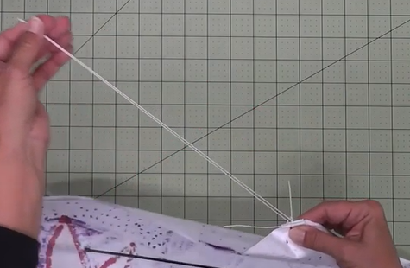
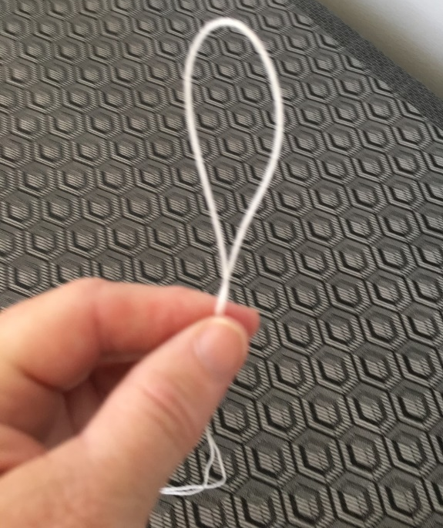
Building the Frustrationless Flyer® Sled Kite
10. Fold the kite sail vertically in half by matching the left and right holes.
11. Run your index finger and thumb along the bridle line to the end to locate it’s center.
12. Tie a knot around the bridle loop.

Slide 10

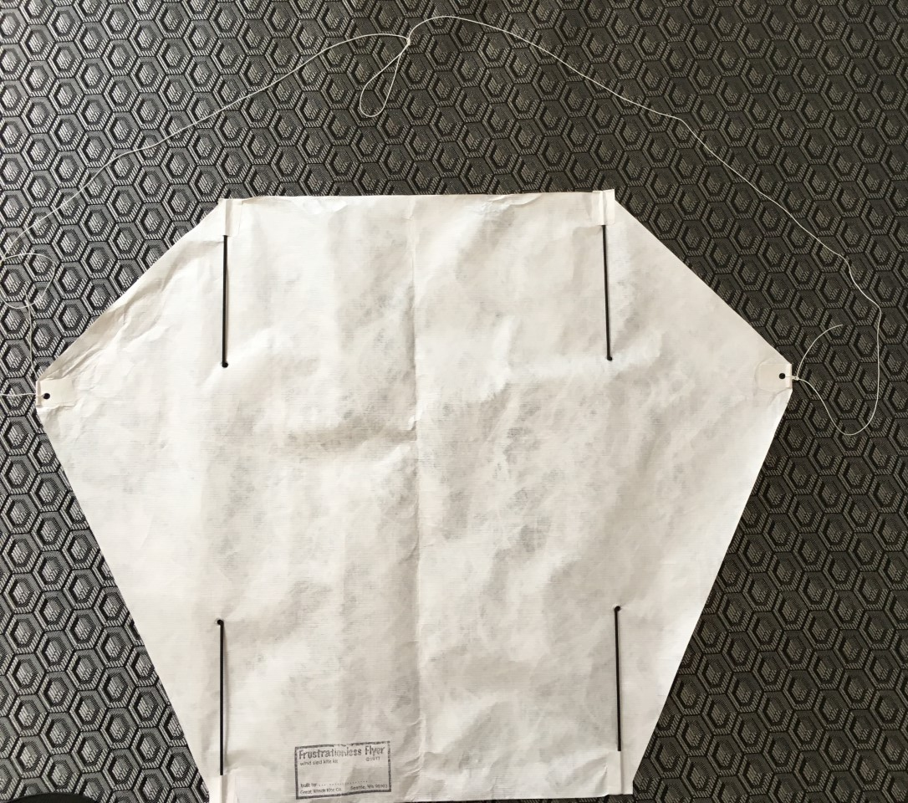
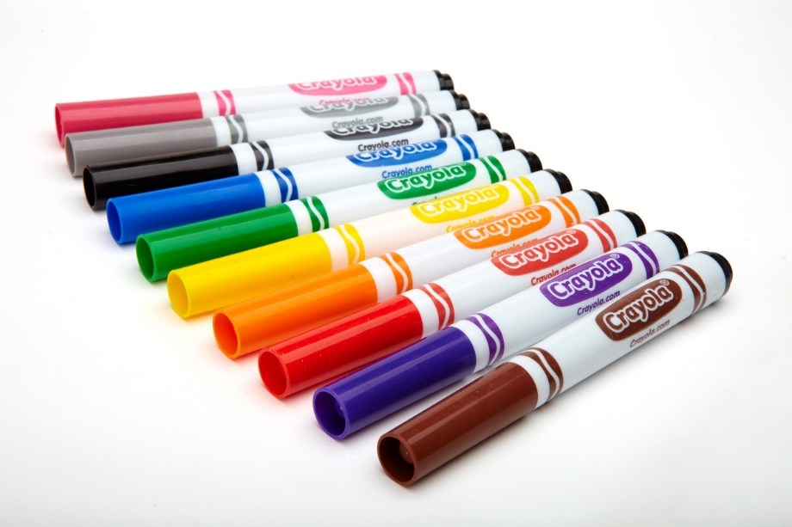
Building the Frustrationless Flyer® Sled Kite
13. Move the bridle line above your kite and decorate your kite sail!
Crayons, markers and paint work fine.

Slide 11
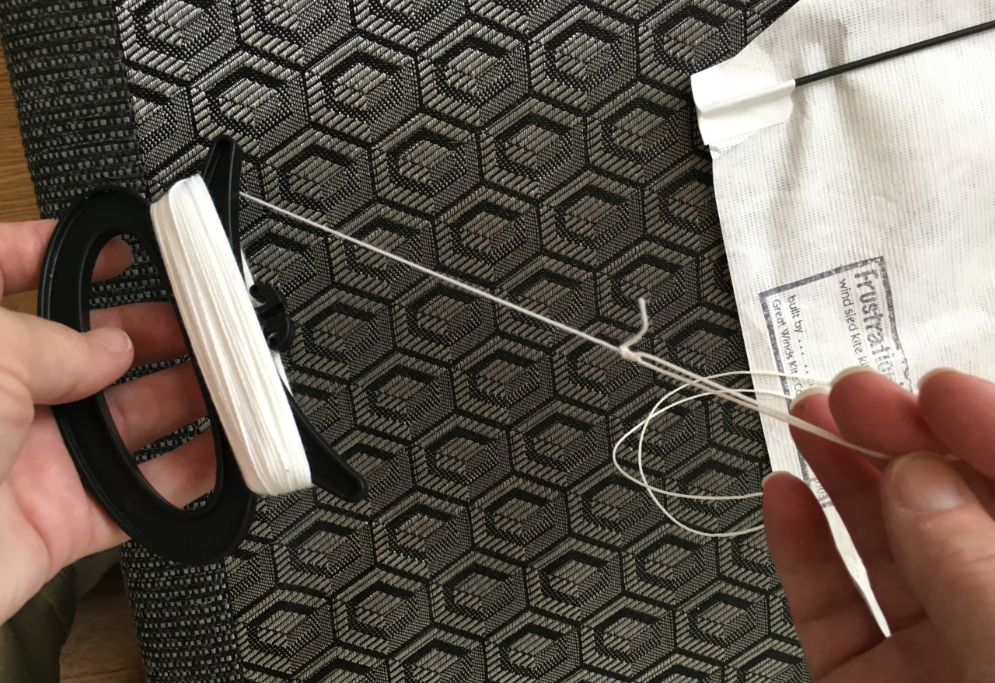
Building the Frustrationless Flyer® Sled Kite
14. Tie the handle kite line to the bridle line.

Slide 12
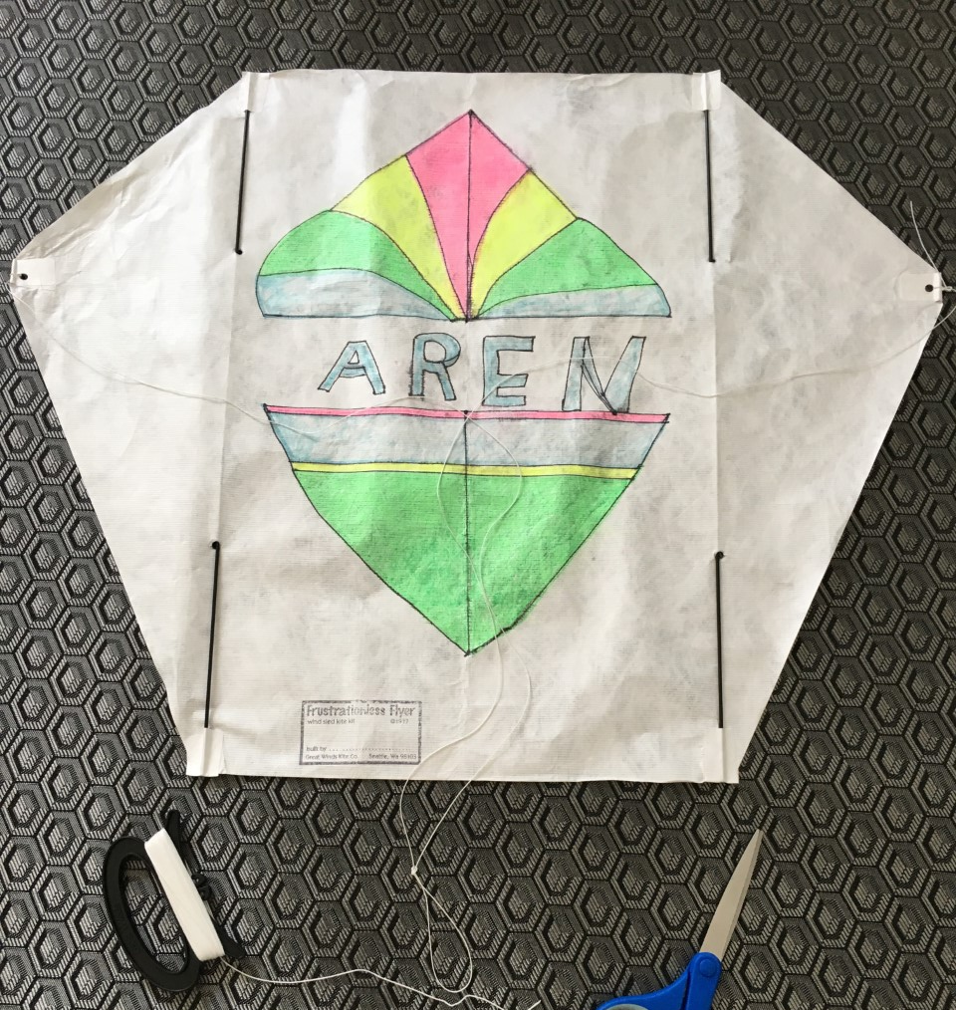
Congratulations! Your Frustrationless Flyer®
is ready for flight!

