Slide 1
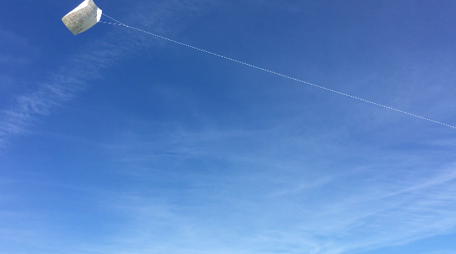

Frustrationless Flyer Field Test Flights

Slide 2
Q. What are the mission objectives for your Frustrationless Flyer Field Flights?
Get to know the wind patterns for the Mission Site?
Practice NASA AREN Launch and Piloting Operation Procedures
Learn to sustain flights using Aeronautic Principles of Flight (Lift and Thrust)
Student Mission Objectives

Slide 3
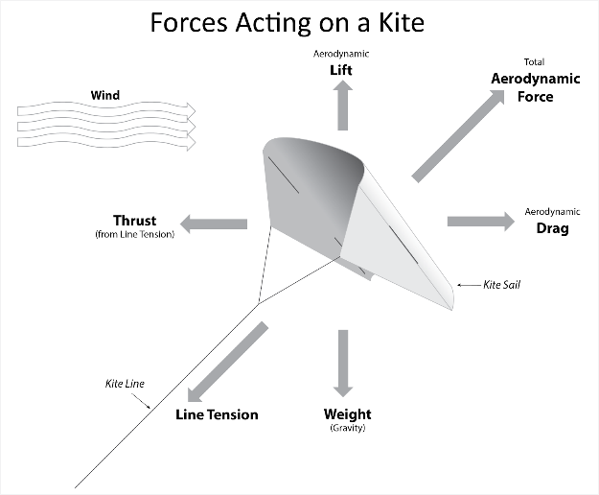
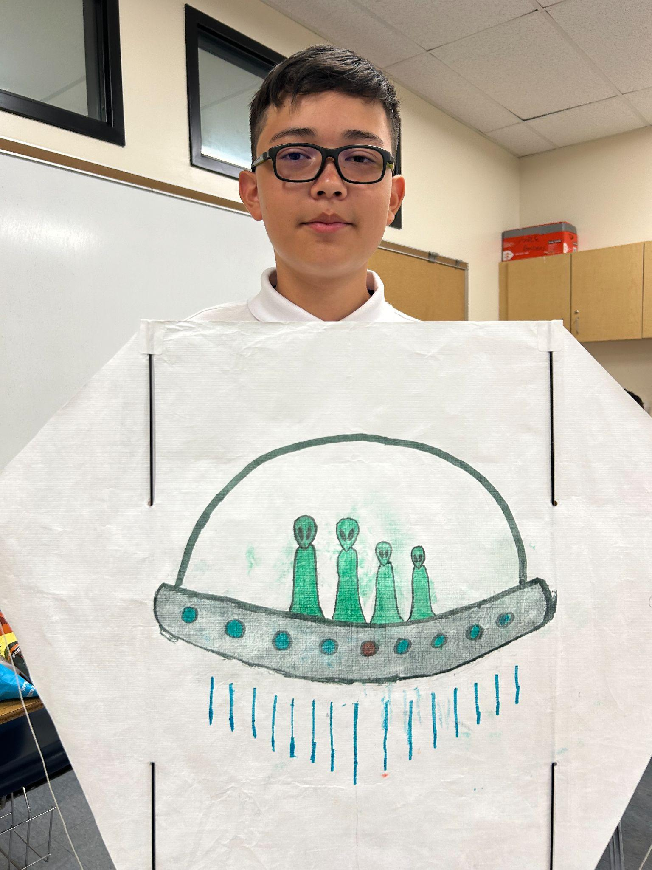
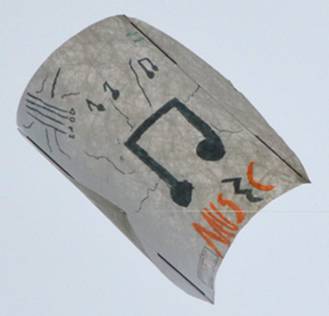
Q. What keeps kites in the air? (Wind)

Slide 4
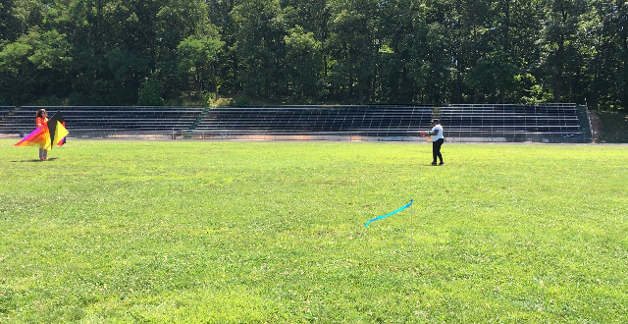
Q. Which way is the wind blowing?
Launcher
Pilot

Slide 5
Clear Communication
Ready?
Ready!
OPERATIONS
Q. What is said by the pilot and launcher when the winds are right for flight?
3, 2, 1, 0 Launch!

Slide 6
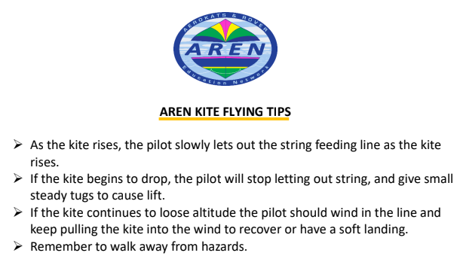
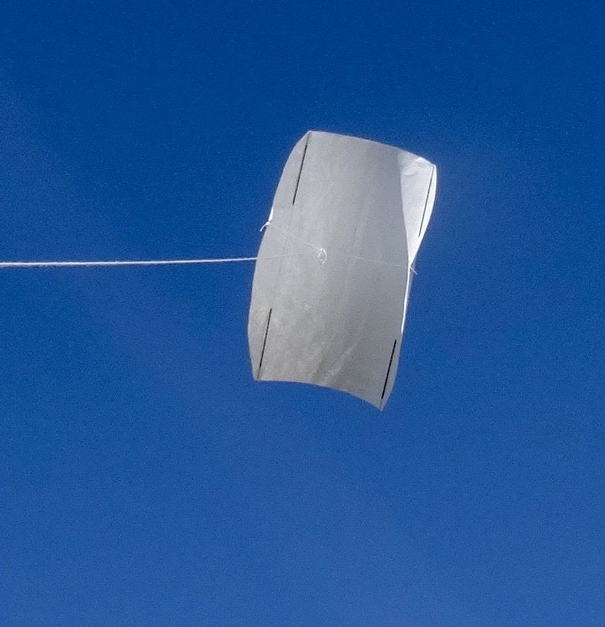

Slide 7
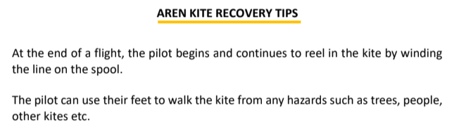
It is always a good idea to try to keep the kite over the middle of the field when flying and recovering in case it suddenly drops.

Slide 8
Post Flight Mission Debriefing
Mission participants share how the mission went from their perspective as both “pilot” and “launcher”

Slide 9
Take “Frustrationless Flyer” Kites Home.
Only fly in SAFE Open Fields in Good Weather!

