Slide 1
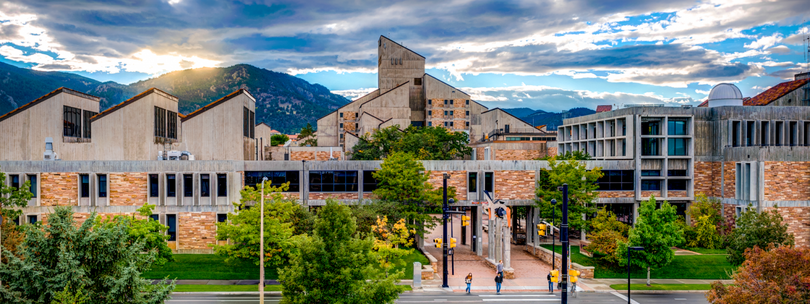
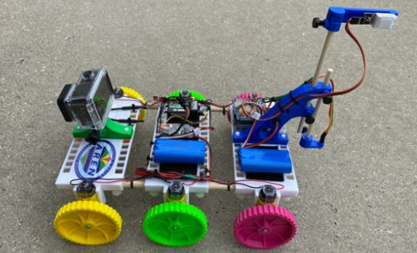
TerraROVER UHIP Environmental Design Challenge
Notes:
Resources:
Albedo: https://docs.google.com/presentation/d/1dTYeUzSVRmypazpvTbseVPrQvxWmWfQaadhv-3YWQv0/edit?slide=id.ga46ede9df0_0_6#slide=id.ga46ede9df0_0_6
Surface Temp & Data Collection: https://docs.google.com/document/d/1odaa6YKsfZ1BUPv8E_Z4Ncgbw9Le4-PQLQwI5-7Gwag/edit?usp=sharing
UHIP Rover Day 1: https://docs.google.com/presentation/d/1hLWy97VZ57OAAWPc4r8zlwL5O9SHofZoJQqFDMfI9uc/edit?usp=sharing
UHIP Rover Day 2: https://docs.google.com/presentation/d/1FxB2zGrVWZ0u3Ucfm5vGjd2nK_wprFxmvPRBIcf-Bcs/edit?usp=sharing
UHIP Rover Day 3: https://docs.google.com/presentation/d/121jMiCW9MZXY7qAX_zAyTEra6nmD0ZF-bAoDsx6CDSQ/edit?usp=sharing

Slide 2

Scan the QR code to take the pre-survey! (include optional survey link)
Notes:
Take a pre-survey to gauge students interest and confidence in engineering.

Slide 3

Meet Our Team!
Name
Year
Major
Fun Fact
Notes:
Introduce the instructional team

Slide 4
Let’s Meet You!
Welcome! Please share:
Your name
Grade
Share a fun fact about yourself (e.g., favorite hobby, sport, music : )
Notes:
Ask students to introduce themselves

Slide 5
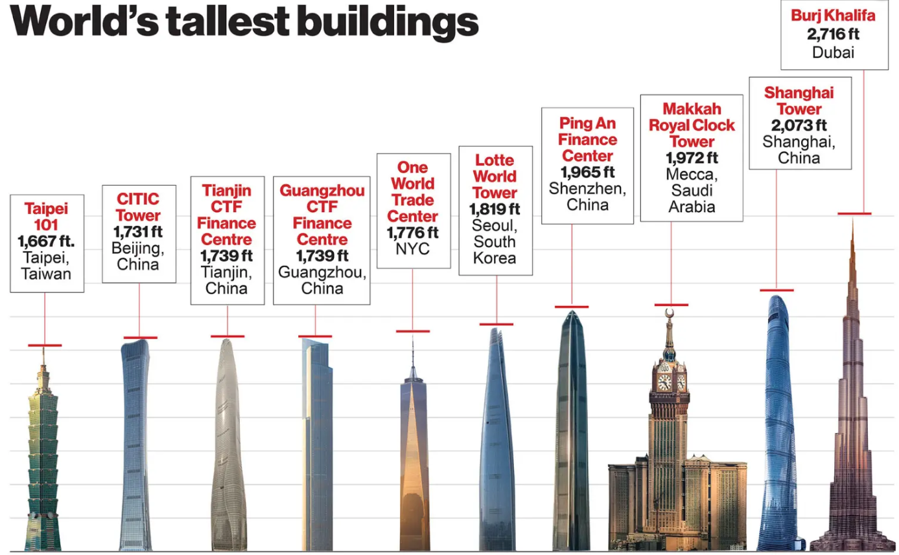
Ice Breaker Design Challenge
In 5 minutes...work in teams to design and build a free-standing paper tower as tall as possible using only:
5 sheets of paper
1 meter (3 feet) of masking tape
1 pair of scissors
Get to know each other & have fun!
Notes:
Introductory engineering design process team building activity.

Slide 6
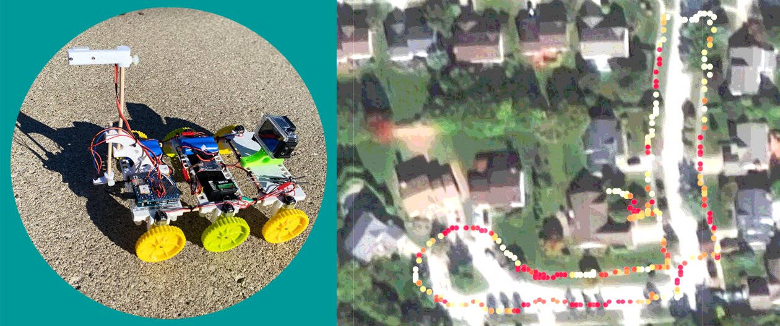
Agenda | Day 1
Introduction to the Engineering Design Process (EDP)
What is UHIP and PM, and why do they matter?
Environmental EDP Challenge and Rover Data Collection
CODAP Data Analysis

Slide 7

The Engineering Design Process (EDP)

Slide 8


Notes:
Highlight that the engineering design process (EDP) is cyclical and iterative.

Slide 9
What is UHIP and PM?
Engineering Design Challenge Background Information

Slide 10
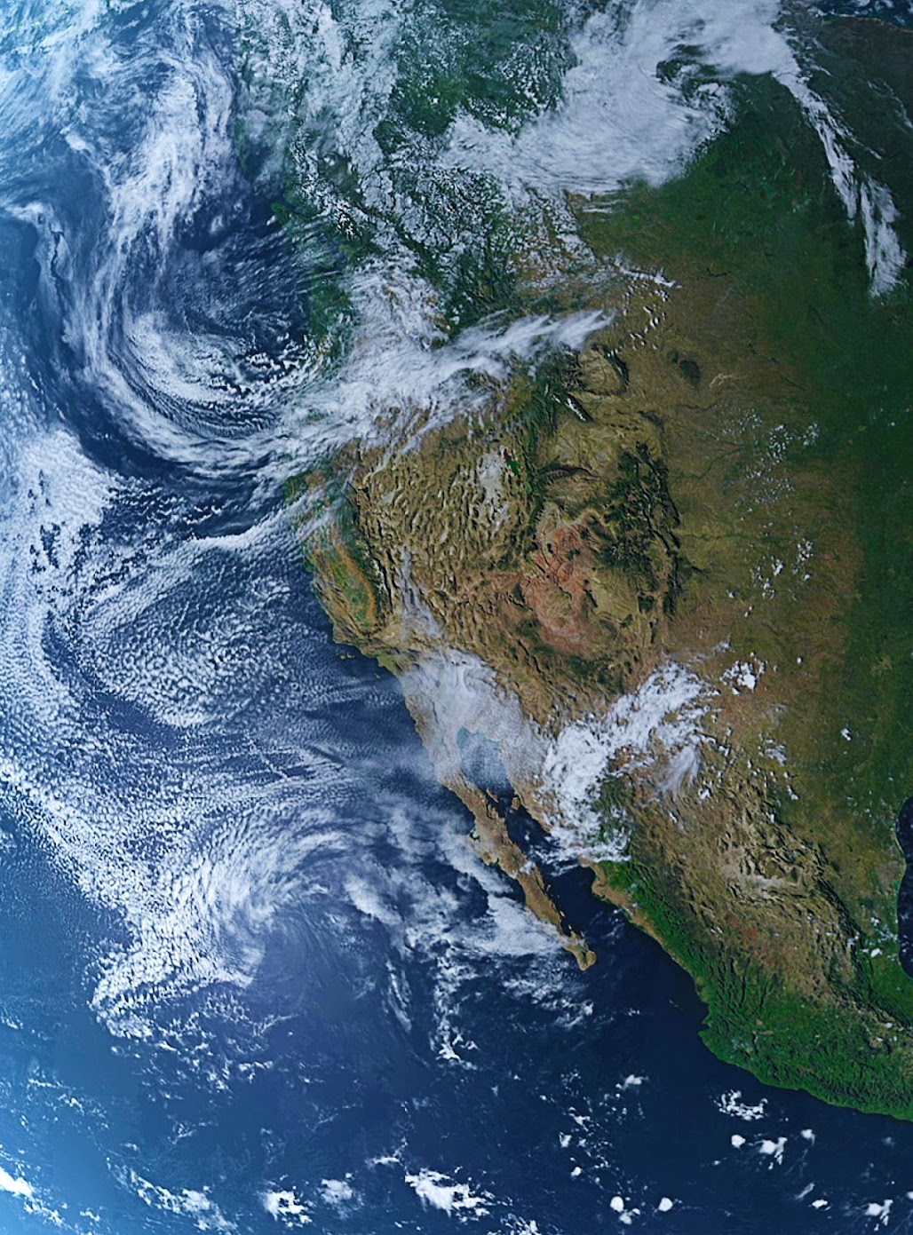
How do natural and human-made surfaces affect Earth's surface temperature?
Land Cover & Surface Temp Exploration:
In teams, use an IR thermometer to measure the temperature of nearby outdoor natural and human-made surfaces in the sun and shade.
DO NOT POINT THE IR THERMOMETER AT PEOPLE!!!
Record your temp data in degrees Fahrenheit (°F).
You have 10 minutes to collect data.
We will analyze the temperature data back in class.
Notes:
Discuss what natural (bareground, vegetation) and human-made (concrete, asphalt, etc.) surfaces are.
Pass out activity, let the kids go outside for less than 10 minutes
As a class, compare and contrast the average surface temperature of natural vs. human outdoor surfaces
Time: 12 min

Slide 11

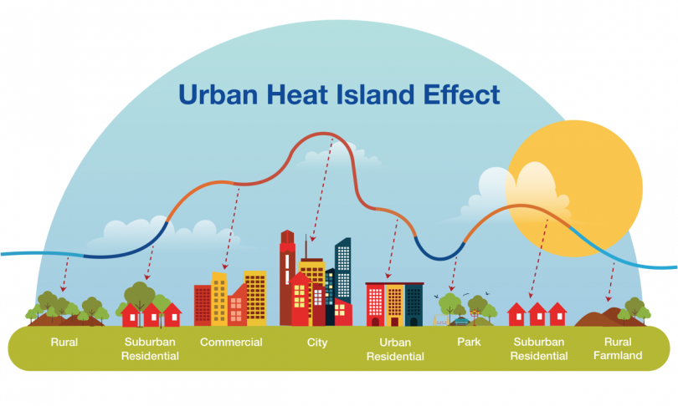
What’s UHIP and why should we care about it?
As a group, watch the video and discuss the causes, effects, and solutions for dealing with the impacts of UHIP:
What causes Urban Heat Islands?
What are the impacts of Urban Heat Islands?
What are possible solutions for Urban Heat Islands?
Notes:
Play the embedded videos
Time: 2 min
Extension video: Albedo Effect Experiment https://www.youtube.com/watch?v=Nv8whXqr4sQ&t=14s

Slide 12
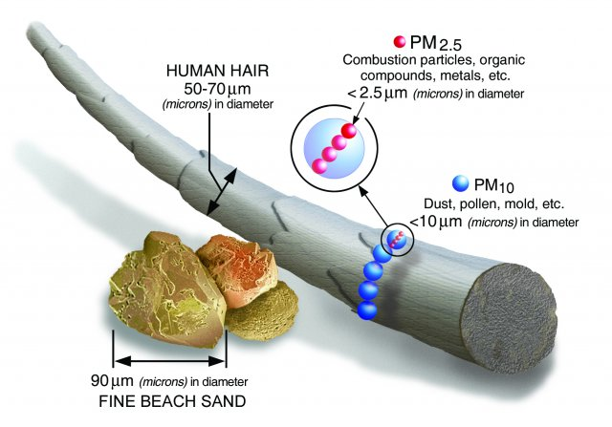
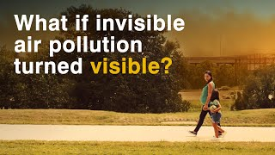
What’s PM pollution and why does it matter?
As a group, watch the video and discuss the causes, impacts, and solutions for tackling PM pollution:
What are sources of PM pollution?
What are the effects of PM pollution?
What solutions for PM pollution and its impacts?
Notes:
Play the embedded videos
Time: 2 min

Slide 13
UHIP and PM
Rover Data Collection
Engineering Design Challenge

Slide 14



Data Collection: Meet our TerraROVERS!
MO
OTTO (AUTO)
BURNY (BURN-E)

Slide 15
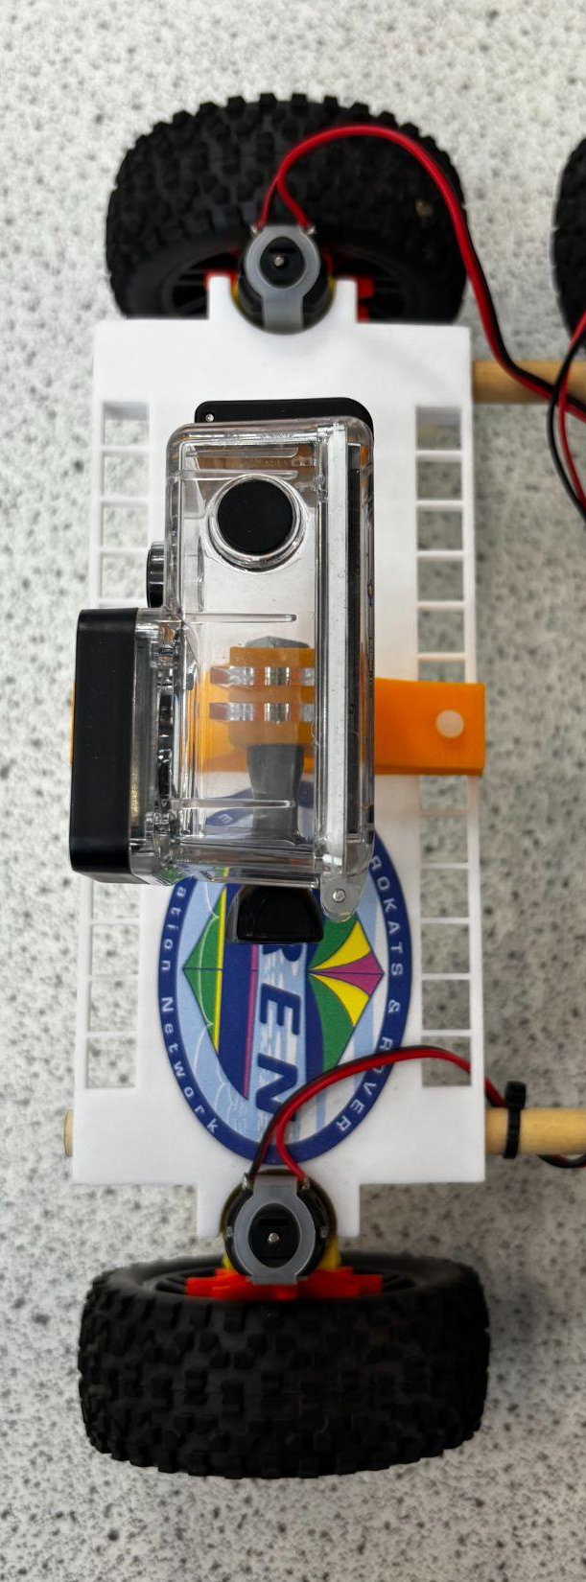
TerraROVER Camera Set Up
Terra Rover: Truss 1
Camera mount
This is the front of the rover!

Slide 16
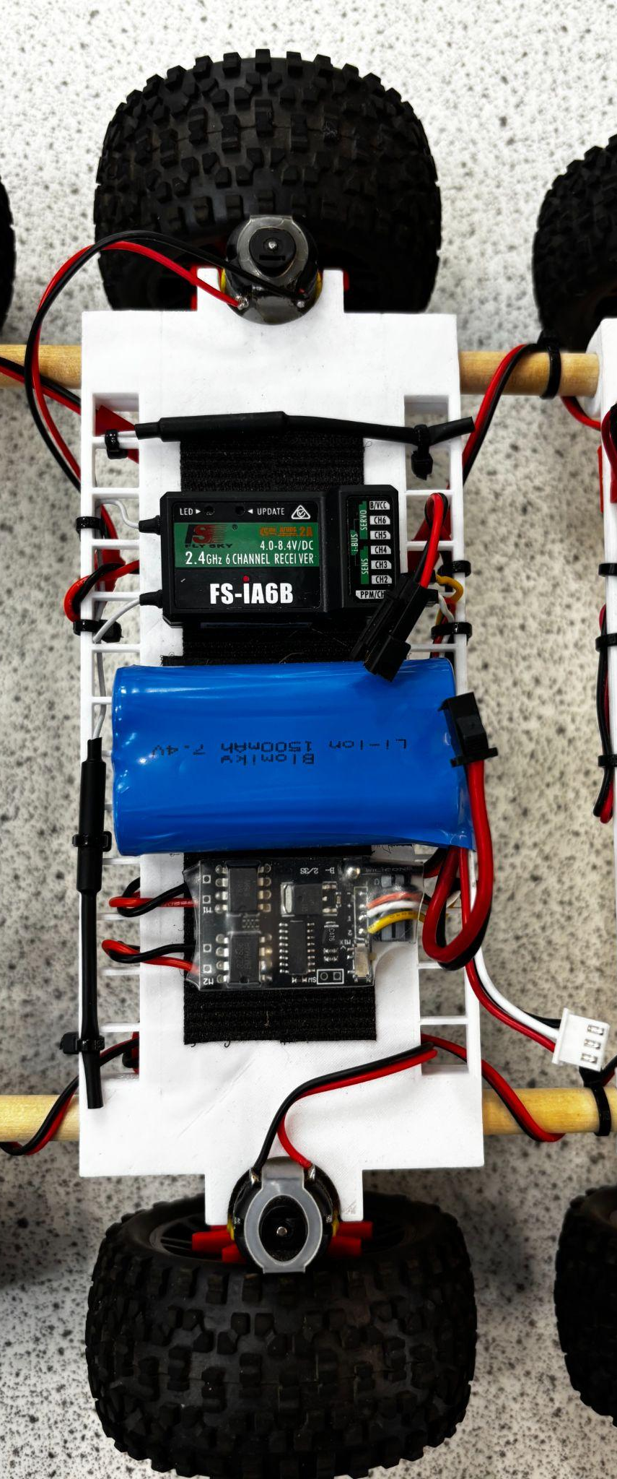
TerraROVER Power Set Up
Terra Rover: Truss 2
Receiver
Battery
Battery Charging Cable

Slide 17
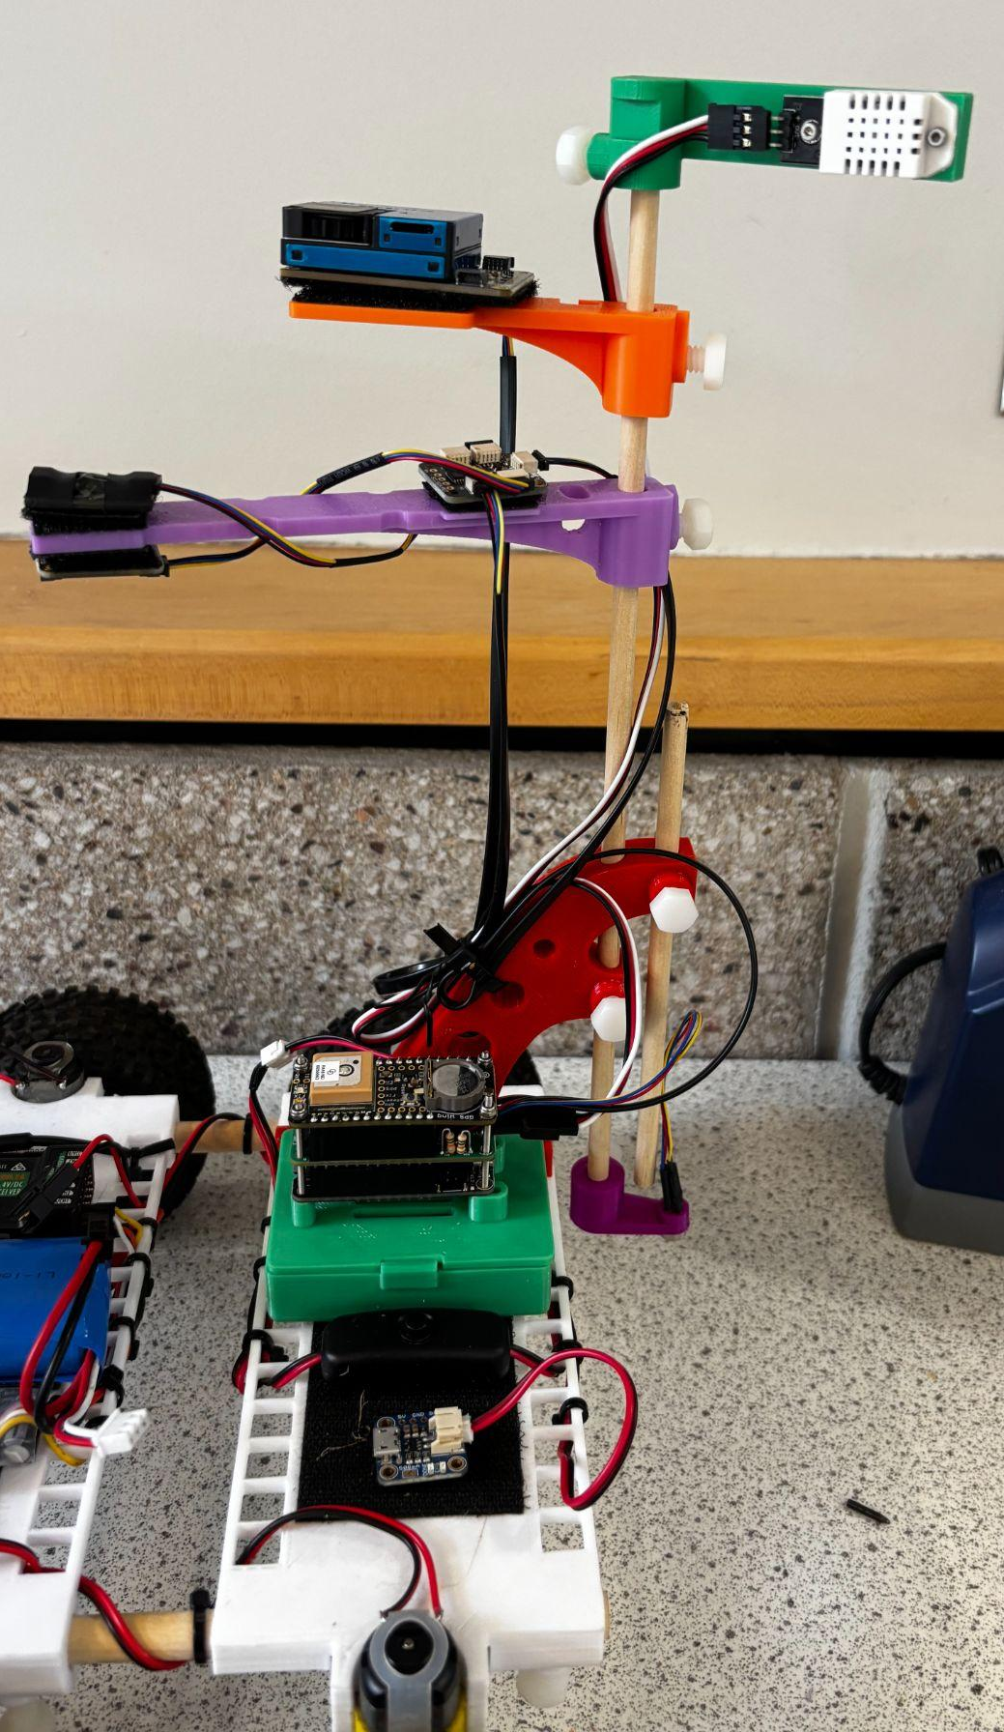
TerraROVER Sensor Set Up
Terra Rover: Truss 3
Air Temperature / Humidity sensor
PM Sensor
Light Intensity sensor
Infrared (IR) surface temperature sensor
On/off button
controls if the tower is taking data
Charging block
Zenith
Nadir
Notes:
Zenith and Nadir are just aerospace coordinates - zenith is the up direction and nadir is the down direction. So, the zenith senor records light above the spot and the nadir sensor records light below

Slide 18
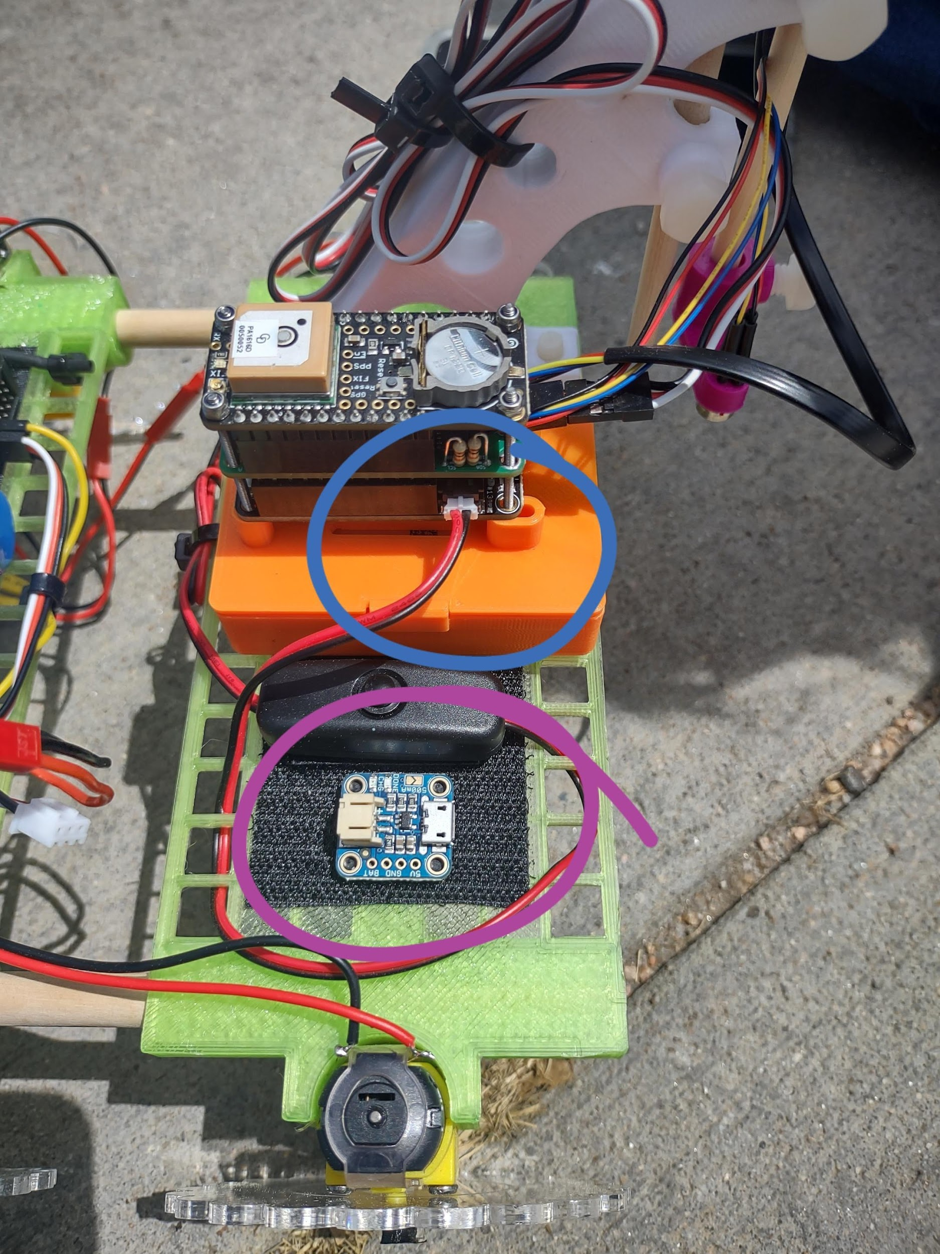
TerraROVER Data Collection
How to record data with the TerraROVER:
Connect the wires to turn the battery on.
Connect the power to the the UHIP sensor (from purple to blue hookups).
Push the black button to start recording data and again to end data collection.
Notes:
Play all the videos
Time: 10 min

Slide 19
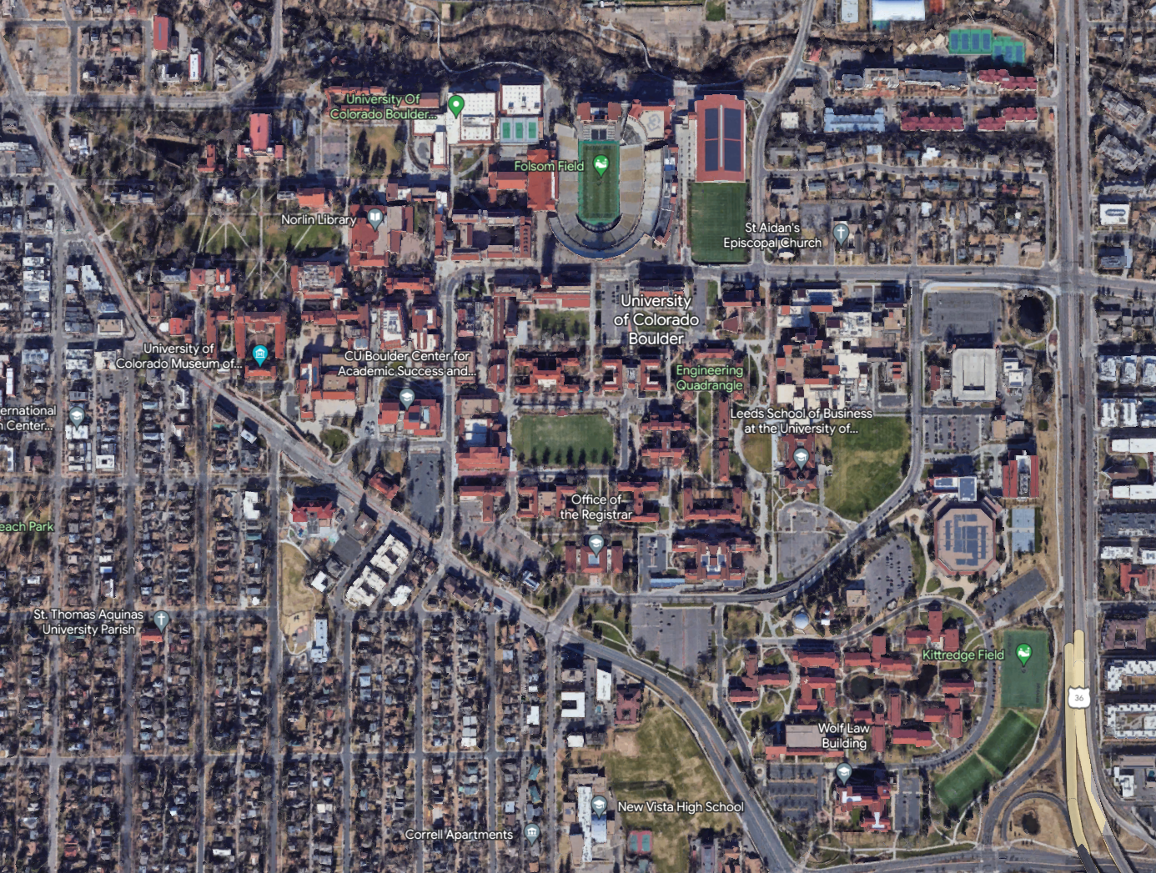
UHIP Exploration!
Each team will use a rover to explore one area of campus:
Engineering Quad
Business Field
Regent Parking Lot
Use the rover to record a path in your area to find out:
Which areas are the hottest?
Which areas are the coolest?
Notes:
Replace with a local location

Slide 20
Notes:
Replace image with a local Google Earth image.

Slide 21
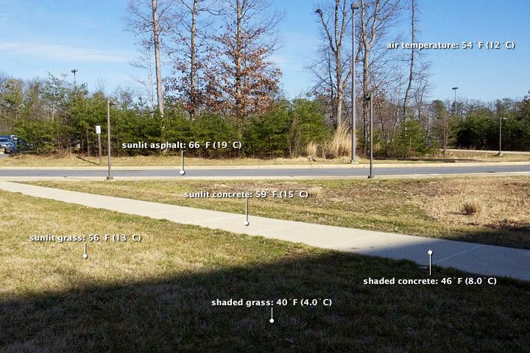
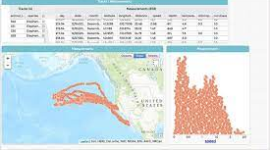
Rover Activity and Data Collection
Design and run an investigation using the TerraROVER to find the warmest and coolest parts of your campus area:
Record 15-20 minutes of outdoor temp data on and off pavement using the TerraRover.
During your trial, make sure to include:
sunny/shady surfaces
built/natural surfaces
different colors of surfaces
Note: The front of the rover has a camera on it

Slide 22
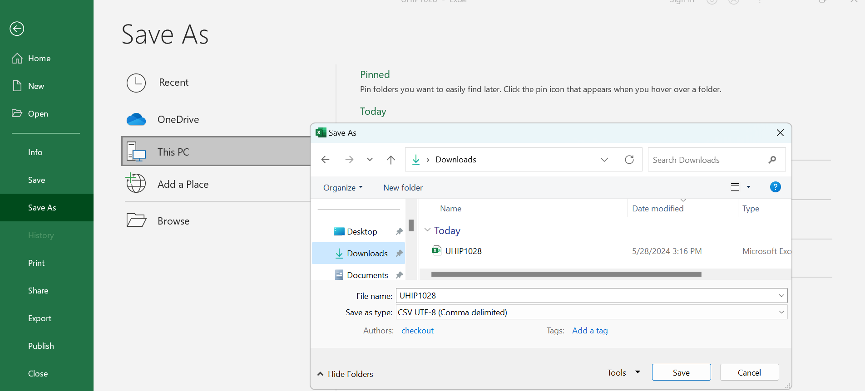
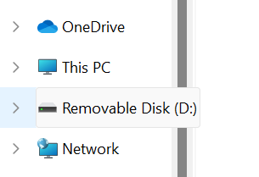
Import Data into CODAP
Open files and go to the tab called removable disk
Open the SD card data as an excel file
Click File → Save As → Browse
Click on downloads
Change option to .csv UTF-8 file, then click save and rename file with your team name
Drag .csv UTF-8 file into the shared folder (add link)
Drag and drop the .csv file into the CODAP site.
Notes:
Instructor to demo the download process
Time: 10 min

Slide 23

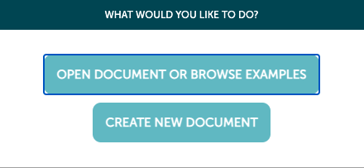
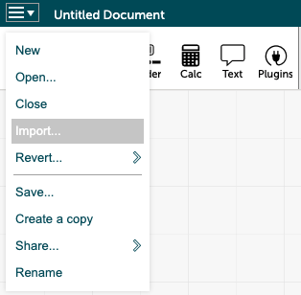
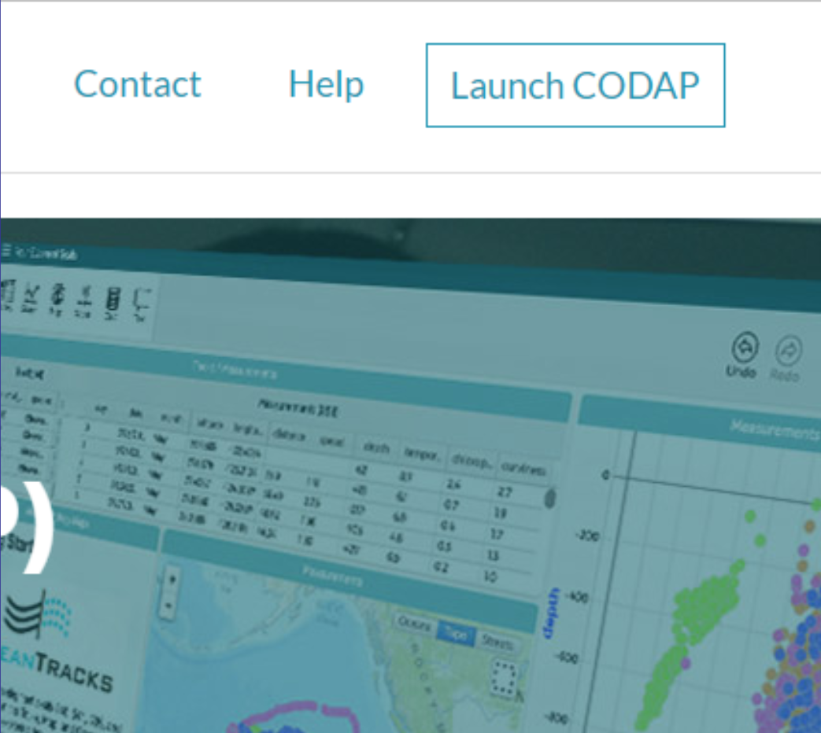
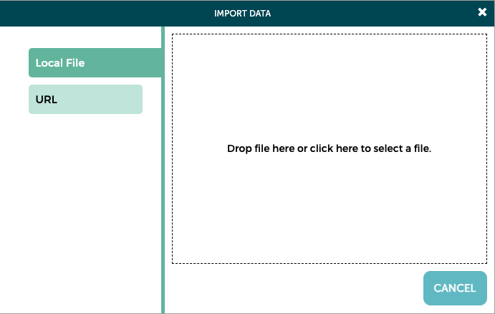
Import Rover File into CODAP
Go to https://codap.concord.org/
Click the Launch CODAP button
Click “Create New Document”
Click “Import…” from the menu
Locate your file and drag it into the window to upload it

Slide 24
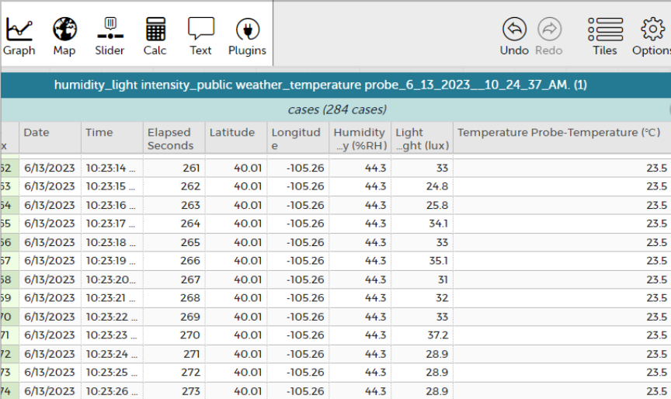
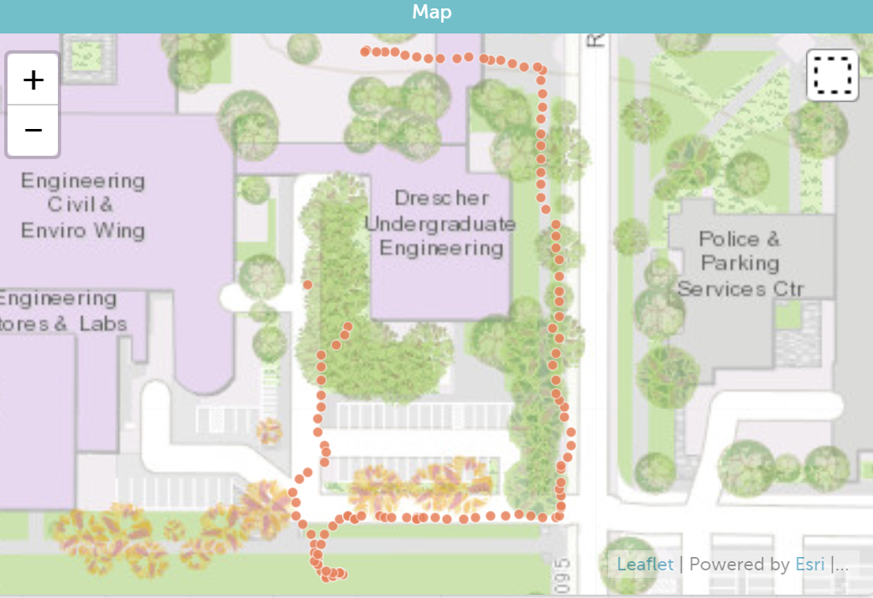
View Rover Map Data
Now that your data's in CODAP, you can map the route that your rover took:
Click on ‘Map’ in the top left corner.
Do the dots follow your rover’s path?
Toggle on/off air temp, surface temp, PM
What patterns do you see in the data?
Notes:
Replace data table with current data

Slide 25
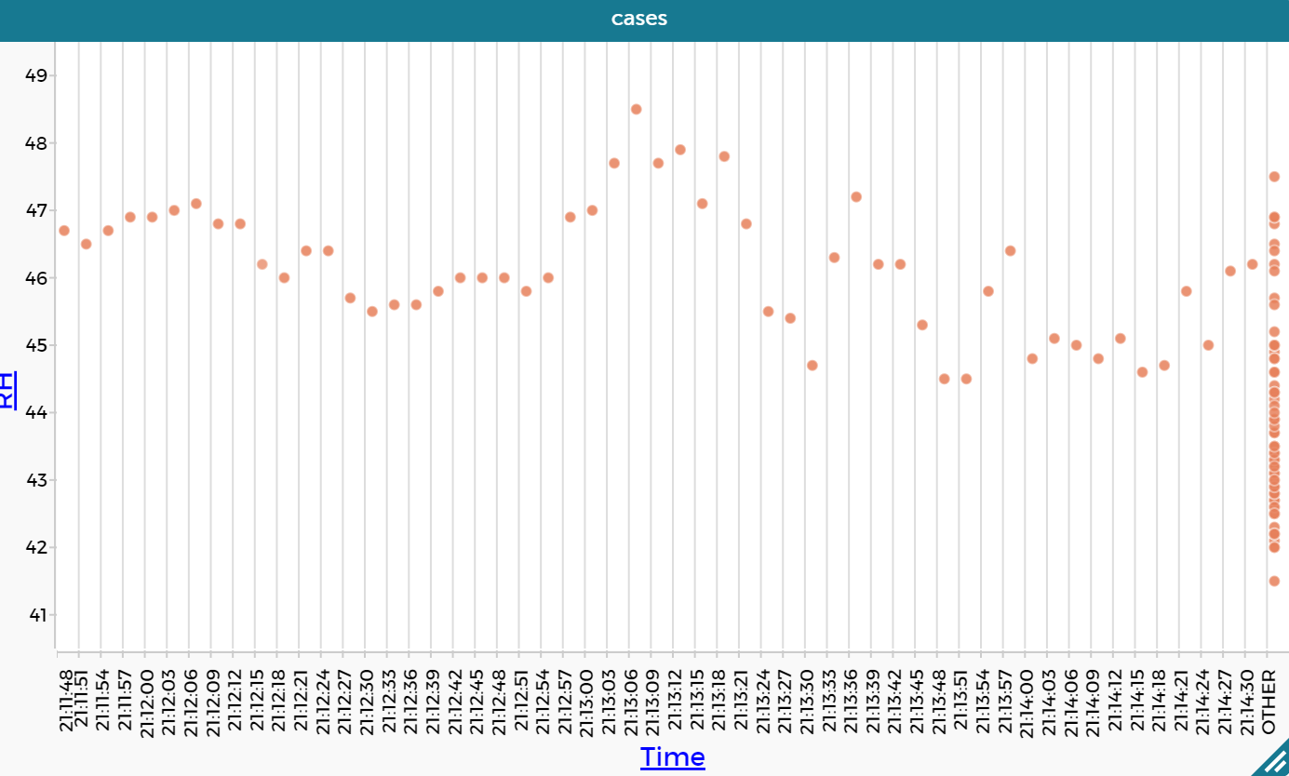
Graph Rover Map Data
Now graph your data:
Click on ‘Graph’ in the top left corner.
Drag ‘Time’ onto the x-axis
Drag air temp, surface temp on the y-axis.
Change the y-axis variable PM.
Do you notice anything surprising in the data?

Slide 26
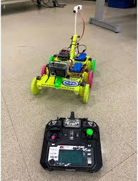
Data Analysis
Air Temp: Click various dots on the map. In the table, is the air temperature consistent (less than 3°C difference) or does it vary a lot (more than 3°C difference)?
Surface Temp: Create a graph with “Time” on the x-axis and “IR Temp” (surface temp) on the y-axis. Which surfaces are cooler? Which surfaces are warmer? How do you know?
Light: Replace ‘Time’ with ‘Light’ on the x-axis. Does the data show a relationship between Light and Surface Temperature? Explain your observations.

Slide 27
Agenda | Day 2
UHIP Review & Research
"Keep it Cool" UHIP-Resilient Community Design Challenge
TerraRover Races!

Slide 28
UHIP Review:
Which surface is hottest? Coolest? Why?!
Guess the temp!
Notes:
Remind the students of what we did in day 1. Ask students to estimate the temperatures of each surface in relation to each other, plus the air temperature.

Slide 29
UHIP Review:
Which surface is hottest? Coolest? Why?!
What is the air temp?
How does the air temp compare to natural surfaces? Built surfaces?
Why is there a difference between natural and built surfaces?
Notes:
Ask students to explain why the temperatures are not the same on all surfaces, and why surface temperatures are higher or lower than the air temperature (albedo effect).

Slide 30
Research: Urban Heat Island & Urban Planning
Cities on Fire: The Urban Heat Island Effect
Urban Heat Island Project
Climate change and severe weather have made urban heat islands worse
Urban heat island effect ‘the silent killer’ has major impact on Las Vegas
The LINE: A revolution in urban living

Slide 31
Design a Cool UHIP-Resilient Community!
Top qualities that define a good neighborhood:
It has lots of trees
You can move around in it without a car
You can find essentials nearby
It is safe. ...
It offers easy access to medical care
It offers a variety of housing types
It provides a full range of public services
It looks appealing
Draw a concept map illustrating how your team would design a city neighborhood that includes the top qualities of an urban community and reduces UHIP impacts.
In your sketch, include the following items:
Housing Options
Greenspaces & Recreation Areas (parks, trees, water, etc.)
Schools
Hospital/Medical Center
Roads & Transportation Options
Shopping & Entertainment Areas
Suggest building materials (types & color)
Notes:
Students work together in teams to collaboratively complete the design challenge. Each team produces one concept map using butcher paper, poster sized post-its, whiteboard or digital drawing technology.

Slide 32
Cool UHIP-Resilient Community Design Presentations
Give an overall description how your team decided on the layout of your community.
Explain each of the features/parts of your community.
Explain how each of the features/parts contribute to reducing UHIP impacts in your community
Audience Q&A and feedback on your Cool UHIP-Proof Community Design
Notes:
Each student team presents and explains their UHIP-proof neighborhood concept map in a 5-10 minute presentation.

Slide 33
Rover UHIP Engineering Reflections
Data Analysis
Rover Exploration
Share Your Feedback
Why are the temperatures in built vs natural environments different?
Which areas have the warmest temperatures in your neighborhood design? Why?
Which areas have the coolest temperatures in your neighborhood design? Why?
Where do you think the rovers can be used to explore surface temperatures in your own neighborhood?
What design ideas do you have to make your own neighborhood cooler in summer? Warmer in winter?
Do you have any ideas to improve the rover design?
What did you enjoy about the rover UHIP workshop?
What was challenging about the rover UHIP workshop?
Do you have any other ideas to share or questions you’d like to ask?
Notes:
Ask students to think-pair-share about the reflection questions.

Slide 34

TerraROVER Races!
Rover Drag Race
Rover Obstacle Course
Notes:
In a safe location, set up a drag racing area and obstacle course to maneuver around objects.Student teams compete for the fastest time.

Slide 35

Scan the QR code to take the post-survey! (insert QR code)

