Slide 1

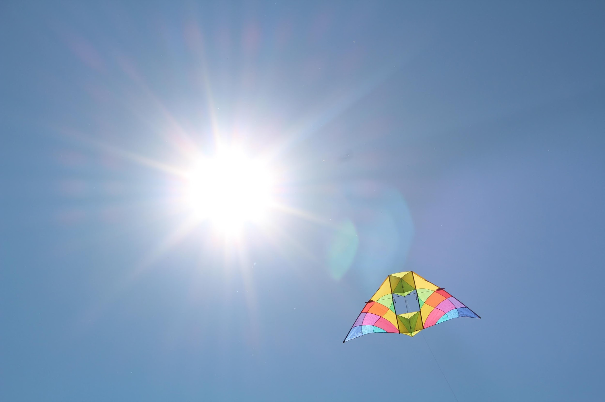
AEROKATS and ROVER Education Network (AREN)
We fly kites for science!
MSU Science Math Resource Center
Department of Education
montana.edu/smrc/aren.html

Slide 2
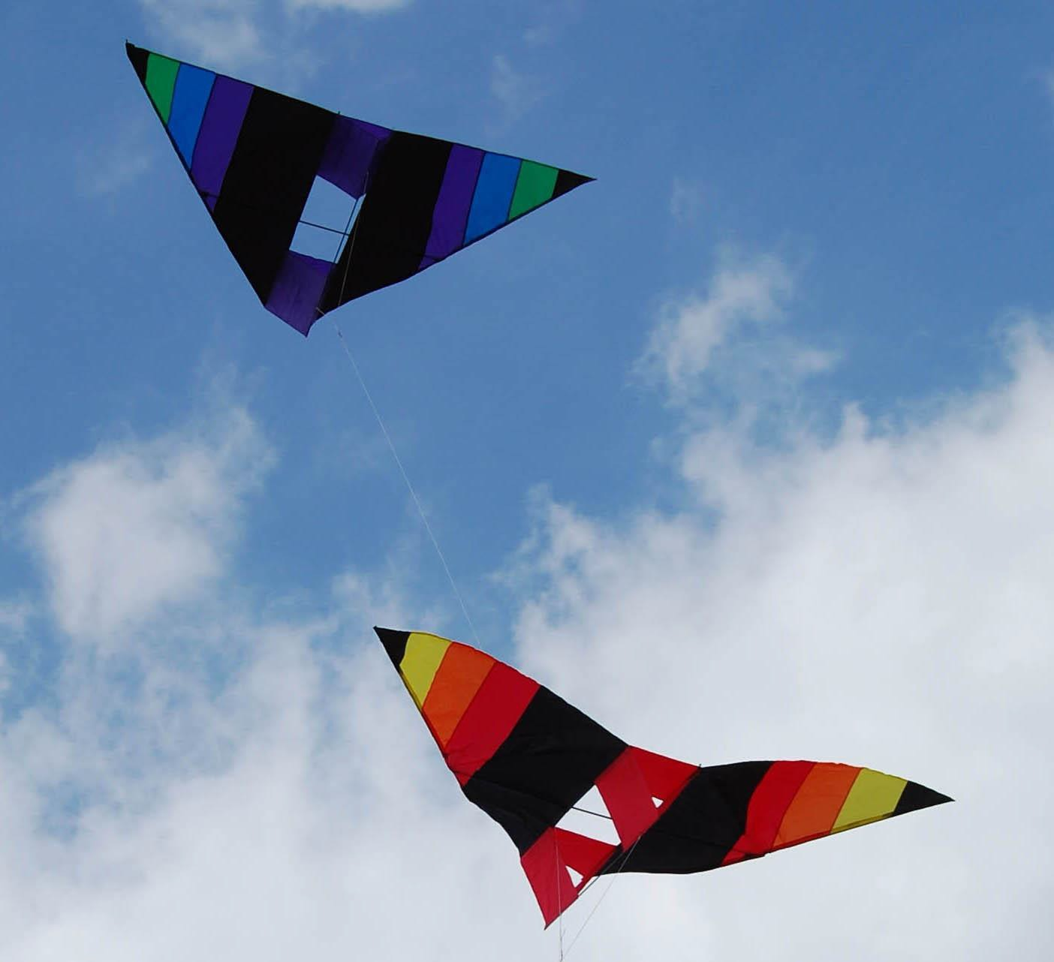

AEROKATS
Advancing Earth Research Observations with Kites/Terrestrial Sensors
Notes:
AEROKATS stands for Advancing Earth Research Observations with Kites/Terrestrial Sensors.
AREN has team mmebers all over the country

Slide 3
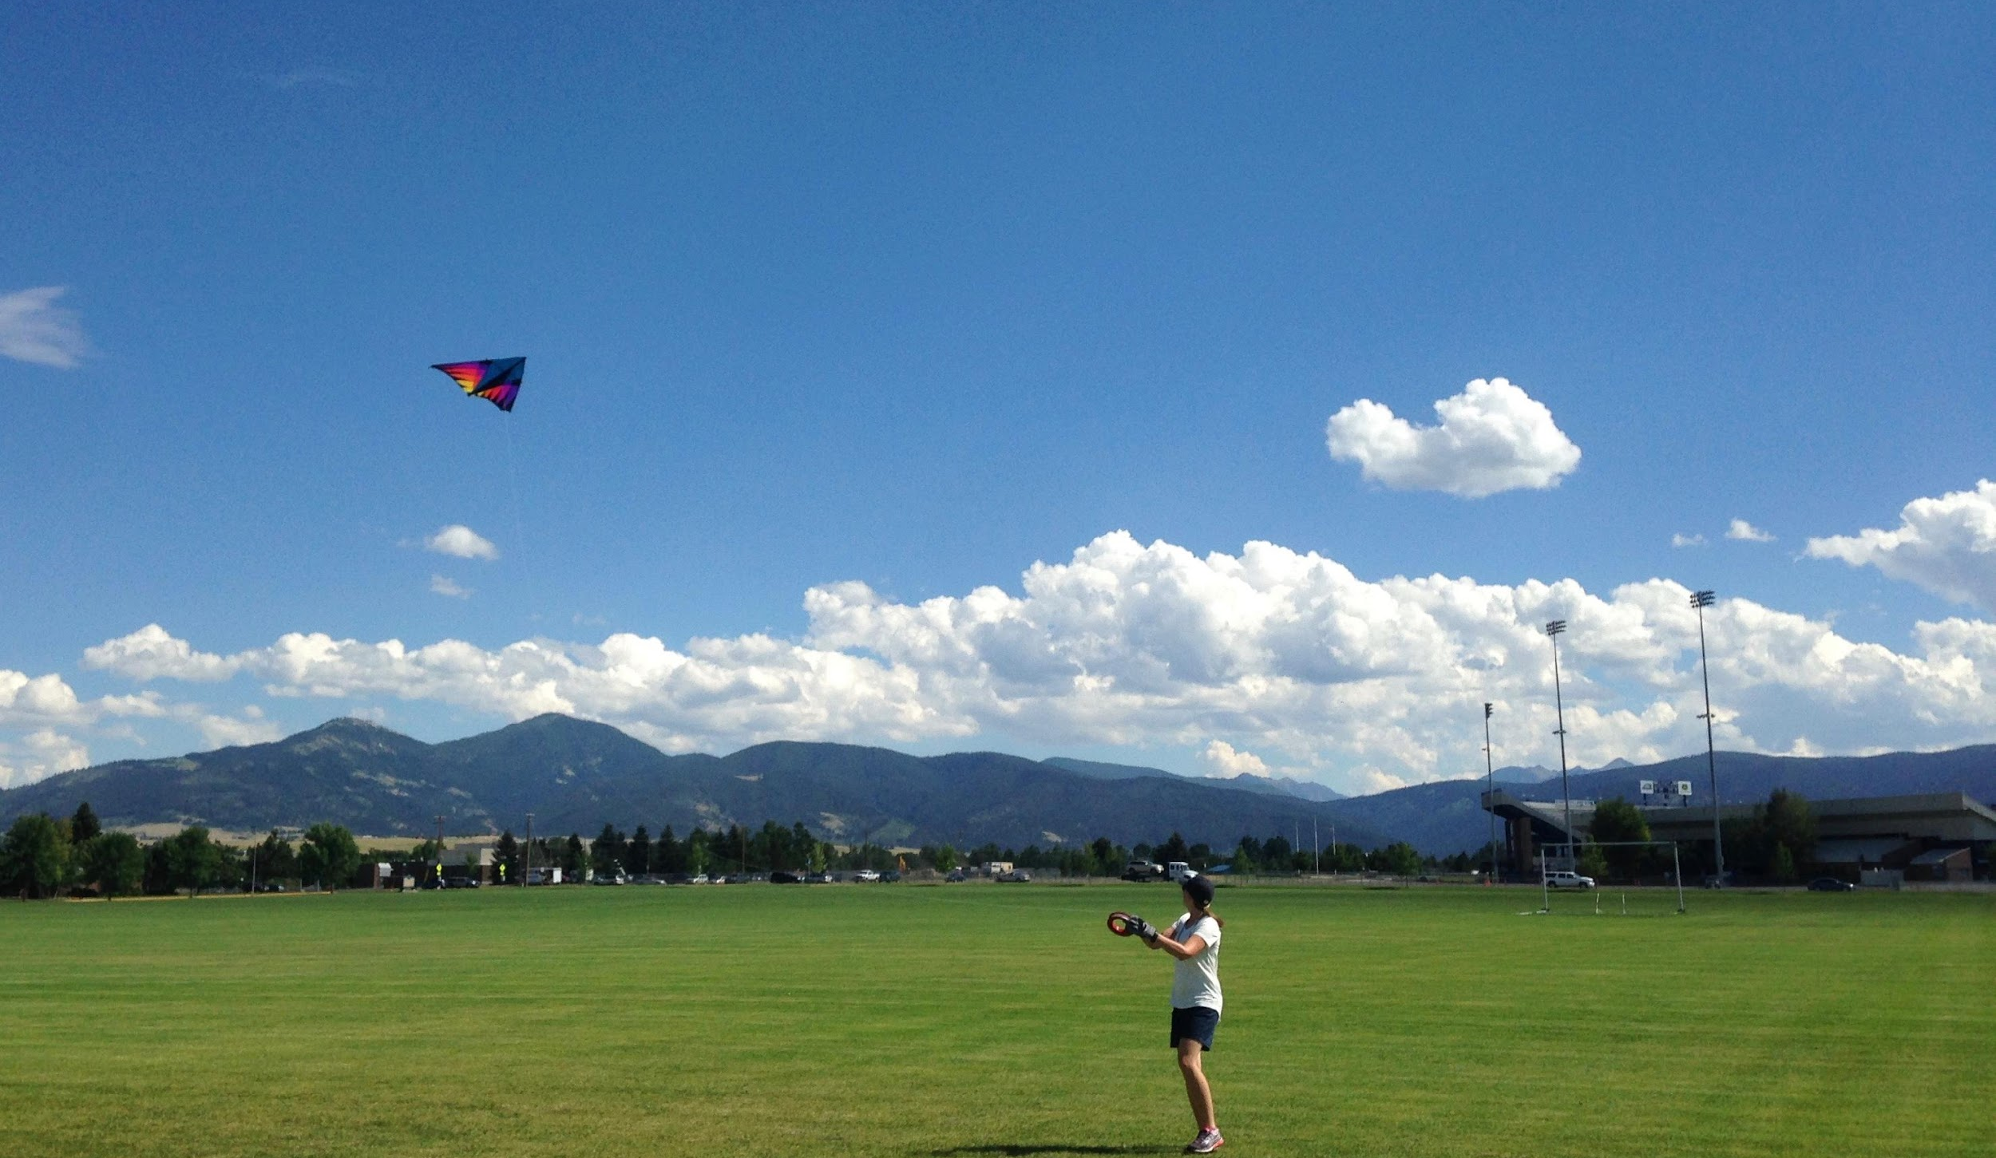
Notes:
MSU has been part of AREN for 5 years

Slide 4
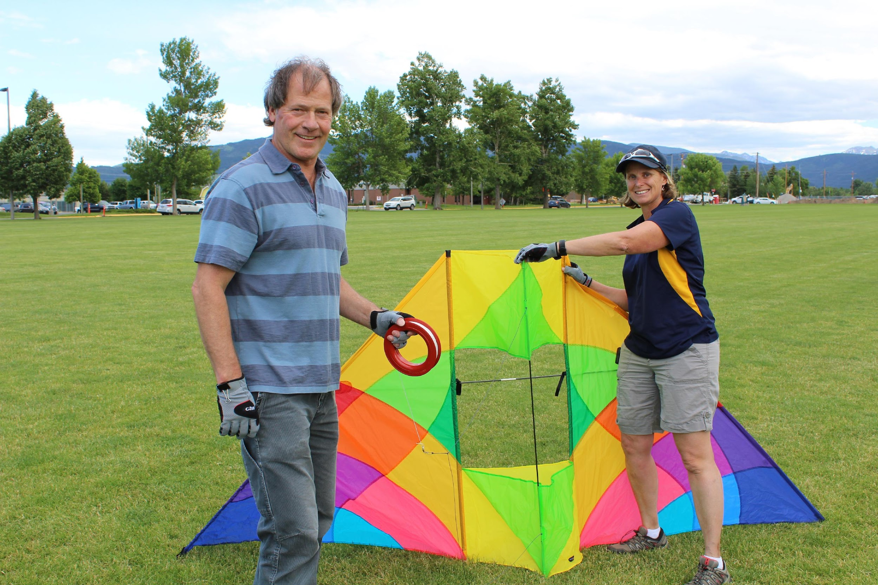
Notes:
Montana State University is part of a NASA project that uses big 10-foot kites to learn more about the Earth. But doesn’t NASA study outer space? Of course! NASA studies planets, and Earth is a planet, so NASA always wants to learn more about our home planet, Earth.

Slide 5
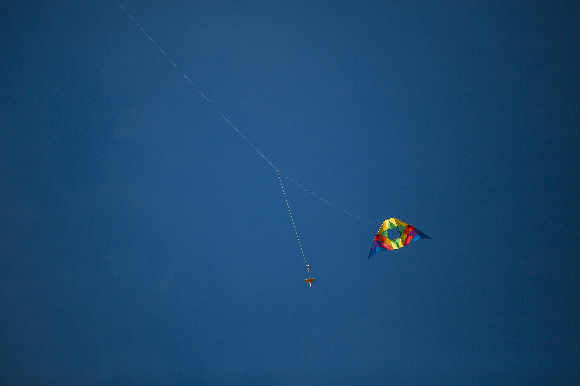
Notes:
We attach a platform called an aeropod beneath the kite. The aeropod looks like two sticks with fins. It hangs beneath the kite and we can attach a camera or weather data instrument.

Slide 6
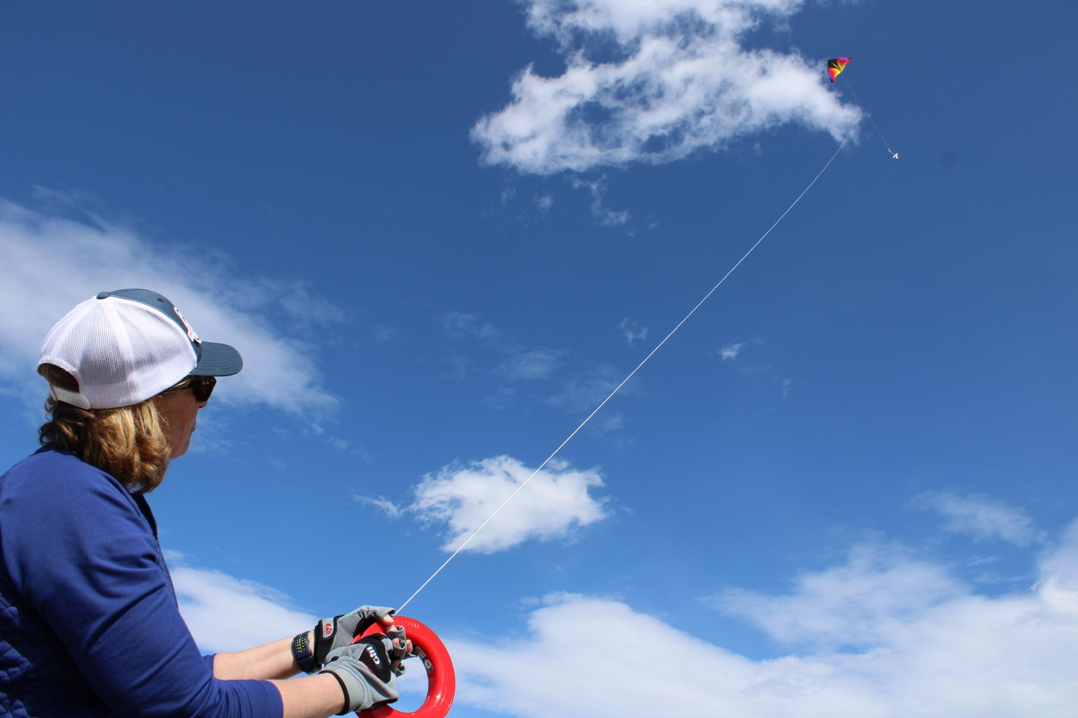
Notes:
The kites are so big and go so high (500 feet) that we have to wear gloves because there is so much tension on the string that it could cut our hands!

Slide 7
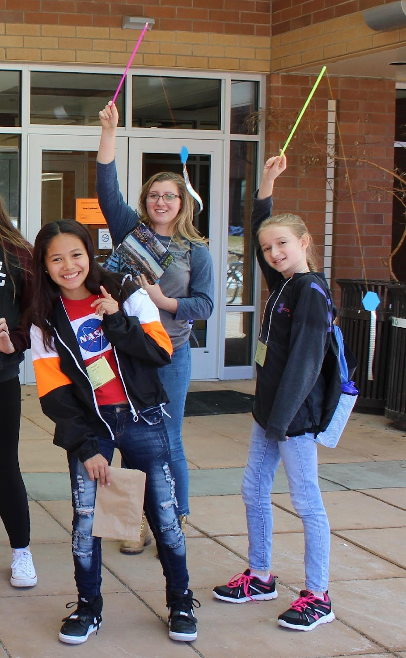
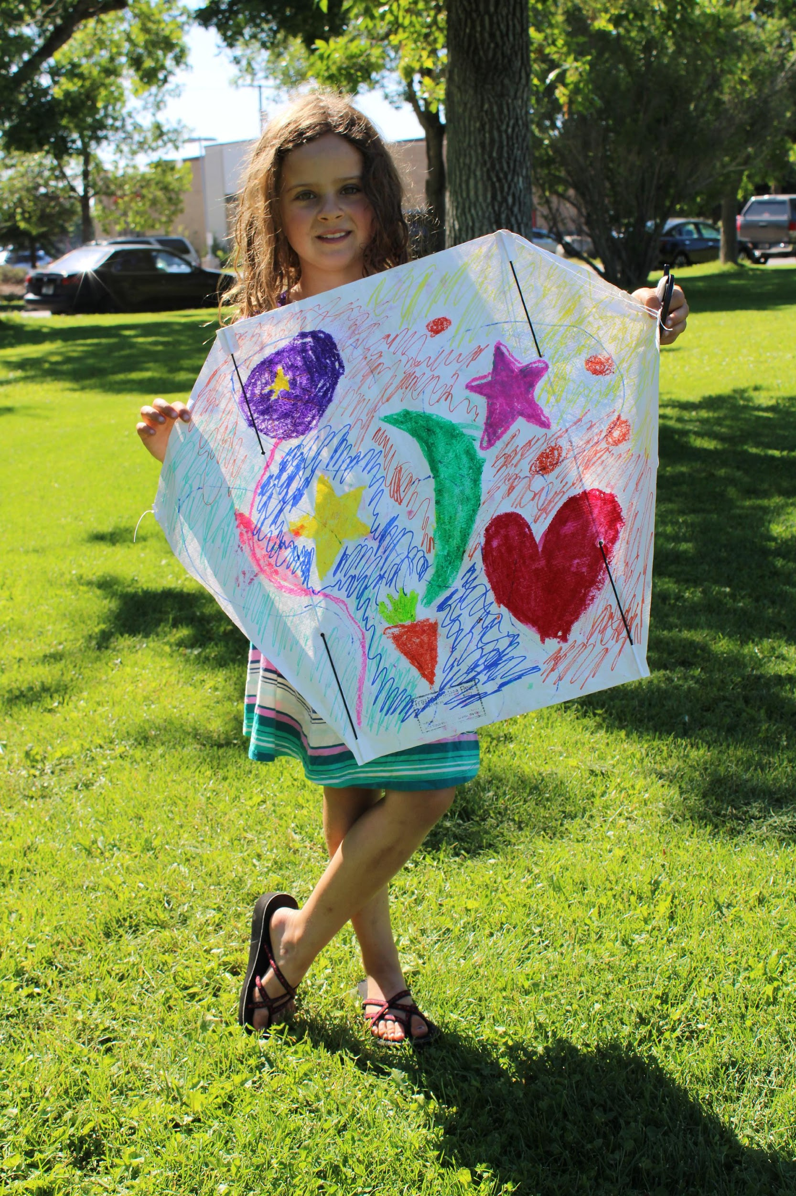
Notes:
Sometimes we design and build our own smaller kites so kids and teachers and parents can learn how kites fly. Have fun making and flying kites!

Slide 8
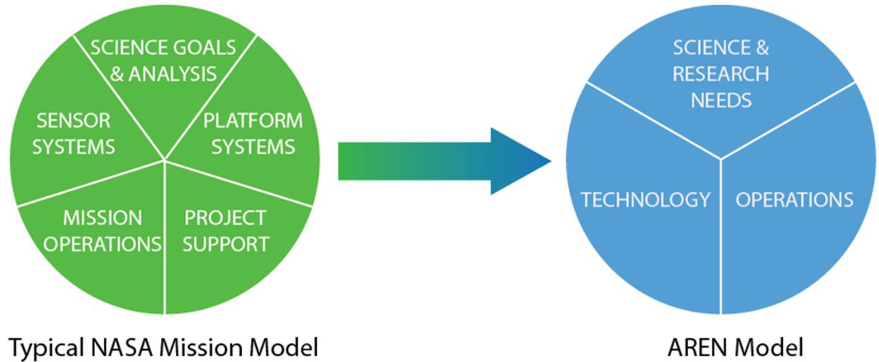
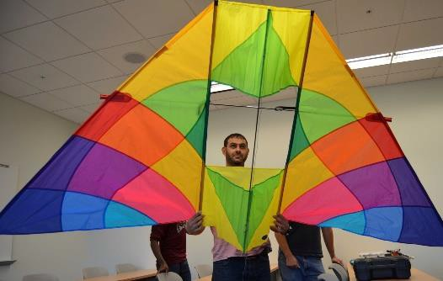
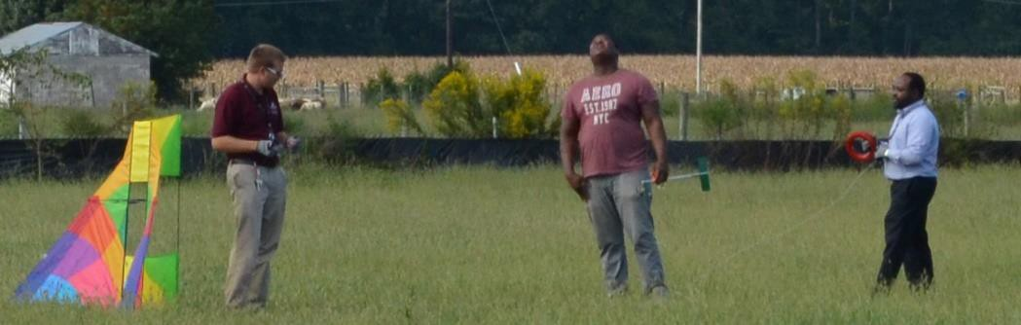
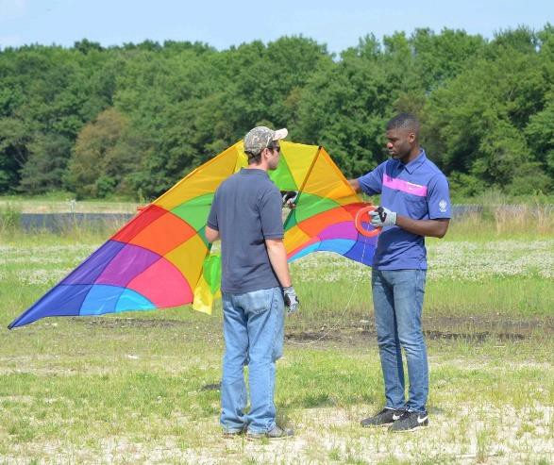
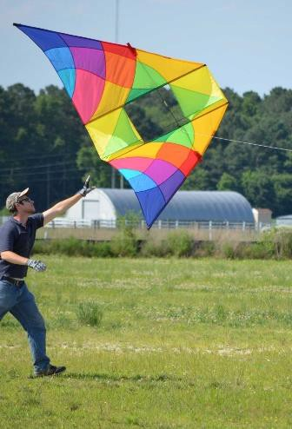
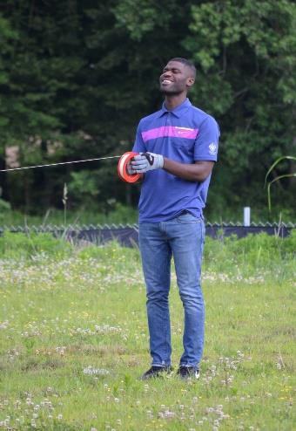
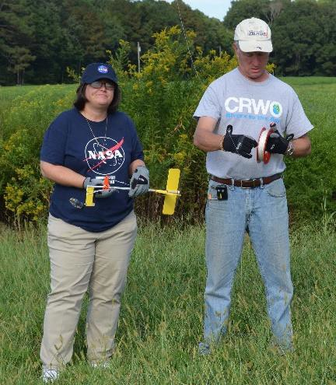

Planning a NASA AREN mission is like planning ANY NASA mission
geoff.bland@nasa.gov 8-21-17
Notes:
Planning a NASA AREN kites mission is just like planning ANY NASA mission. There are people responsible for science and research, technology and operations. Operations includes safety, which is very important!

Slide 9
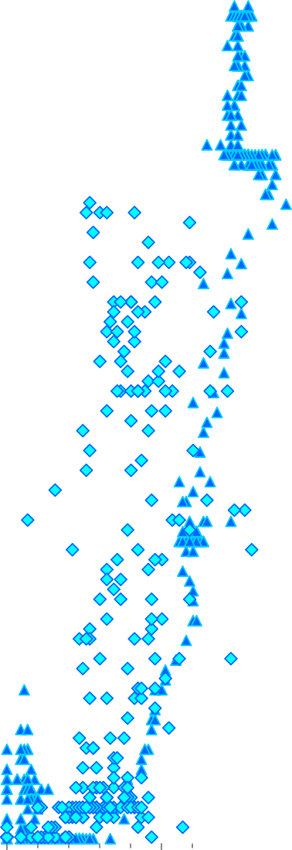

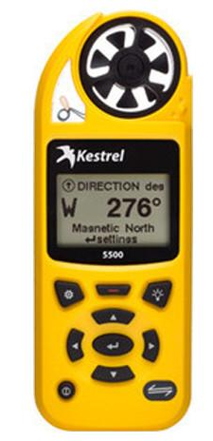
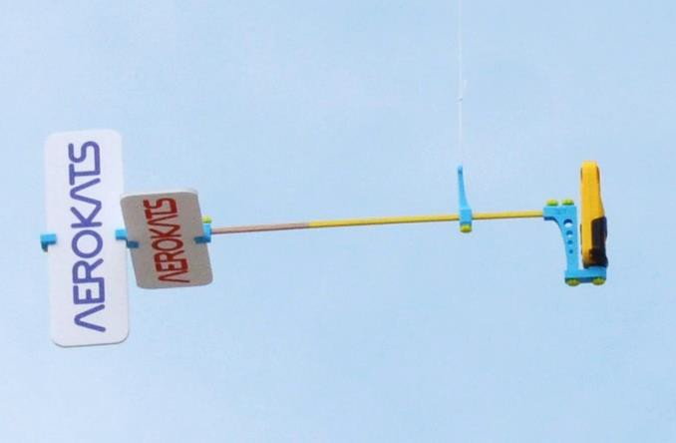
Profiler
300
Wind mph v Alt Ft - Beach
Wind mph v Alt ft - Field Temp F v Alt Ft - Beach
Temp F v Alt ft - Field
250
200
150
100
50
0
0.0
10.0
20.0
30.0
40.0
50.0
60.0
70.0
80.0
90.0
geoff.bland@nasa.gov 8-21-17
Notes:
Every time we fly, we have a goal. Sometimes the goal is to collect data.
The instruments help us know how the temperature changes as the kite goes up, or whether the wind speeds are higher near the ground or up in the air.

Slide 10
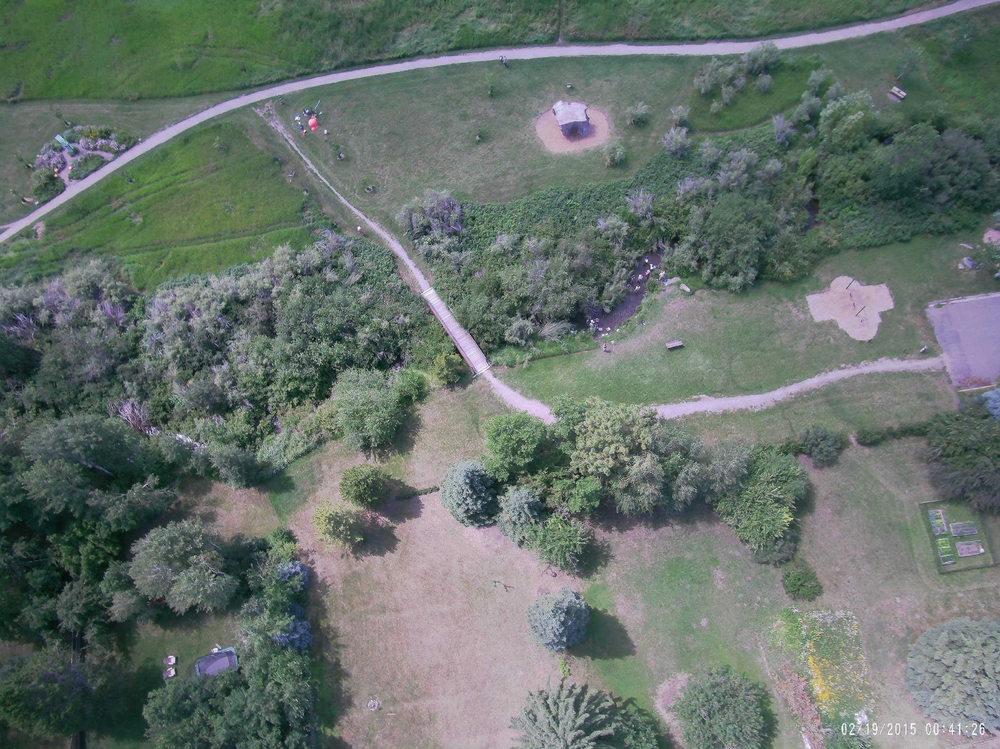
Notes:
The camera lets us take pictures of the Earth so we can see things we can’t see from below.

Slide 11
Kite Mysteries
All of these photos were taken from a kite.
See if you can solve the mysteries!
What else do you notice in the photos?
What would you like to photograph from high up in the air?

Slide 12
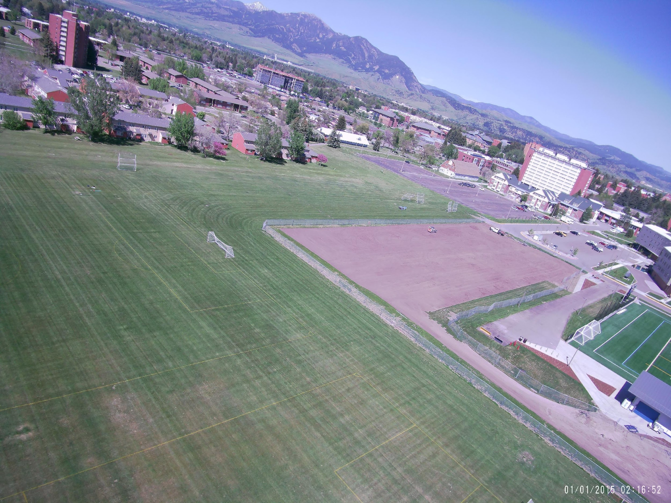
1. Where is this?

Slide 13
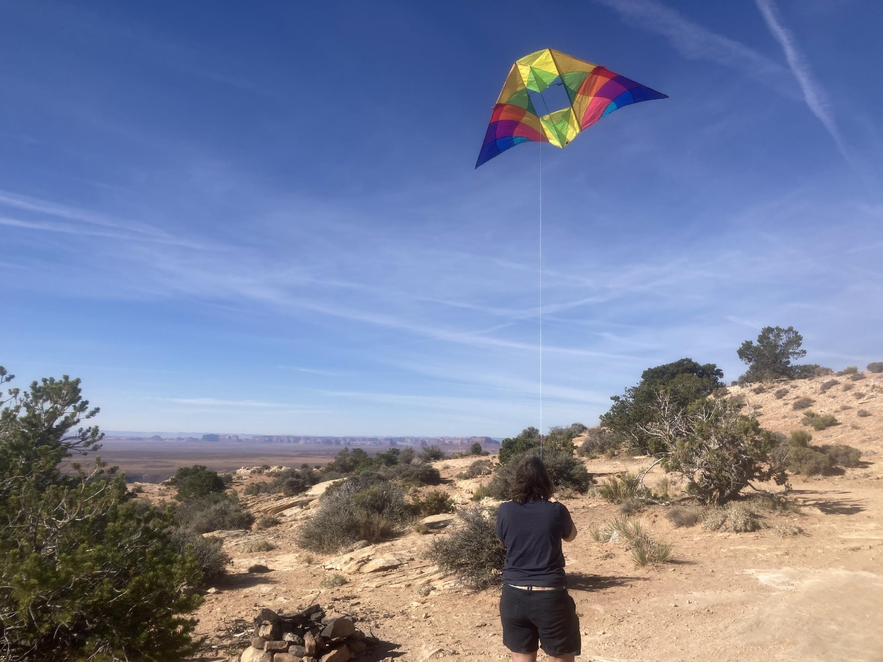
2. Which way is the wind blowing?

Slide 14
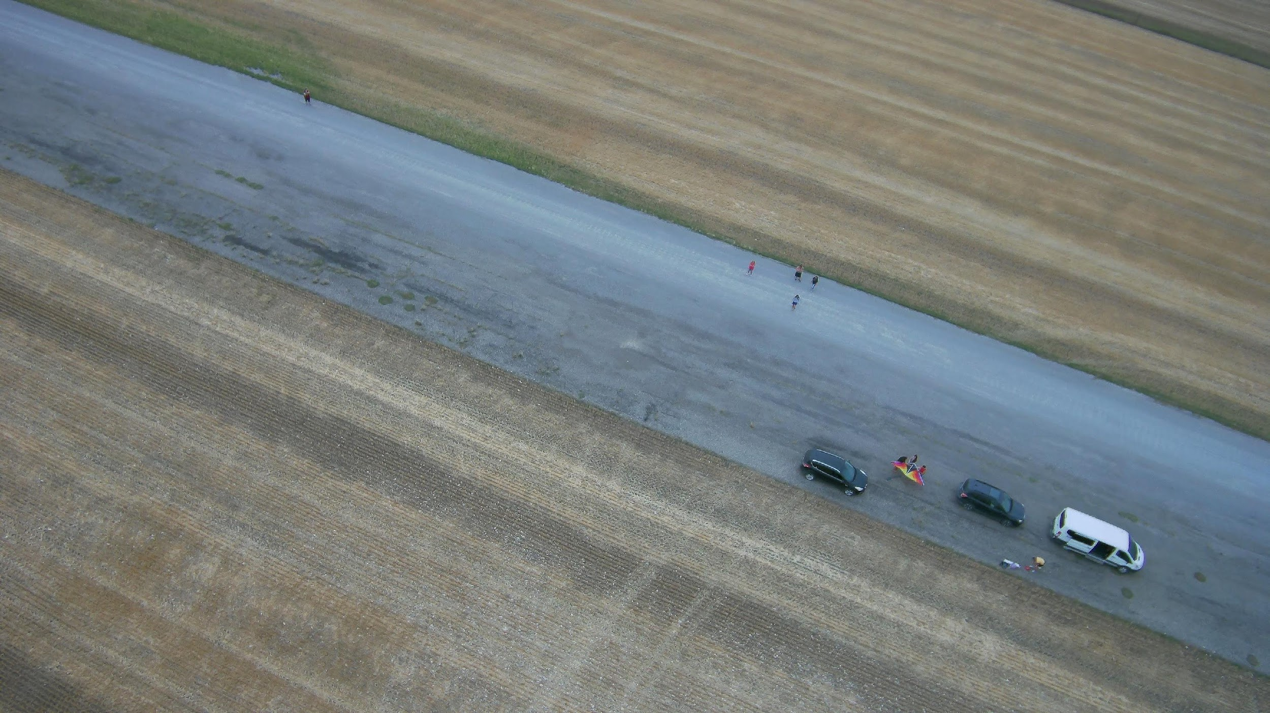
3. What do you see? What’s happening?

Slide 15
4. What can you see from the air that you probably can’t see on the ground?

Slide 16
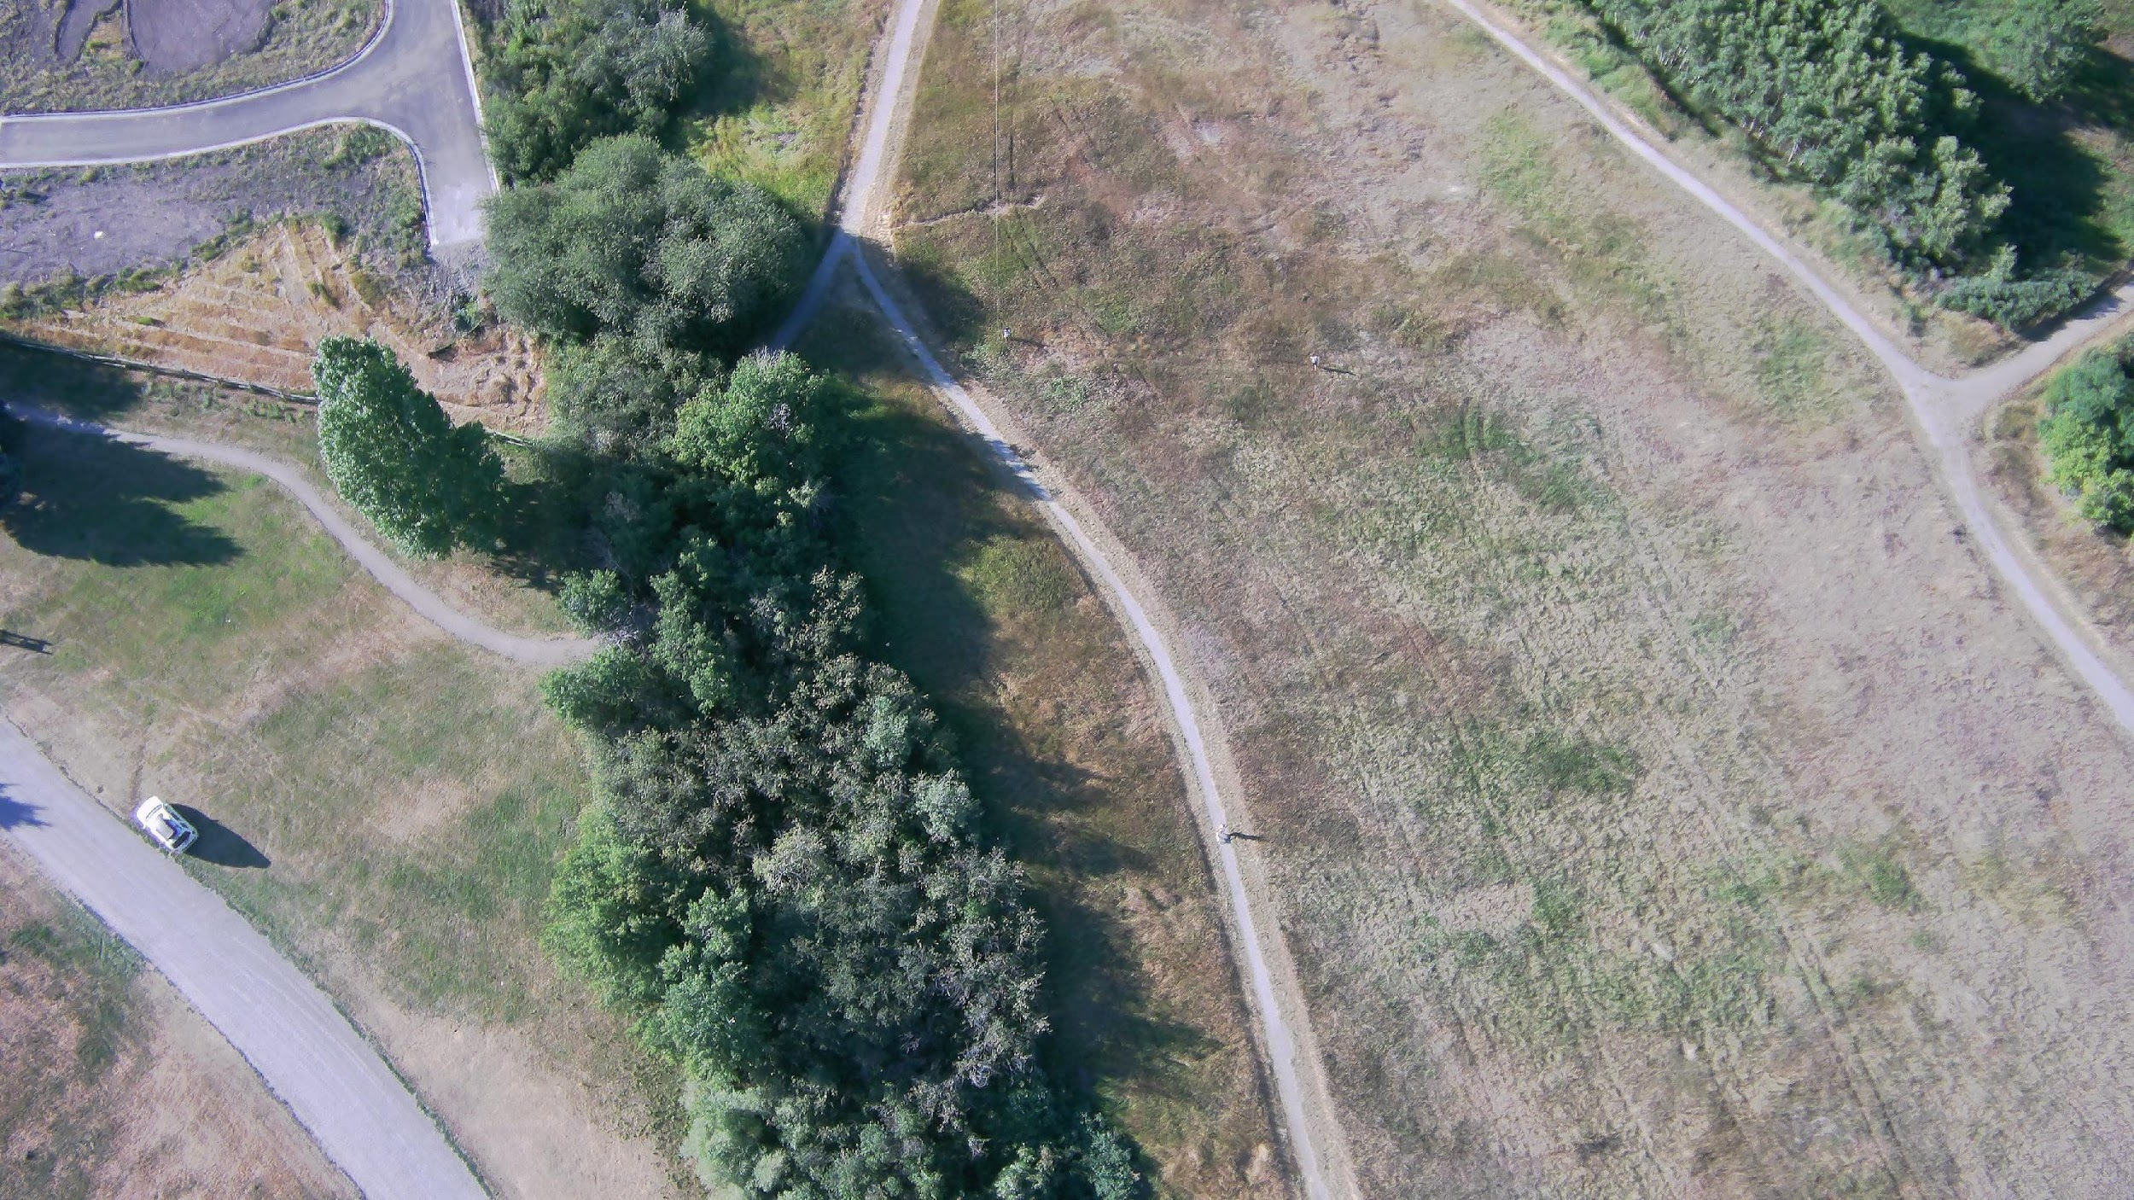
5. Where is the kite pilot? (The person flying the kite)

Slide 17
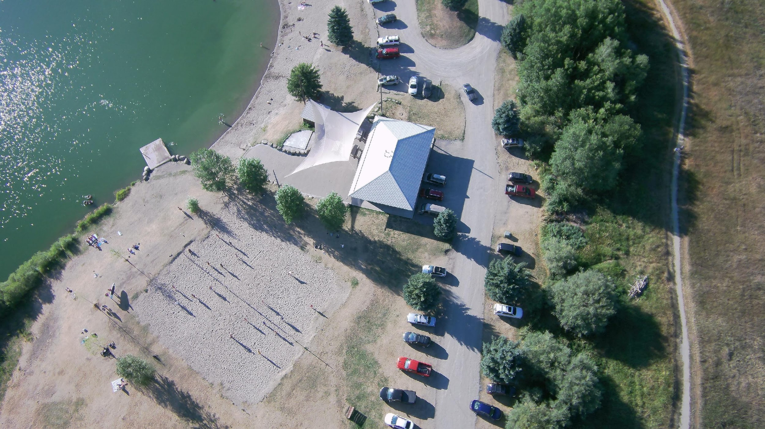
6. What sport is going on here?

Slide 18
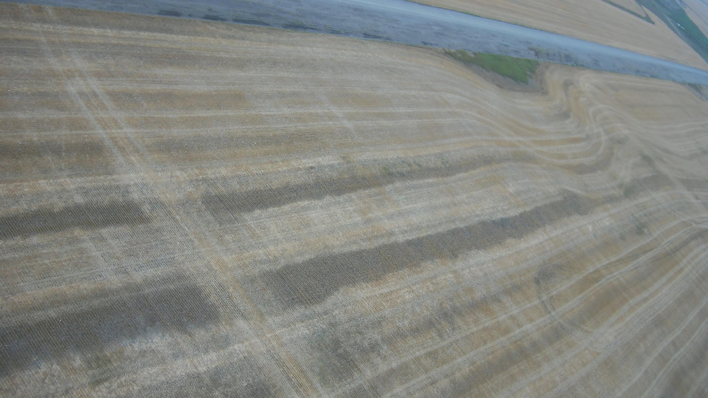
7. Where did the tractor drive?

Slide 19
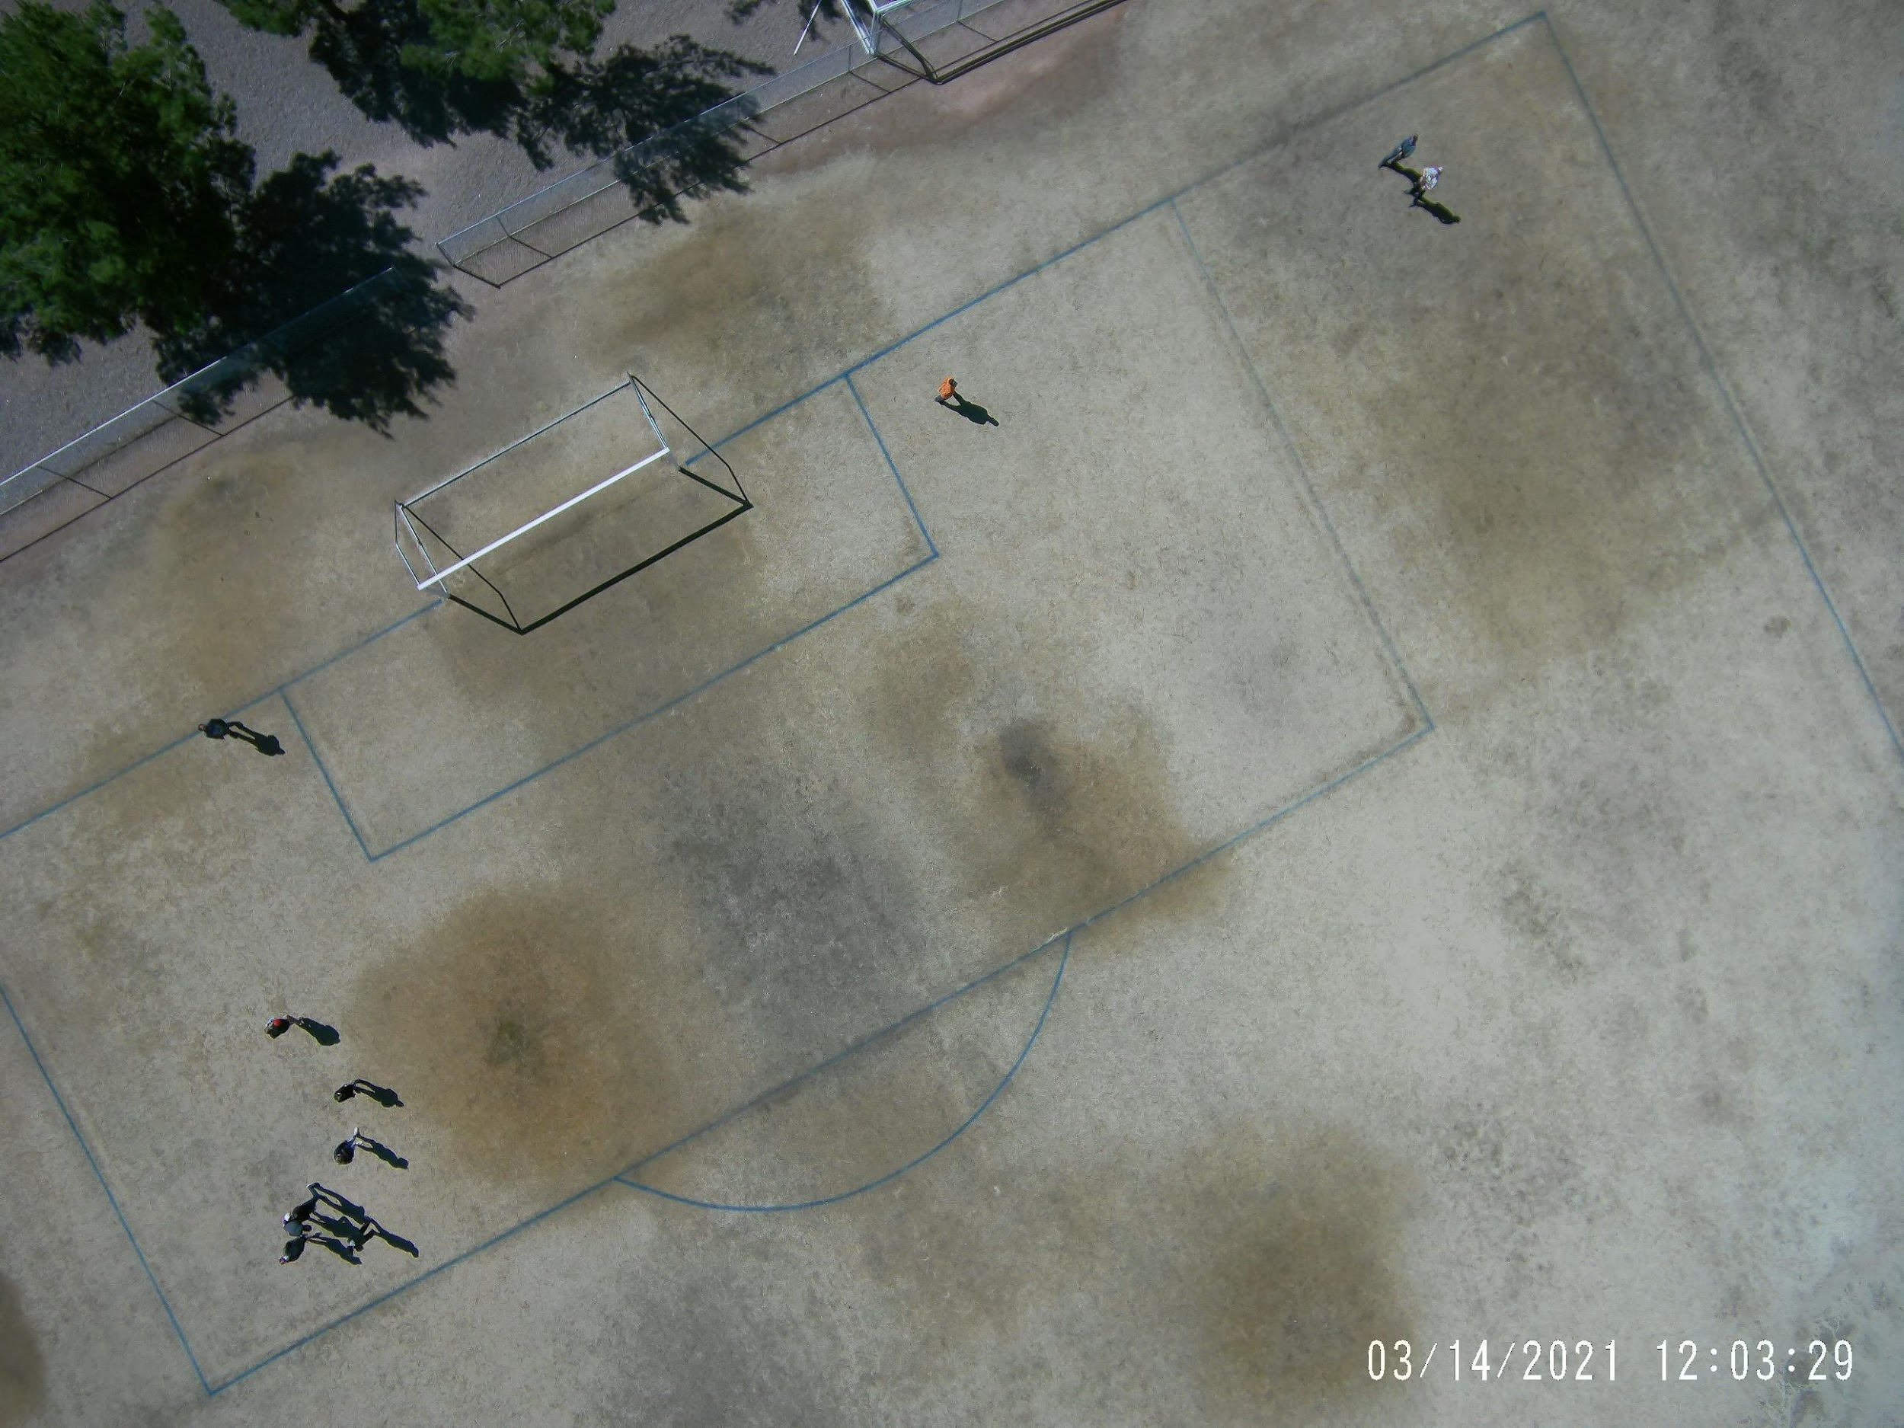
8. What kind of place is this? Why do you think some areas are darker and lighter?

Slide 20
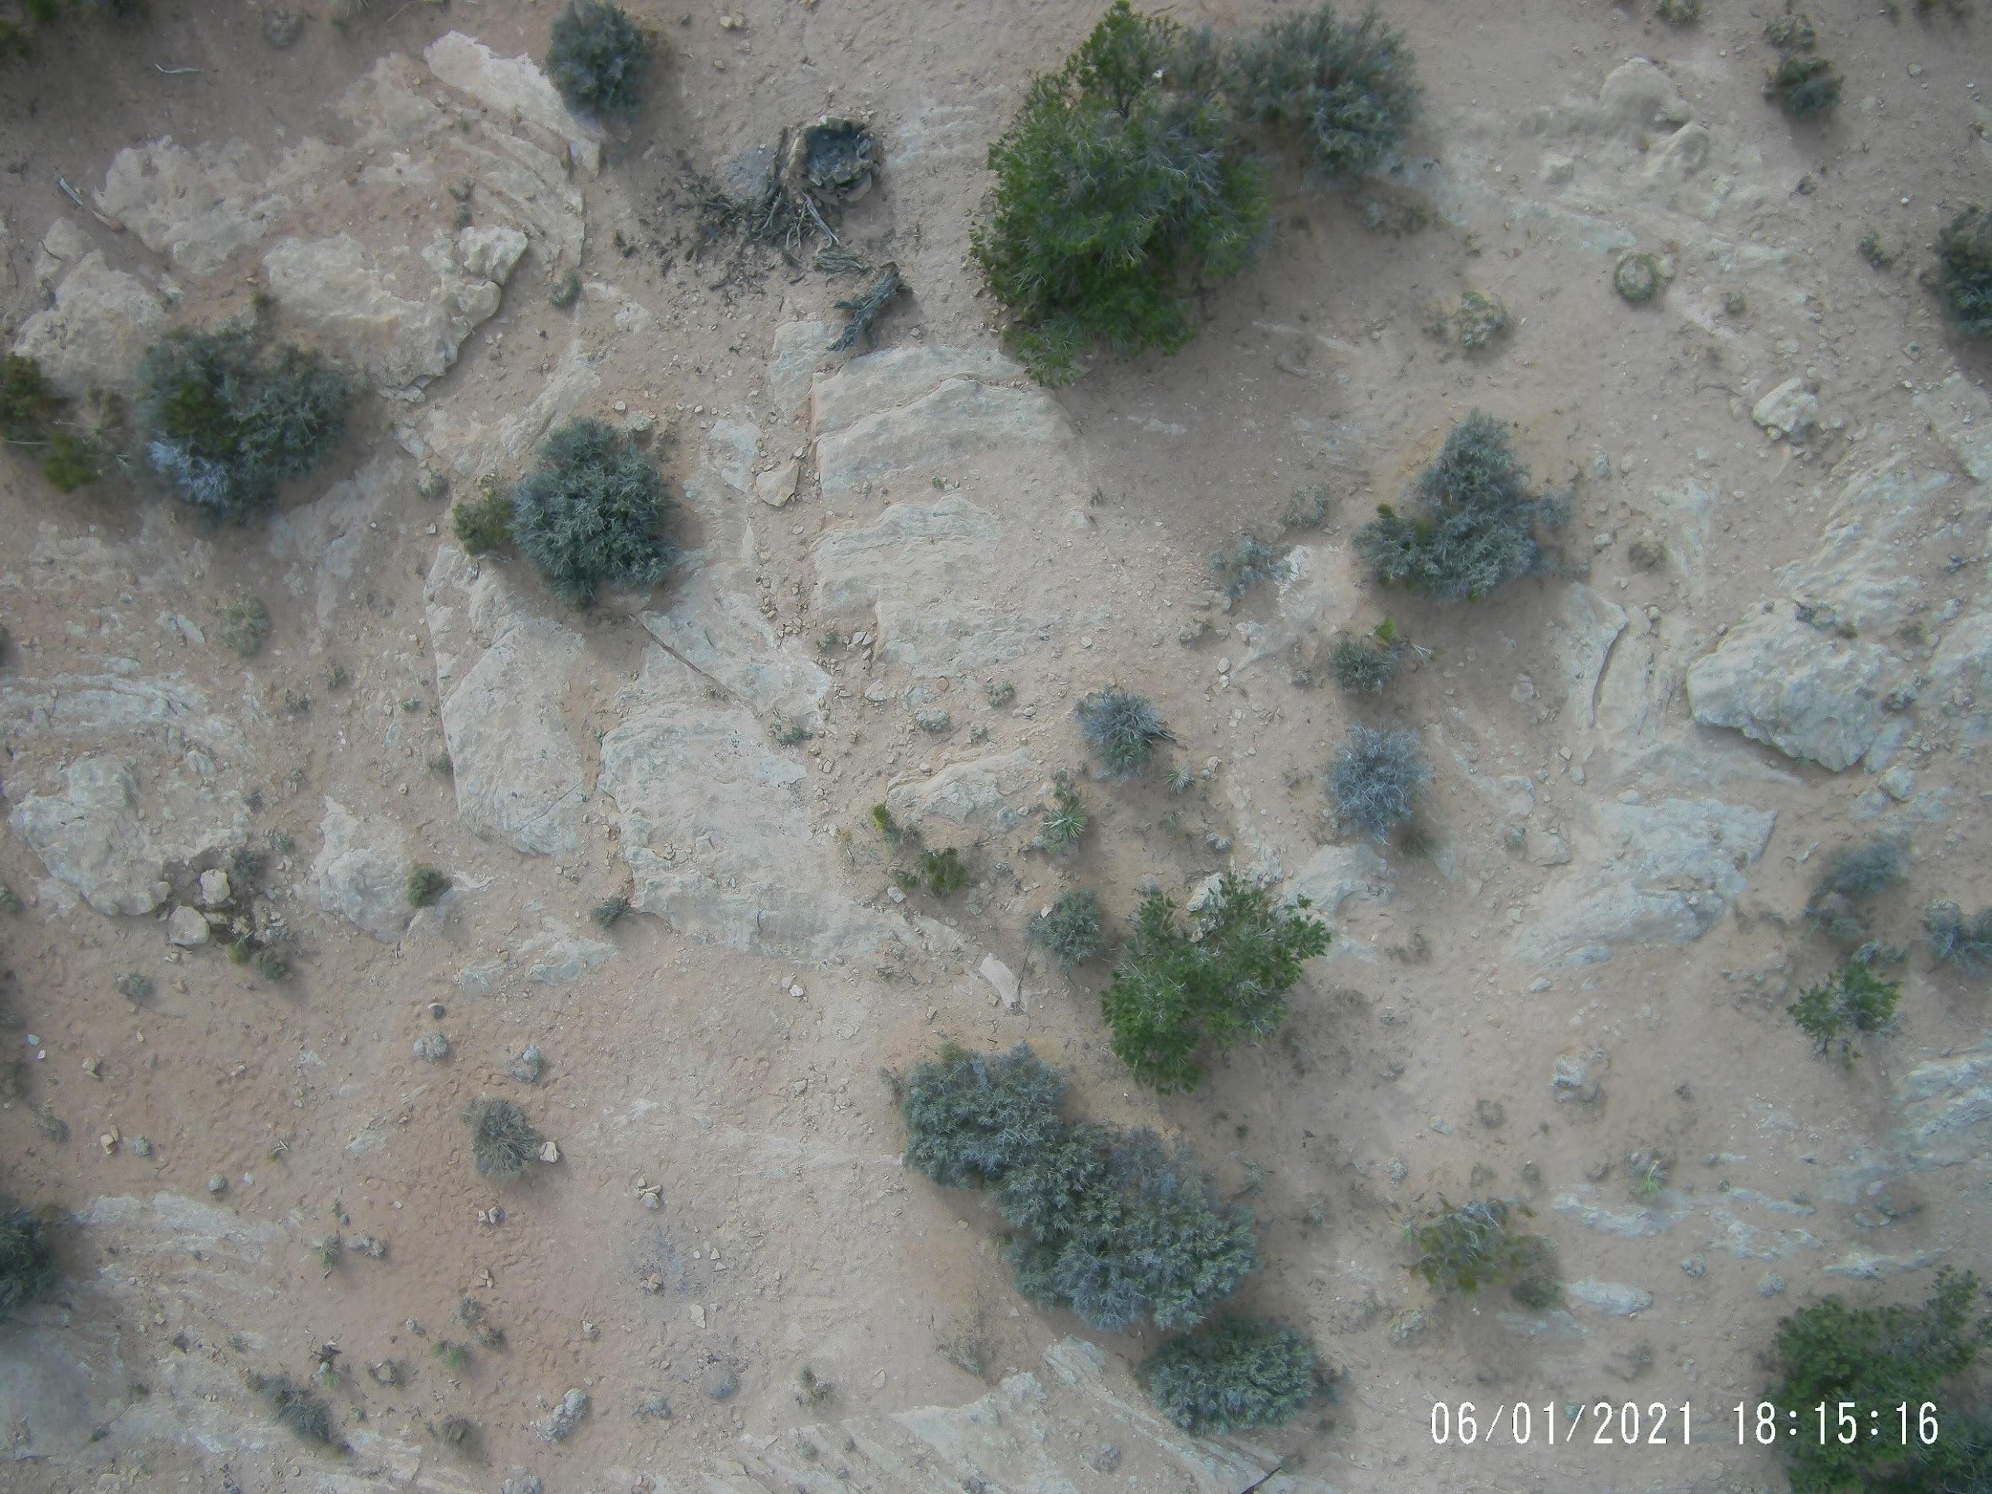
9. Can you spot something that might be made by people?

Slide 21
10. What time of day is it?

Slide 22
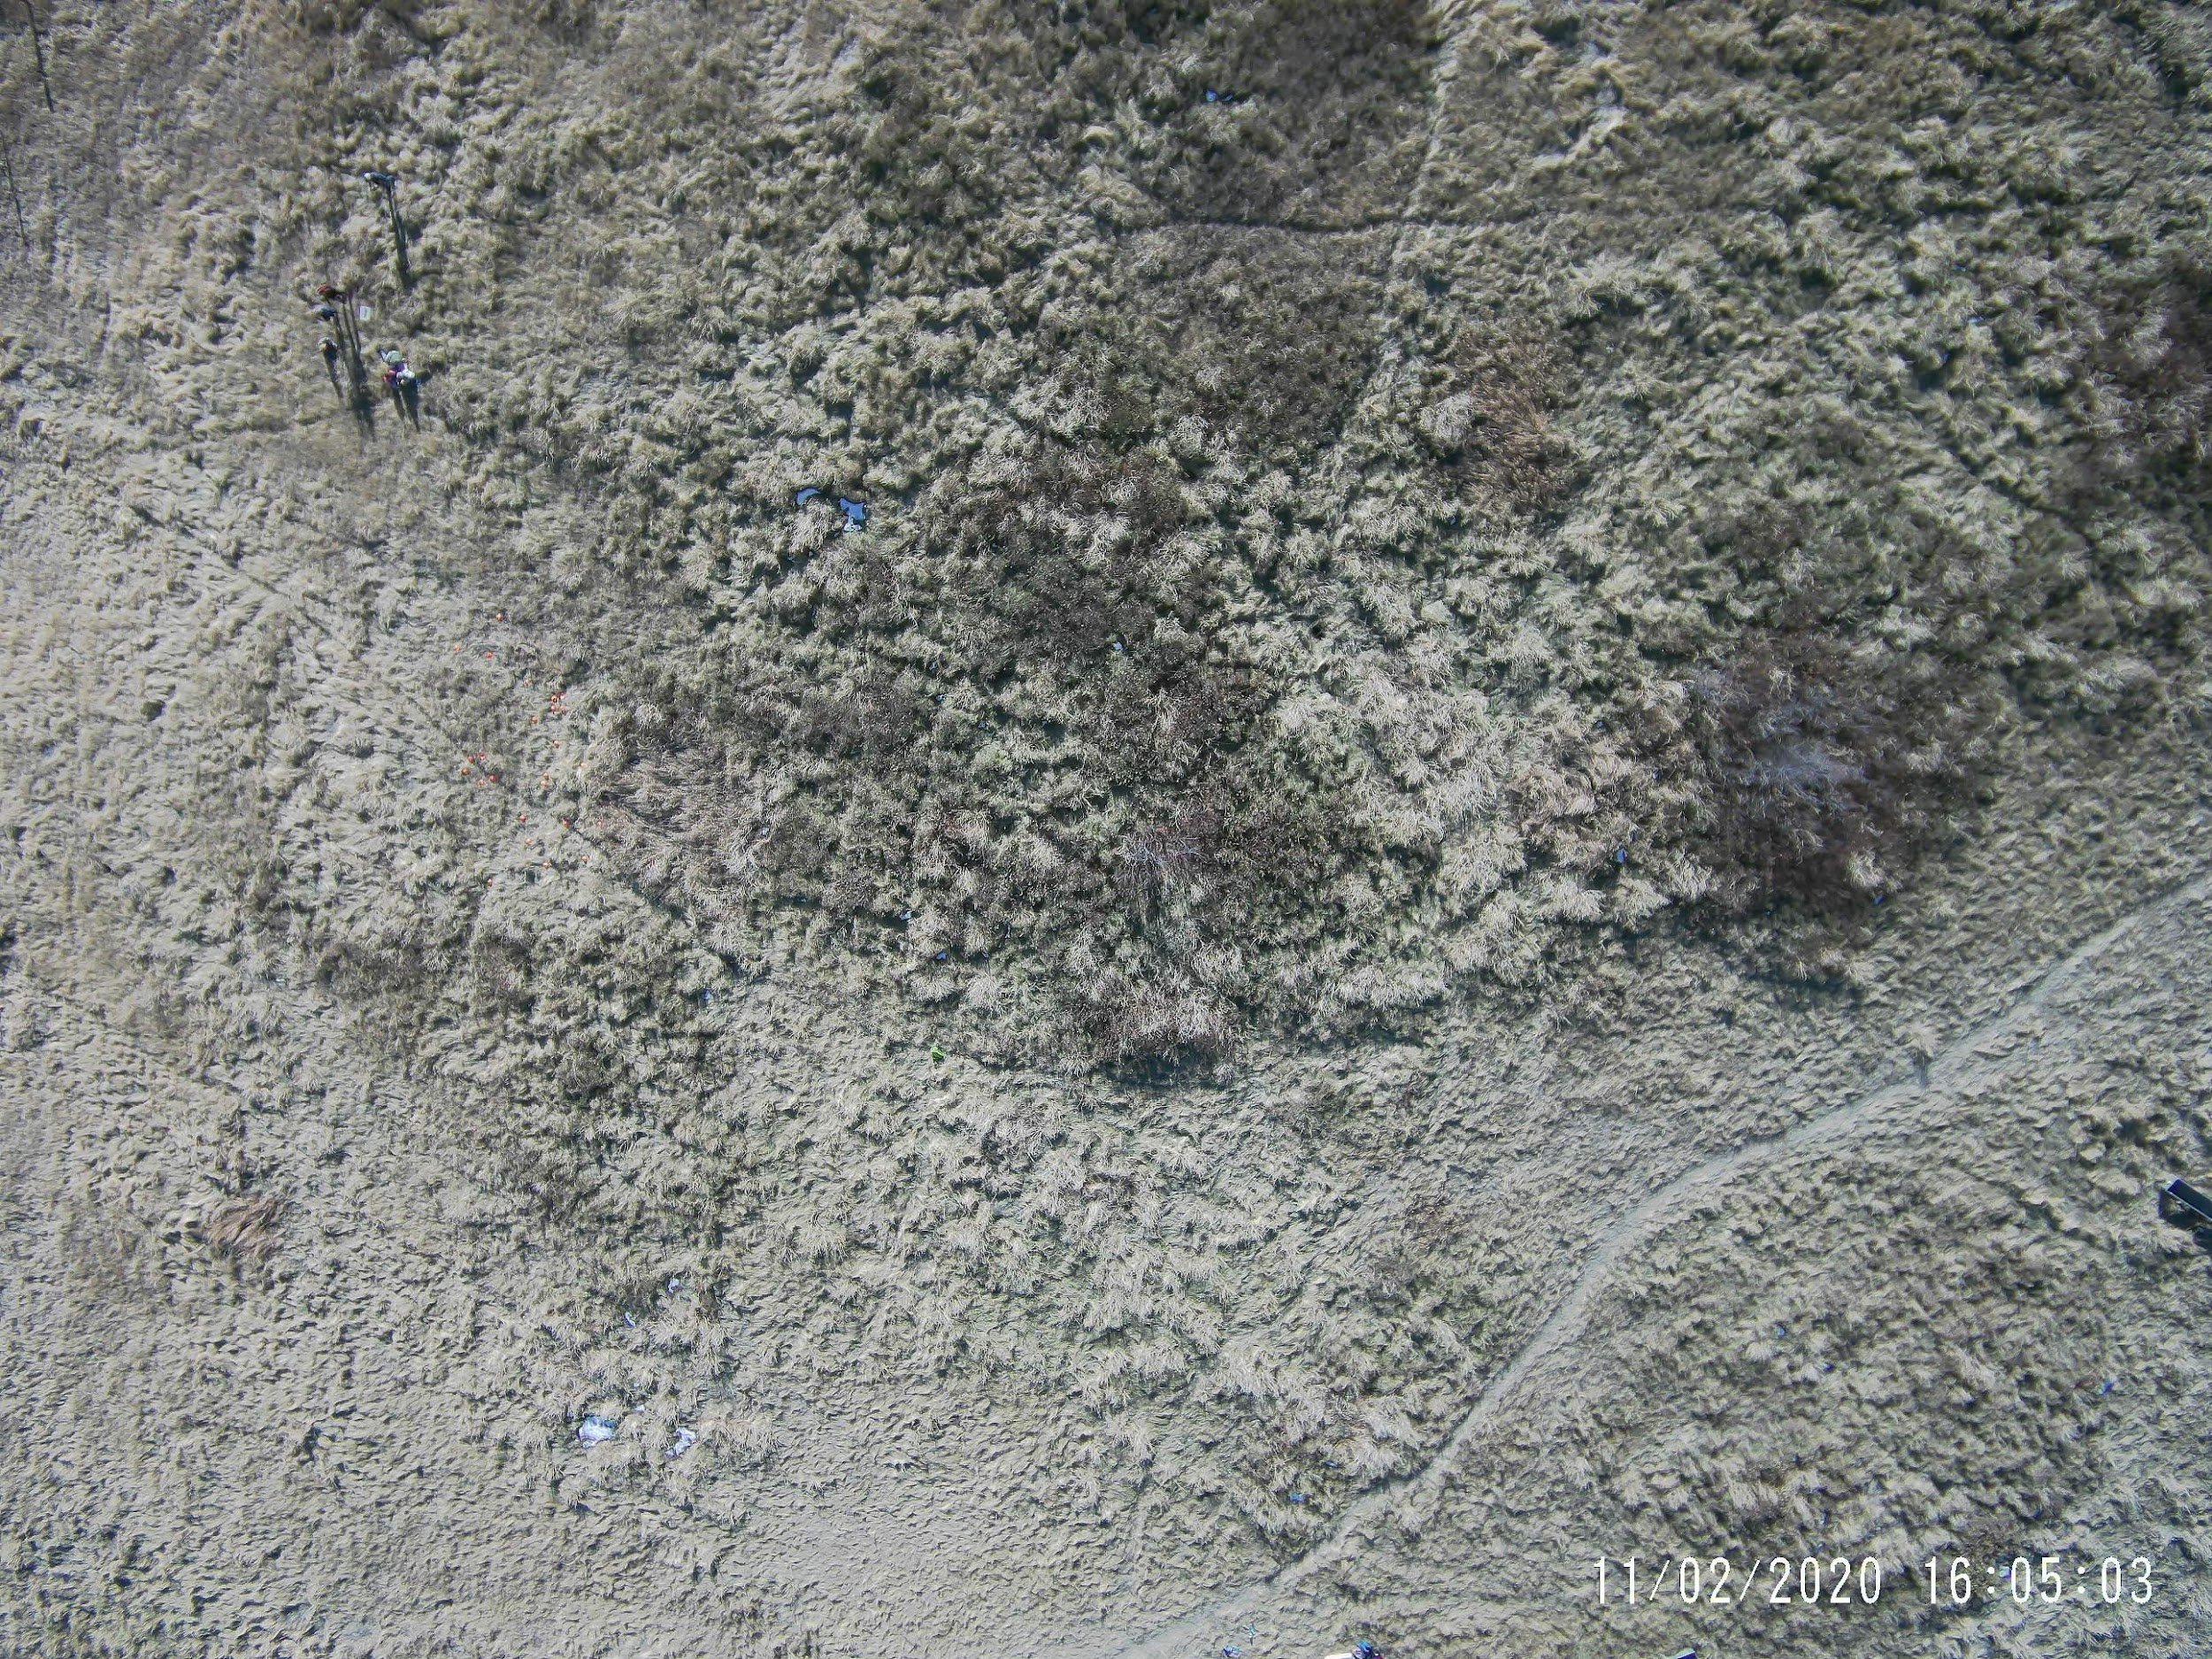
11. Where is the lost backpack?

Slide 23
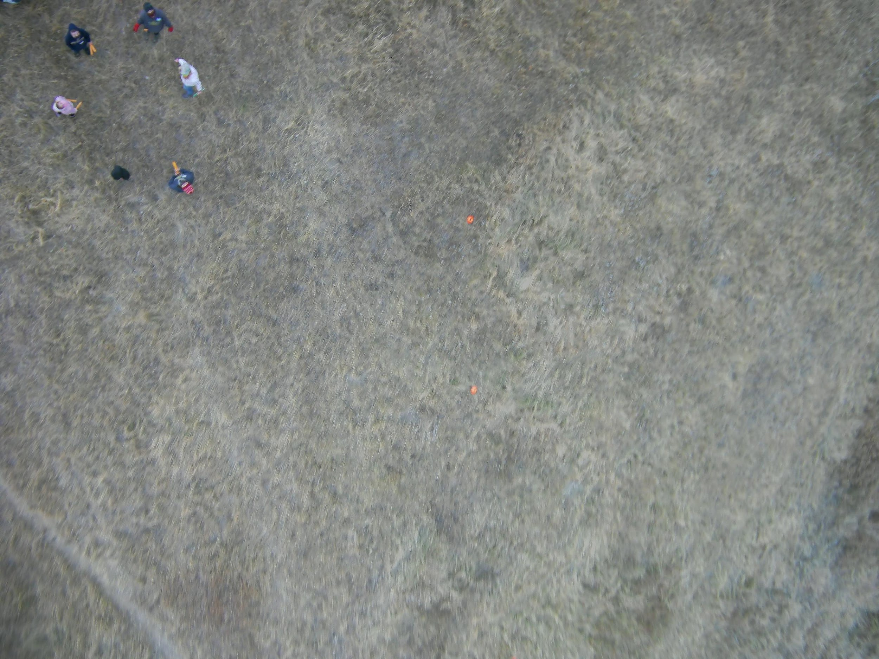
12. What are they doing?

Slide 24
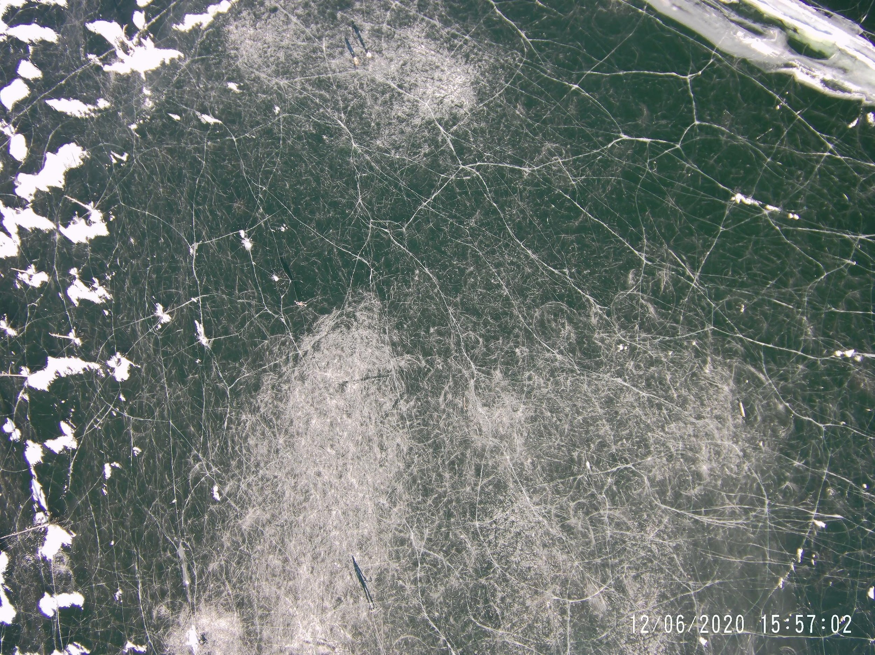
13. What is this?

Slide 25
Answer key
MSU in Bozeman
The wind blows from the person’s back (and slightly from the right side) to loft the kite into the air
No right or wrong answer here: wheat field, very straight road, less mountainous part of Montana (near Lewistown). People on the ground are waiting to launch the second kite
Many answer: Trampoline (perhaps?) in yard on left; garden in yard on right. Can also see tree tops. People in upper left are launching a red balloon with a camera on it. People in the stream are collecting water quality data. Can also see the curve of the stream and trails.
Center top – you can see the string coming down
Beach volleyball. May also be a person with a paddleboard or kayak?
Look for the tractor tracks
Soccer field. We think the darker spots may be the more used spots, like where the goalie goes or place for penalty kicks
Looks like a man-made fire pit toward the top left
Near dusk – long shadows coming from the west
Look for lime green spot near the center of the photo. Straight up from the number 11 in the question.
This one is harder – they made orange sticks for safety – to direct people away from the kite. They formed a circle as something interesting for the kite to photograph. What patterns could people make on the ground that would be interesting?
This is out on a frozen lake. The ice is scratched up where people played hockey. The kite flyers are at the top center. You can see the long shadow of a hockey player holding a stick toward bottom left.

