Slide 1
PBIS in Lincoln Park
November 8, 2019
Dan Mercer, Lincoln Park High School Principal
daniel.mercer@lpps.info

Slide 2
Mr. Terry Dangerfield
Superintendent, Lincoln Park Public Schools

Slide 3
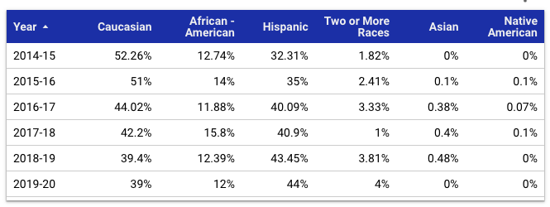
Who are we?
Only high school in Lincoln Park, a community of about 6 square miles and nearly 40,000 residents.
Changing Demographics
Community Eligibility Program Participant
Enrollment up district-wide and at LPHS
Students from 15 different countries on five different continents

Slide 4

Tier One Focus
Shift from Tier 2 and 3 focus to a mindset that emphasizes the importance of what happens at the Tier 1 Level
By improving EVERYONE’s experience, we reduce the number of students that need Tier 2 and 3
Mindset becomes more proactive, rather than reactive
Building the strong foundation
This has to be who you are!

Slide 5
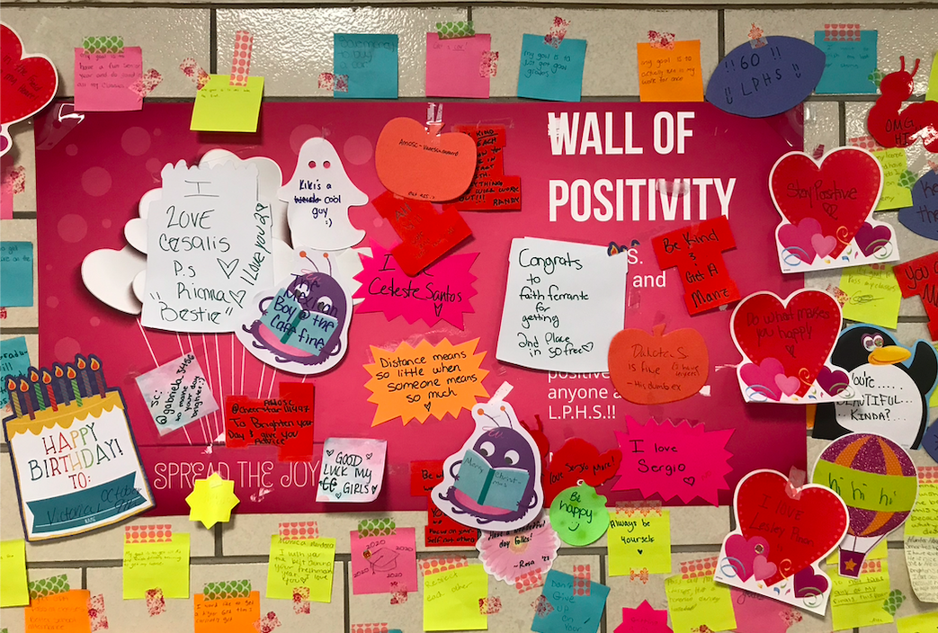
What does that Tier 1 work look like?
Commitment to 5:1 positive to negative feedback ratio
Mindset shift to include 5:1 ratio when considering experiences in the building
Increase the positive experiences
Increase sense of belonging
This includes staff!
Classroom Interventions
Classroom Visits
180 Classroom Walkthroughs in October
Every teacher gets at least 1 visit per week
Coaching vs. Feedback

Slide 6
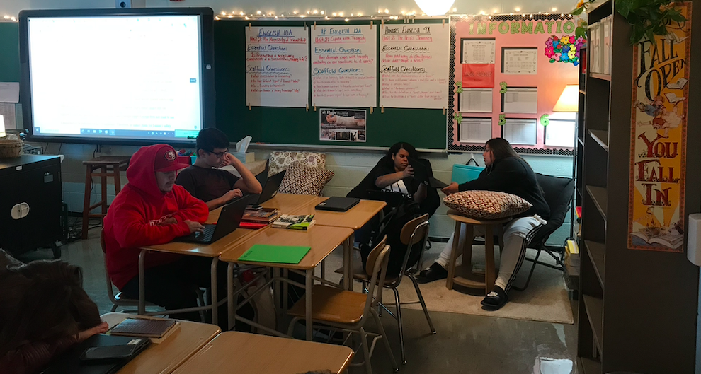
Tier 1 in the Classroom
Fidgets and Tactile Opportunities
Calming Corners/Spaces
Small Group Instruction
Community Circles
Don’t sweat the small stuff!
Notes:
Do you see anything in that picture that wouldn’t be allowed in your school?

Slide 7
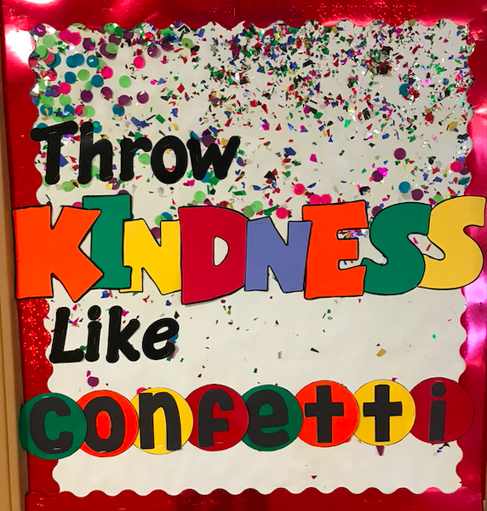
Tier 1 Supports Outside of the Classroom
Intervention Staff
Positive Rewards
Social Work Services
Henry Ford Medical Clinic
Special Events
Counseling Services
Responsible Thinking Center

Slide 8
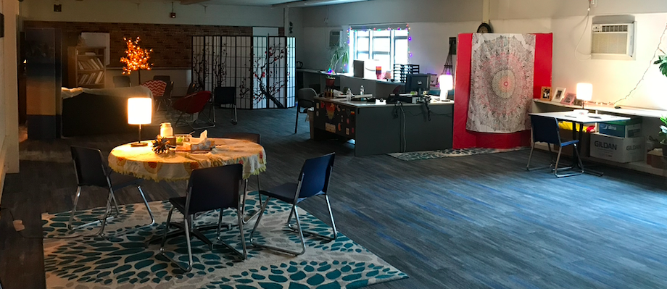
Responsible Thinking Center
When self-regulation needs more than the classroom can offer or when students need support from more than the classroom teacher.

Slide 9
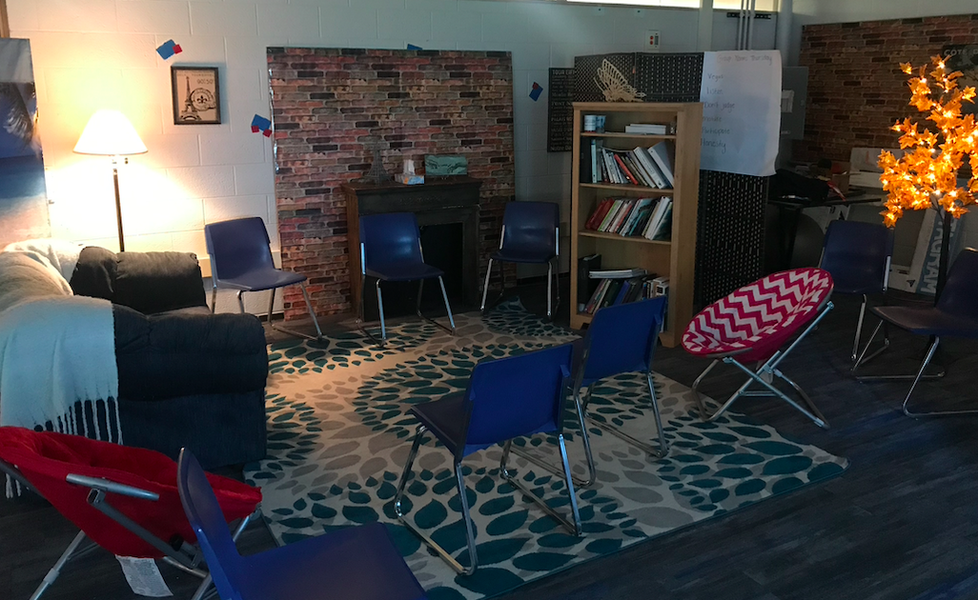
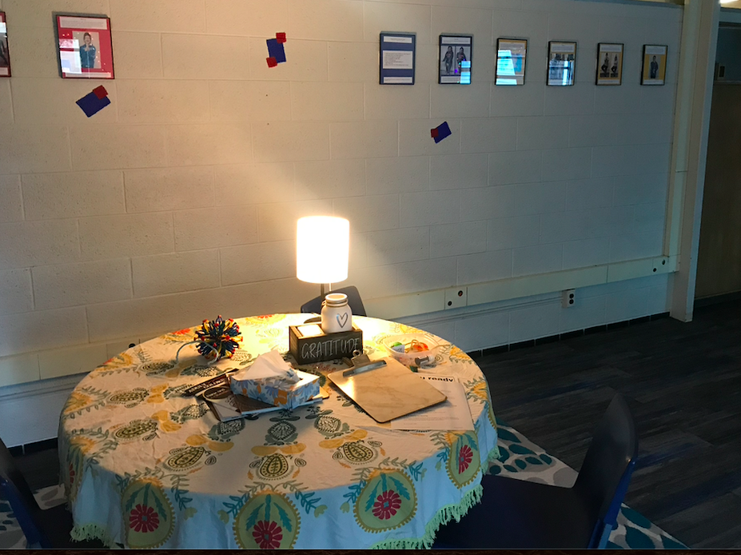
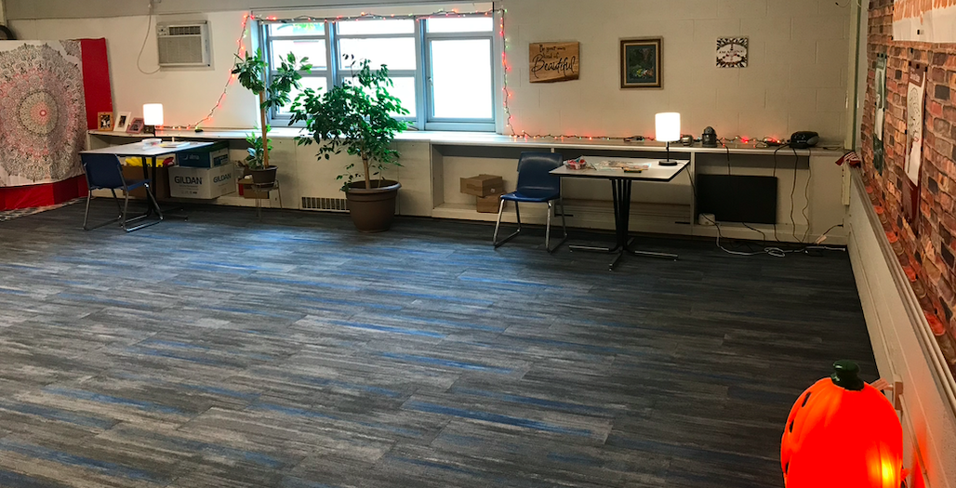
RTC, Continued

Slide 10
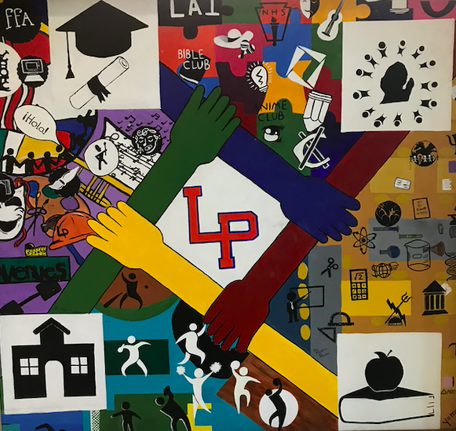
Tier II
Student Support Team
Teachers can refer students to a team of school administrators, social workers, counselors, nursing consultant, teacher consultant and more as needed.
Strategies already attempted with the students are discussed and recommendations are made to teachers and/or options are chosen from a menu of other resources that we can employ for the student.
Regularly collect data and follow up.

Slide 11
SST Menu Options
Adult Mentor
Group Participation
Referred to a Club
ELL Consult
Right Trac Attendance Program
Restorative Work
Planned Breaks, Behavior Intervention
Social Work Services
Building-Level Responsibility or Participation
Peer to Peer Program
Tutoring
Check in/Check Out
Medical Referral

Slide 12
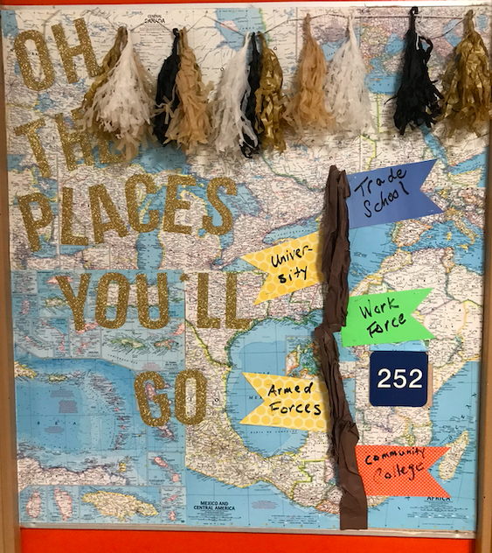
Tier III
Wrap Around Services
More intense therapy and group options
Guidance Center
Henry Ford Health Clinic
Still a focus for improvement at LPHS

Slide 13
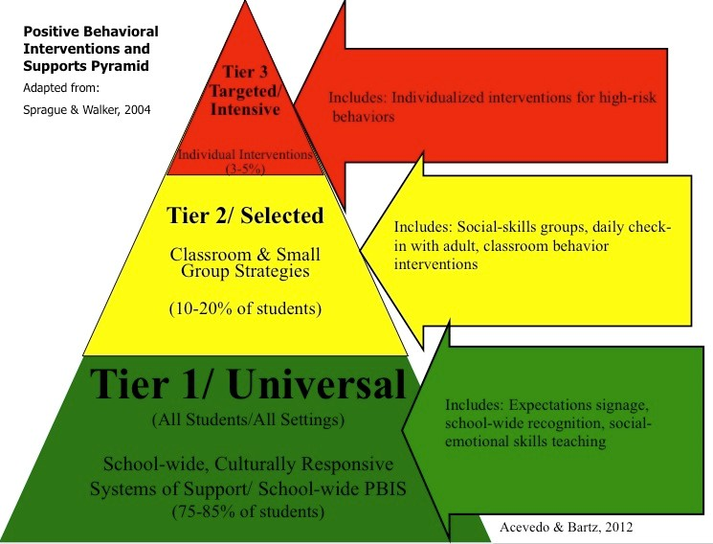
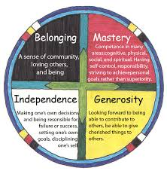

Blending PBIS with the
Resilient Schools Project

Slide 14
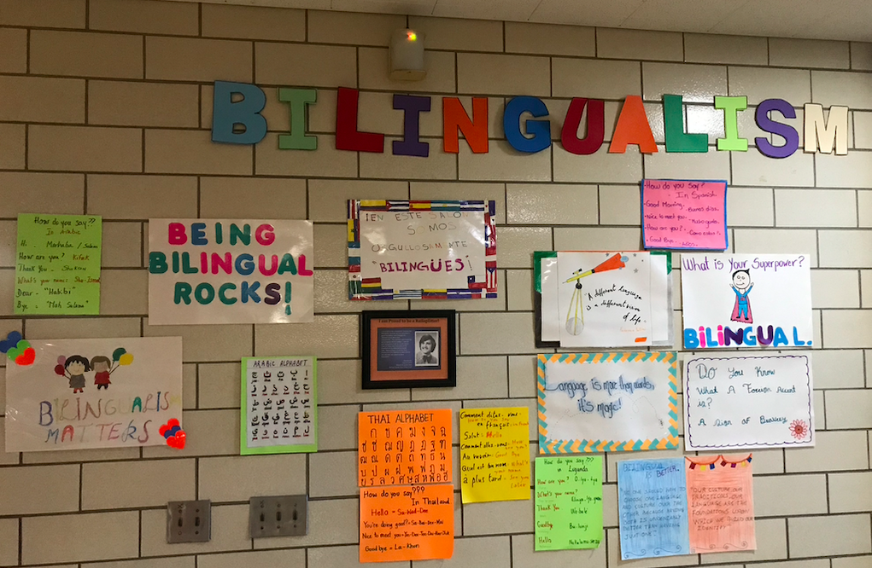
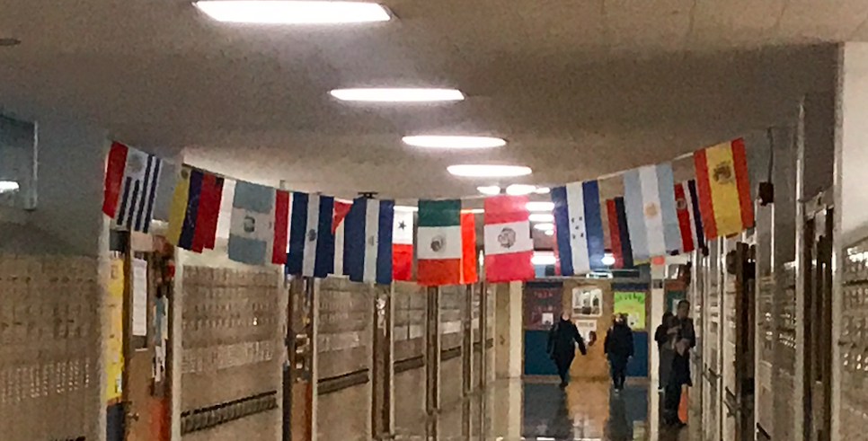
Belonging
A sense of community, where all are welcome
Who our students are and what they do is cause for celebration. It’s our jobs to help them recognize that.

Slide 15
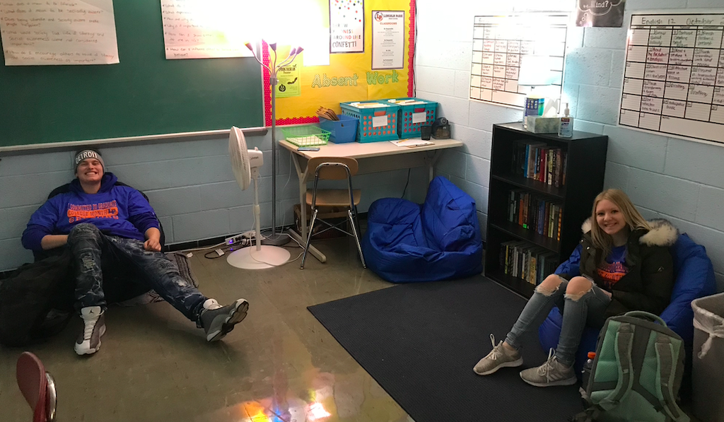
Mastery
A feeling of competence in many areas. Having self-control, responsibility, and achieving personal goals
This area stresses the importance of small group instruction and of meeting students where they are
Important to know students’ strengths
and interests
Promote growth mindset -
The Power of Yet!
Notes:
Data driven instruction. Setting goals. Recognizing that success looks different for different people.

Slide 16
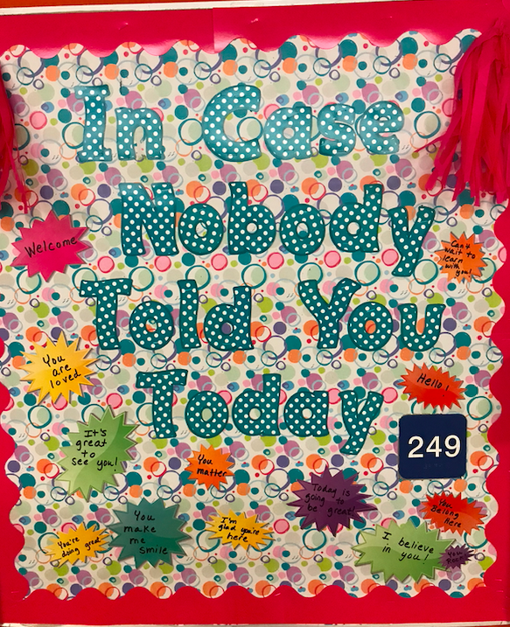
Generosity
Looking forward to being able to contribute to others or give cherishables to others
Classroom Jobs
Community Circles and Communication
Service Learning Projects
Finding Value in Student Strengths

Slide 17
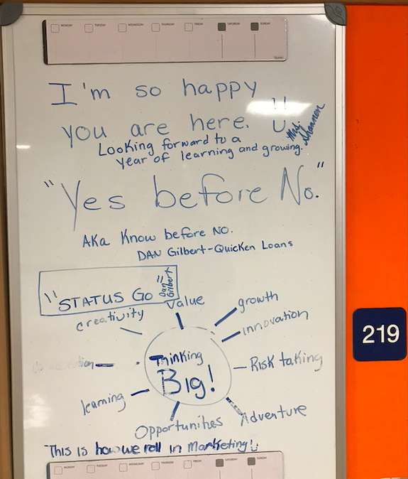
Independence
Making one’s own decisions and being responsible for one’s success or failures
Risk taking - big for staff as well!
Clear communication on expectations
Choices where possible
Ensure that you are there to help;
not punish for mistakes

Slide 18
Suspension Data
Year | OSS | ISS | Total
10-11 | 513 | 209 | 722
11-12 | 429 | 302 | 731
12-13 | 349 | 252 | 601
13-14 | 396 | 355 | 751
14-15 | 275 | 384 | 659
15-16 | 201 | 149 | 350
16-17 | 179 | 178 | 357
17-18 | 85 | 83 | 168
18-19 | 130 | 81 | 211

Slide 19

It works, but it has to be who you are!

