Slide 1
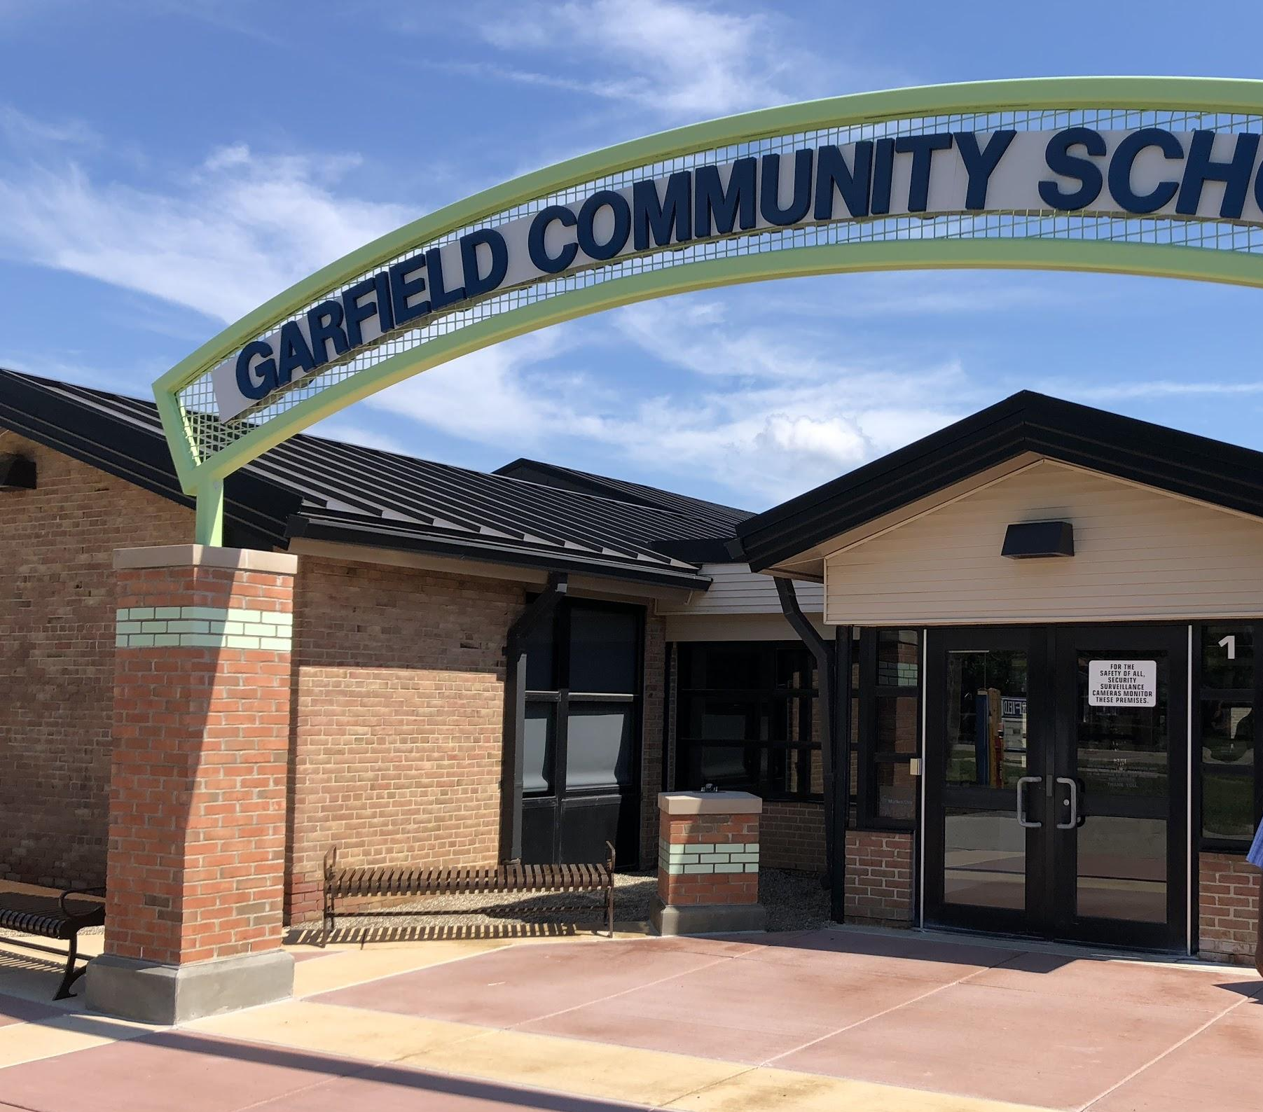


Western Wayne Skill Center at Garfield Community School PBIS
Patrick Mies, Rick DuBay, Ashley Van Tiem, Leah Clark
Notes:
Jason Mraz video-
https://www.youtube.com/watch?v=BFkTu8Y1KLs
Pat

Slide 2
Western Wayne Skill Center
Center program that serves students (18-26) with moderate cognitive impairments and autism
Serves Western Wayne County (Crestwood, Garden City, Livonia, Northville, Plymouth-Canton, Redford Union, Romulus, South Redford, Van Buren, Wayne-Westland, Westwood)
Part of Livonia Public Schools
Serves approximately 175 students
PBIS 1st year of full implementation
Notes:
Pat

Slide 3
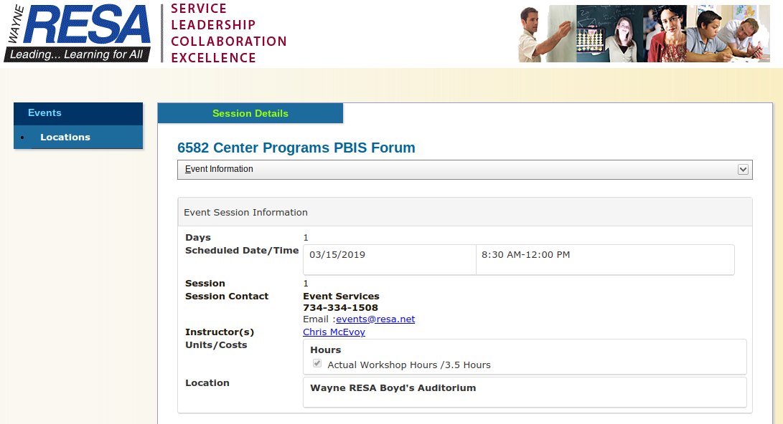
How we started:
-Start with a small group (5 people)-Spring 2017
-Wayne Resa workshops (Tier 1, 2, 3)
-School Visits (Jo Brighton, Drew Transition Center, Lutz)
-Worker of the Week
Notes:
Leah

Slide 4
Planning Year
- We had an unofficial pre-planning year where the principal helped the staff understand PBIS. The following year...
-Chris McEvoy and Kayrl Reynoso icebreaker (background info and buy in)
-Created larger team and determined chair/co-chair
- Determined a set date each month to meet (stayed true to meeting dates)
-PBIS Self-Assessment Survey to PBIS team and then to entire staff-baseline data
-Matrix (areas and what does it look like to be safe, responsible, respectful)
-How do we want our program to look? (school store, PBIS dollars, punch card, etc)
-Determined the Majors/Minors
Notes:
Leah
Picture of matrix and minor and majors

Slide 5
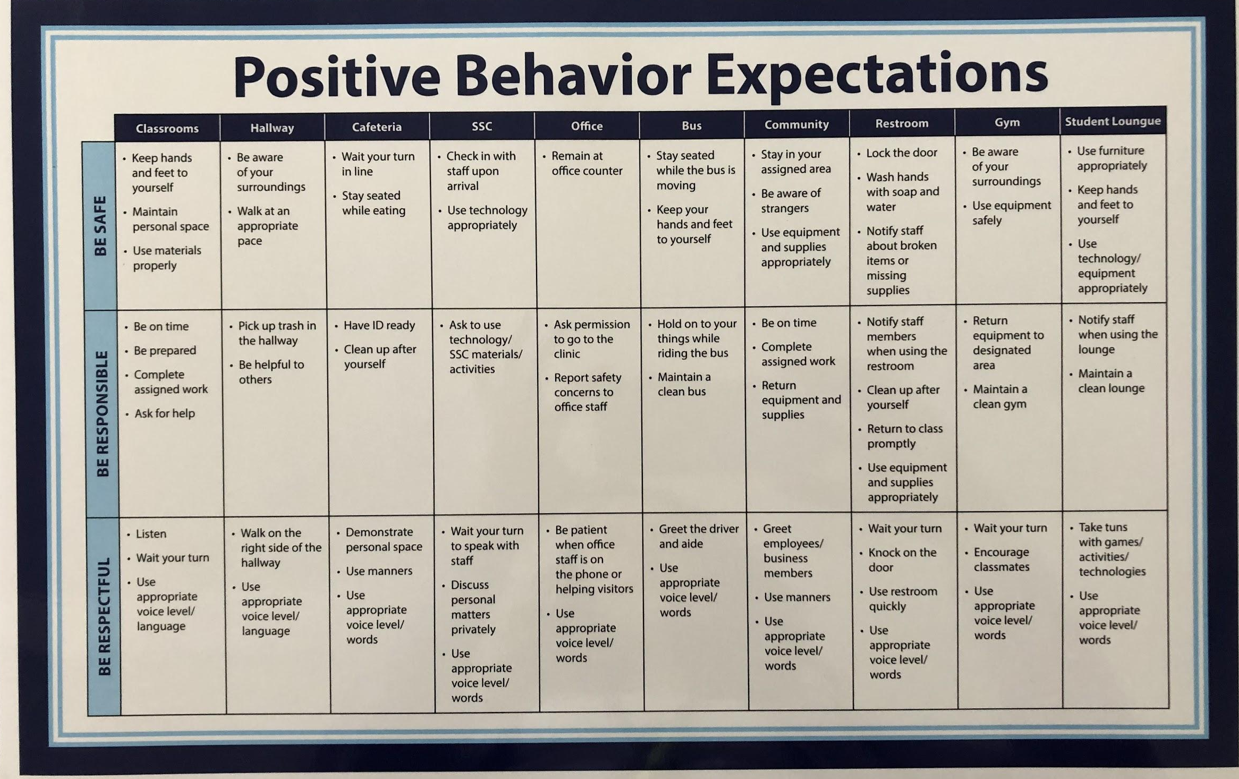

Slide 6
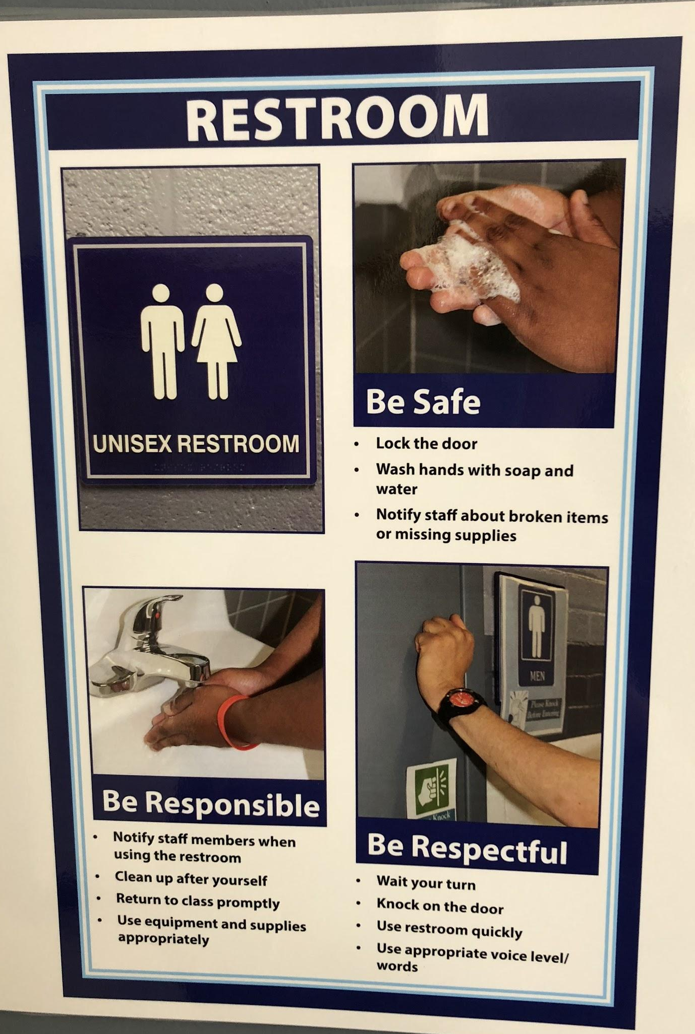
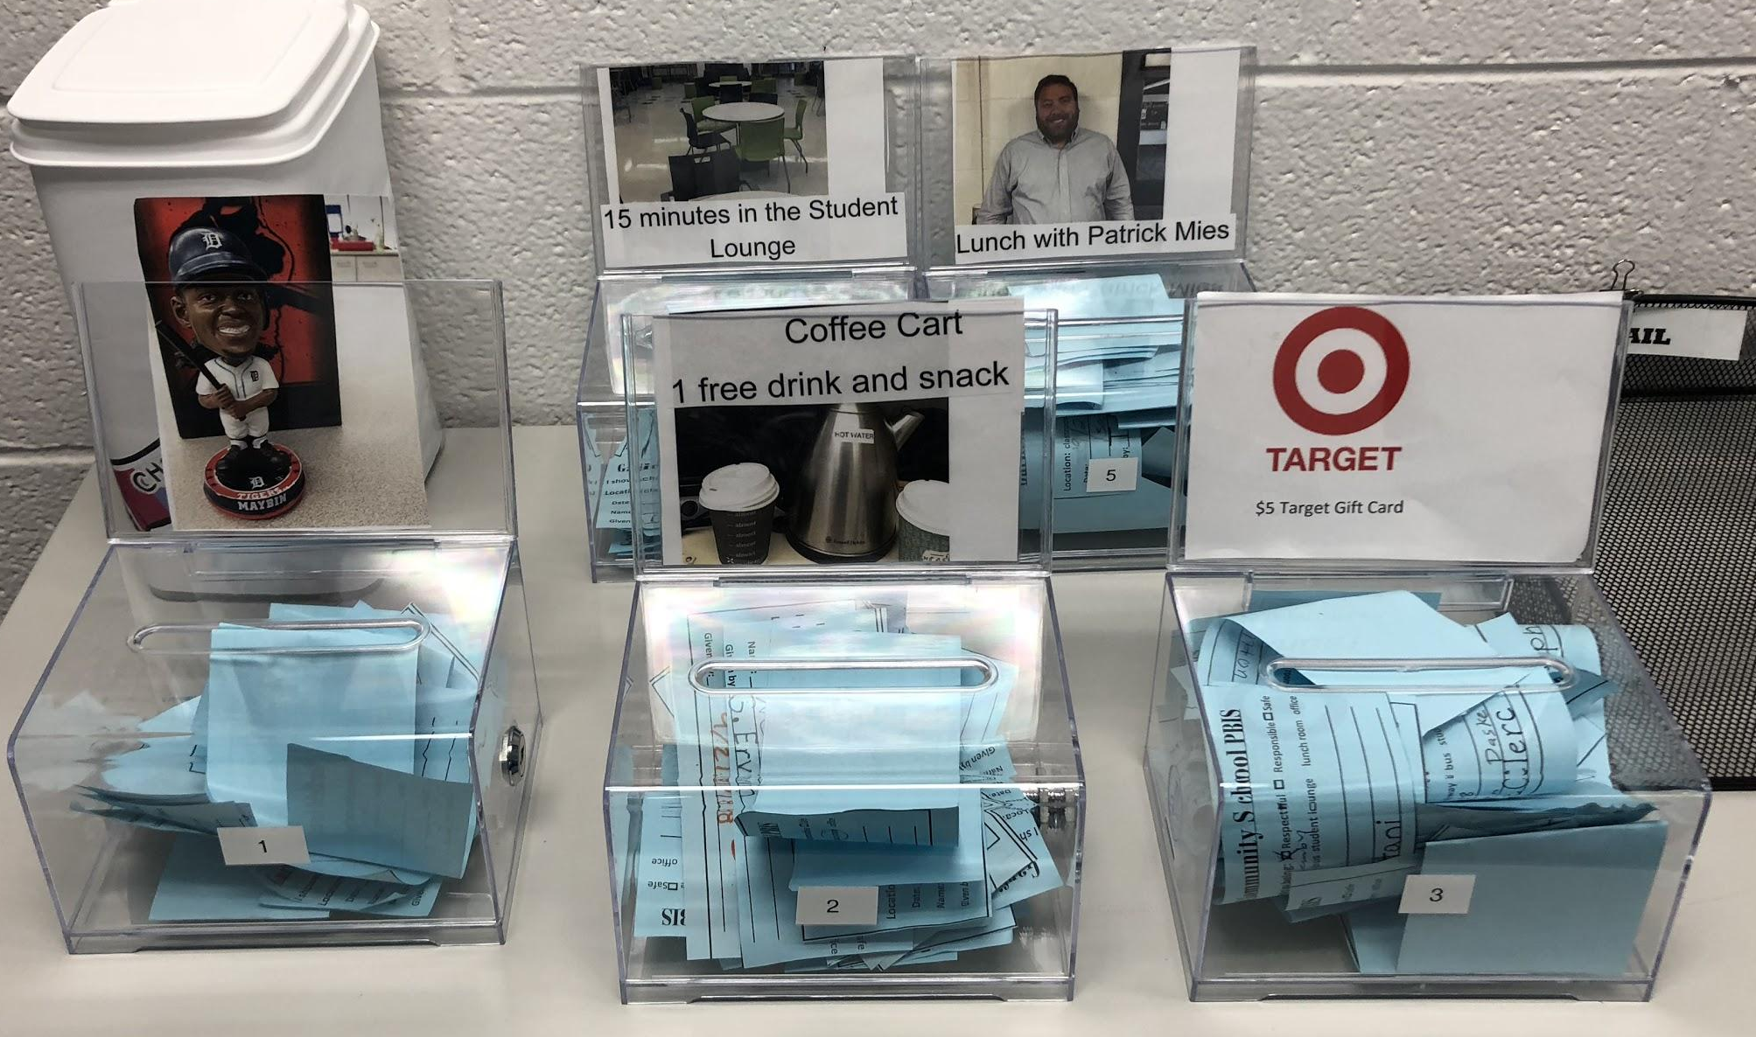
Planning Year Continued...
-Posters and Brochures (real pictures vs cartoons) (getting them in on time)
-Funding raffle prizes (staff and student donations)
-PBIS for staff (Cheers for Peers)
-PBIS Kickoff/video
-Data
-Timeline of spending grant money
-PBIS powerpoint to teach staff and students (see handout)
Notes:
Ticket data - started taking data on teacher, date, student, location (now only take data on total number of tickets handed out),
Leah

Slide 7
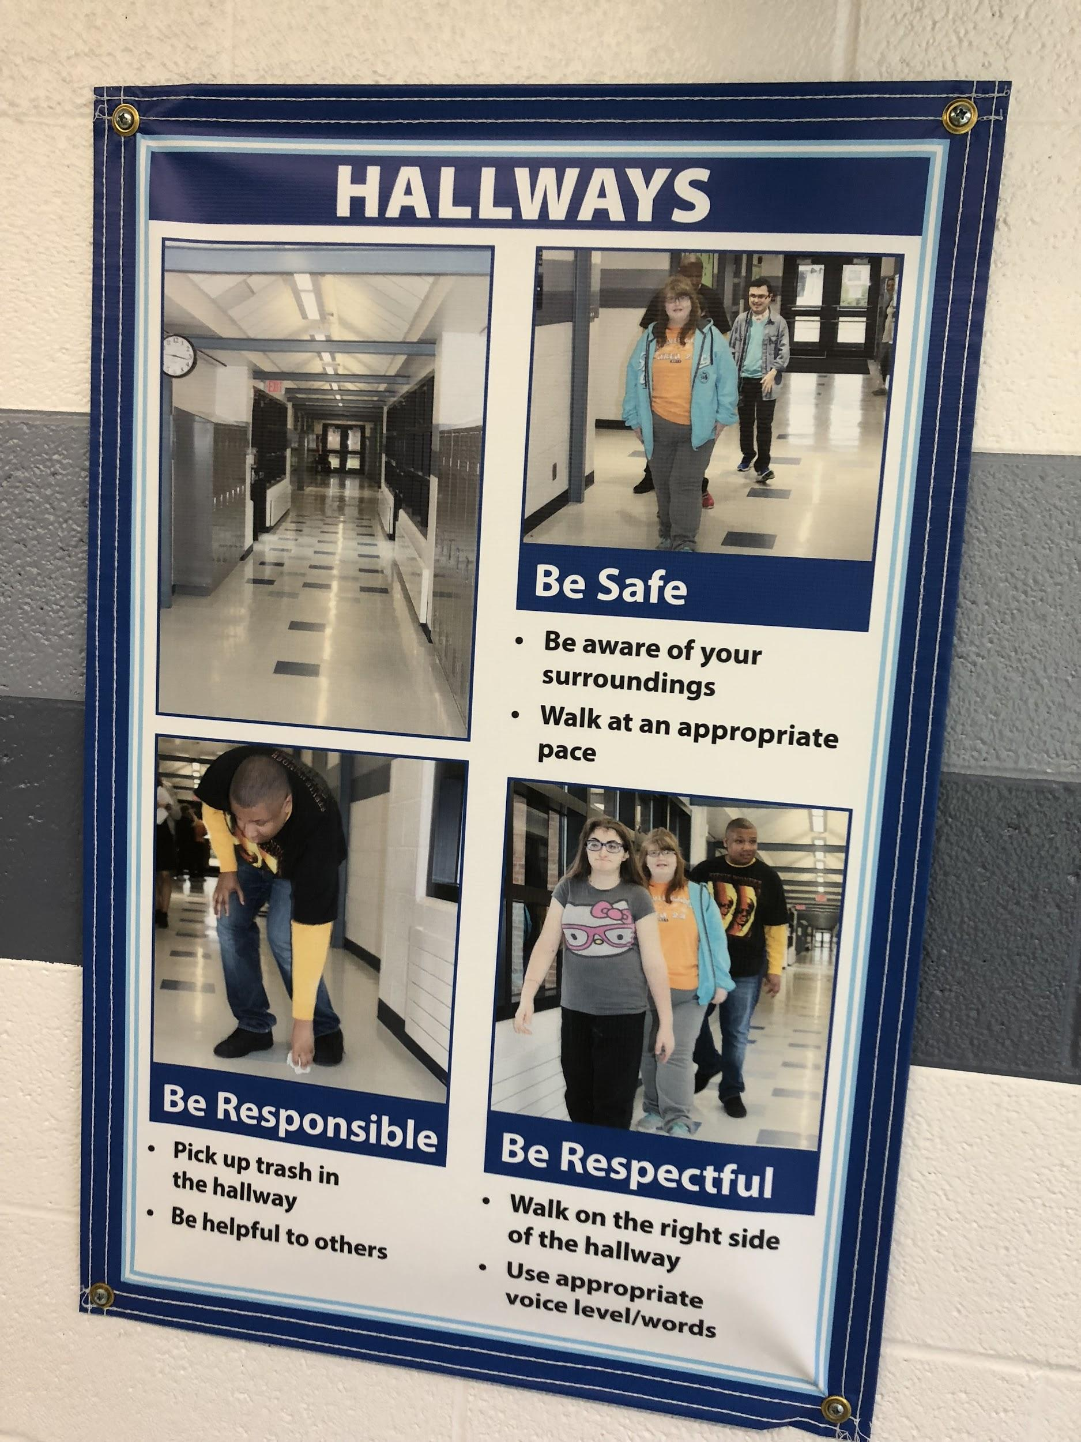
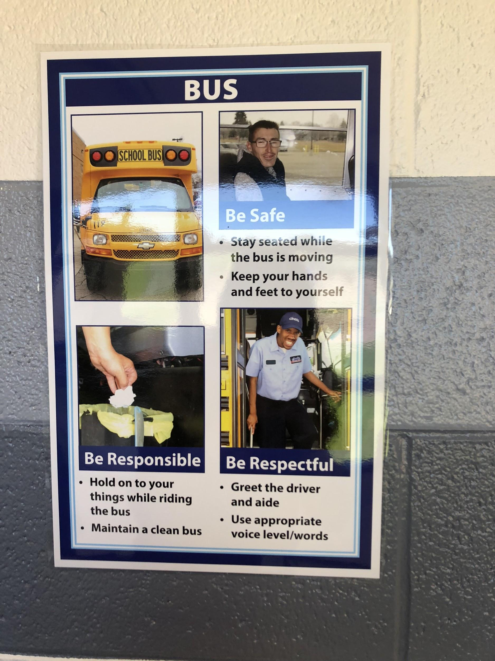
Notes:
Leah

Slide 8
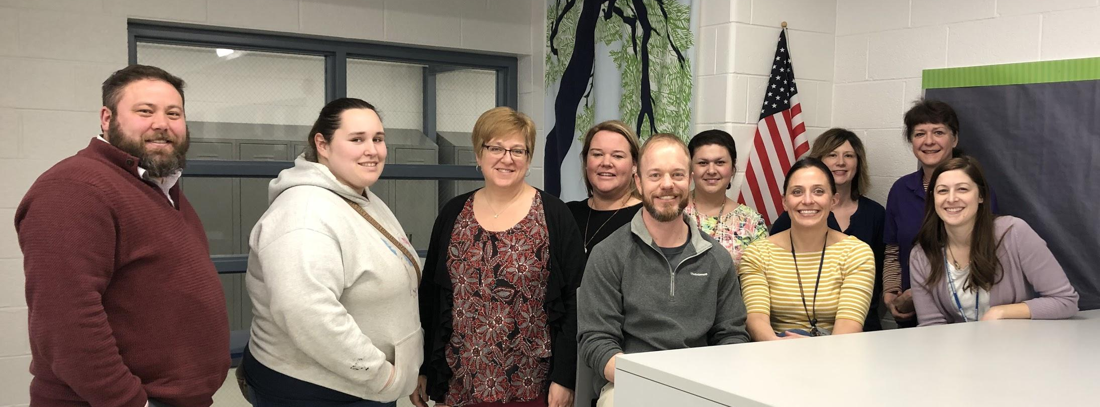
PBIS Team
Principal, program specialist, behavior specialist, 6 teachers, and 1 paraprofessional
Meet once a month
Tier 1 team and Tier 2/3 team meet monthly
Role models for staff and students
Notes:
tier ⅔ team developed criteria for students to enter/exit tier 2 and tier 3 and reviews monthly
Pat

Slide 9
PBIS Kickoff Video
Garfield Community School PBIS final copy.mp4

Slide 10
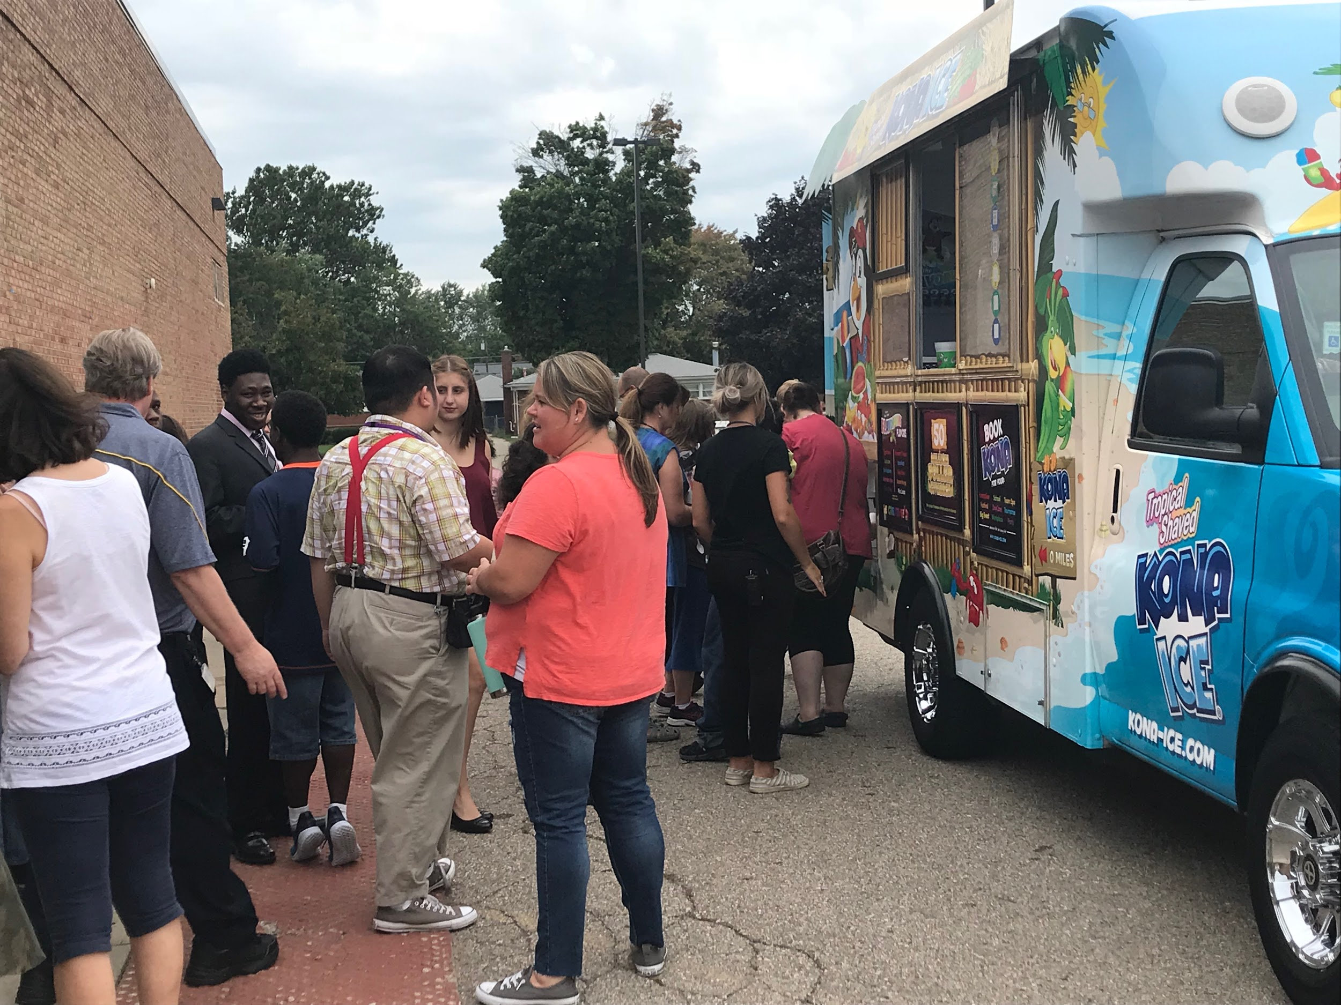
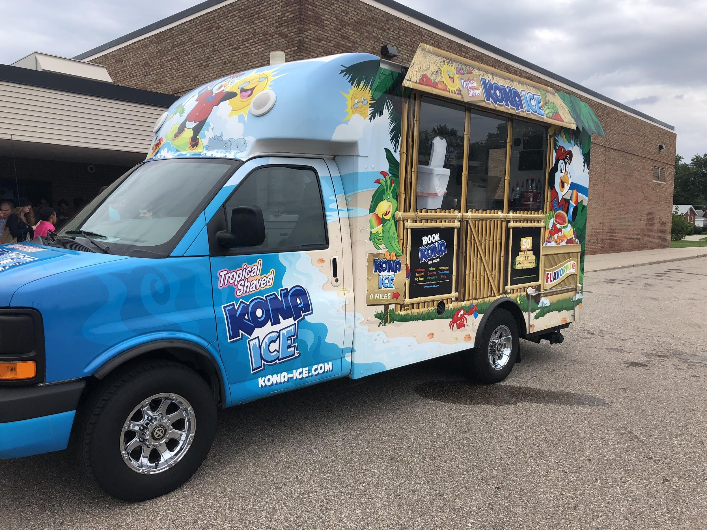
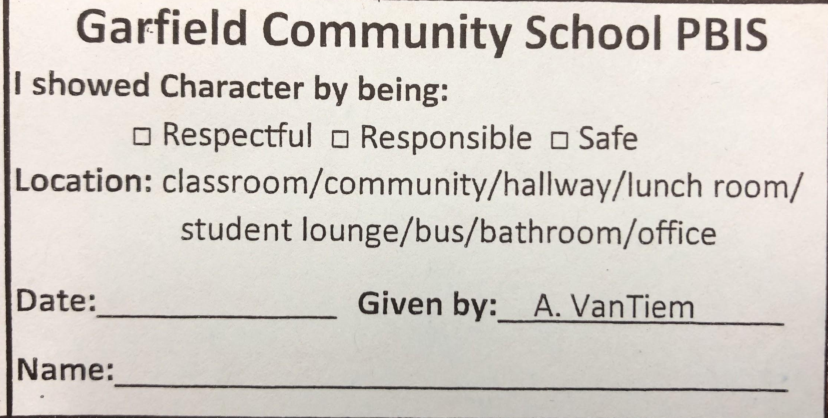
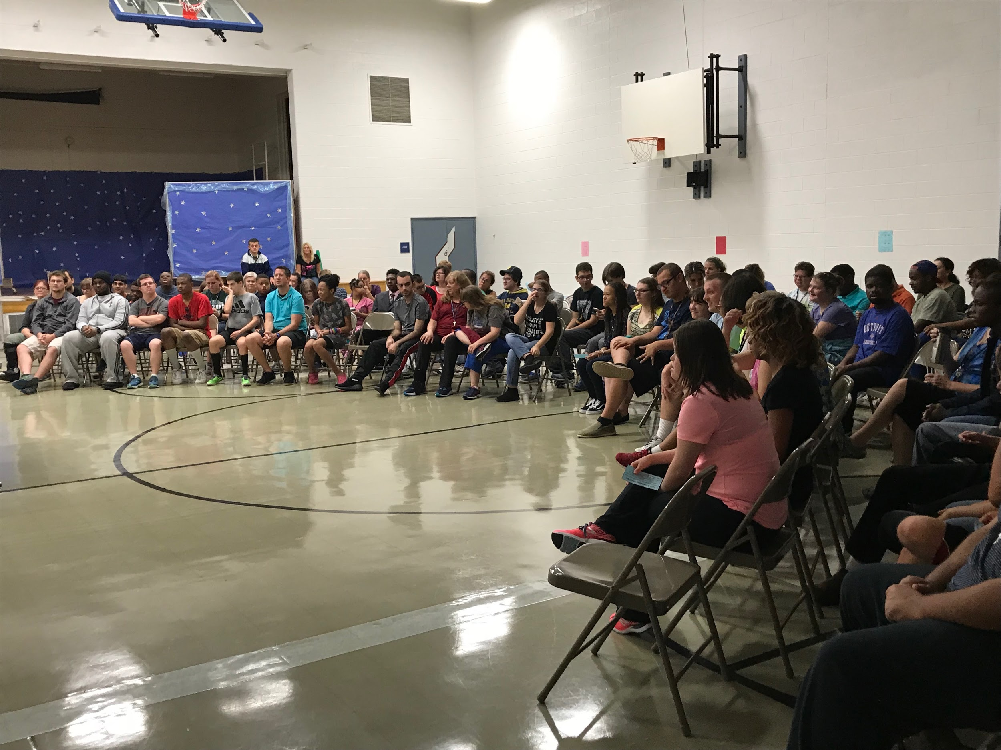
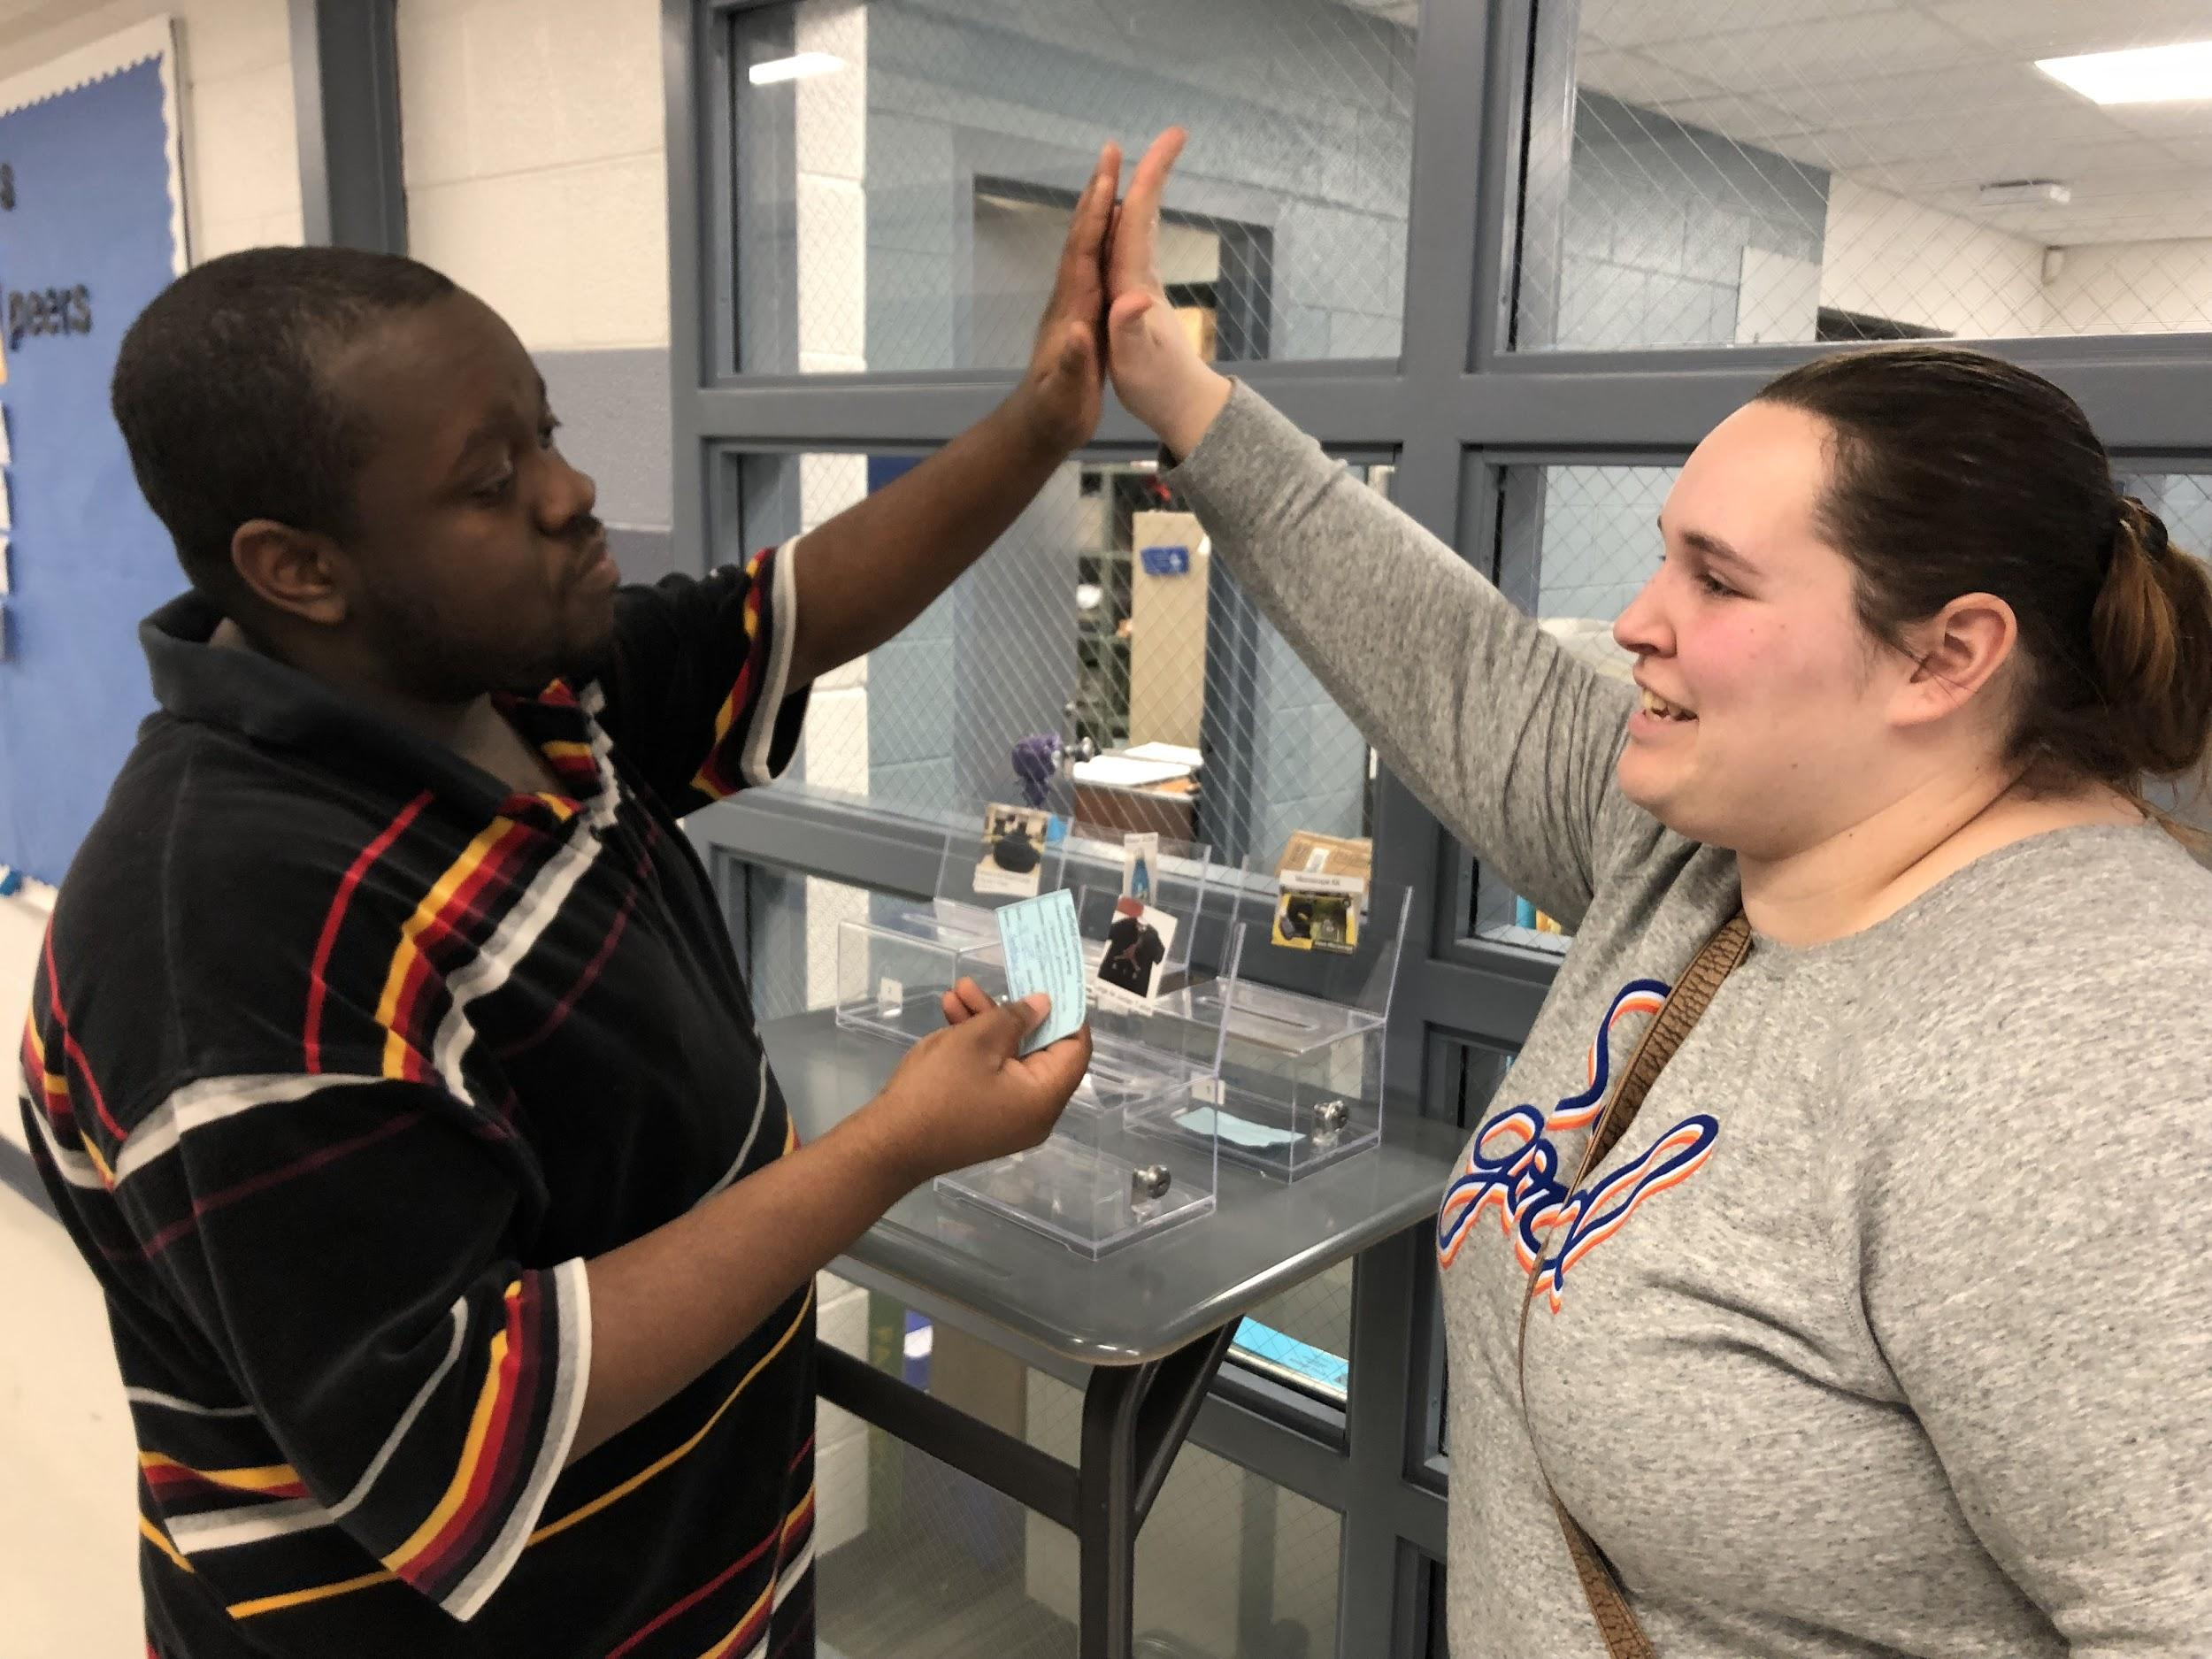
First Year-Tier One
Survey
Staff buy in
Teacher is the first to handle minor behaviors
Teaching the matrix
Kickoff (Rewards, video, dance, Kona truck)
Blue Tickets
Weekly Raffles (5 bins-Gift Card, t-shirt/sport item, lunch with staff member, time with lizard/ducks/, rotating)
Notes:
Picture of raffle bins, blue tickets, google doc for teaching strategies, survey on next slide, examples of teaching the matrix
Ashley

Slide 11
PBIS Self-Assessment Survey
1. A team exists and meets regularly for school-wide behavior support planning and problem-solving.
o In Place------------82.2%
o Working on It-----15.6%
o Not in Place-------2.2%
2. A school administrator is an active participant on the school-wide PBS team.
o In Place---------------82.2%
o Working on It-------15.6%
o Not in Place---------2.2%
3. Data are collected and used (discipline summaries, surveys) to guide decision making about school-wide behavior interventions.
o In Place----------------51.1%
o Working on It---------44.4%
o Not in Place------------4.5%
4. A small number (i.e., 3-5) of positive student behavior expectations have been identified school-wide for all students (e.g., be respectful, responsible, and safe).
o In Place-----------------59.2%
o Working on It---------36.7%
o Not in Place-----------4.1%
5. Specific positive behavior expectations have been defined for all classroom settings.
o In Place-----------------39.1%
o Working on It----------50%
o Not in Place------------10.9%
6. Specific positive behavior expectations have been defined for non-classroom settings (e.g., hallways, cafeteria, playground, bathrooms, etc.).
o In Place--------------------34%
o Working on It-------------55.3%
o Not in Place---------------10.6%
12. Problem behavior (both major and minor offenses) are defined clearly for both staff and students.
o In Place--------------------------34%
o Working on It-------------------53.2%
o Not in Place---------------------12.8%
13. Consequences for problem behaviors are defined clearly for both staff and students.
o In Place------------------------21.3%
o Working on It-----------------66%
o Not in Place-------------------12.8%
14. Distinctions between office v. classroom managed problems are clear to staff and students.
o In Place----------------------20.9%
o Working on It---------------65.1%
o Not in Place-----------------14%
15. Staff actively supervise (move, scan, and interact) students in non-classroom settings.
o In Place-----------------------75%
o Working on It----------------22.9%
o Not in Place------------------2.1%
16. A system for addressing problem behavior in non-classroom settings exists and is practiced by supervising staff.
o In Place--------------------------34.8%
o Working on It------------------63%
o Not in Place-------------------2.2%
17. There is adequate staff to supervise students in non-classroom, common areas.
o In Place-------------------------47.8%
o Working on It----------------41.3%
o Not in Place------------------10.9%
18. Transitions (between classes, in hallways, and in non-classroom areas) are planned, taught to students, and are orderly.
o In Place---------------------------29.2%
o Working on It-------------------62.5%
o Not in Place---------------------8.3%
19. A simple process exists for teachers to request and receive assistance for individual students with more significant problem behaviors.
o In Place-----------------------------64.4%
o Working on It---------------------35.6%
o Not in Place-----------------------0%
20. Families are informed about school-wide positive behavior expectations for students.
o In Place------------------------------22.7%
o Working on It----------------------59.1%
o Not in Place------------------------18.2%
21. Parents or guardians are actively involved in the process of developing behavior intervention plans.
o In Place-----------------------------------53.3%
o Working on It----------------------------40%
o Not in Place------------------------------6.7%
7. Expectations are posted visibly in non-classroom settings (e.g., hallways, cafeteria, playground, bathrooms, etc.)
o In Place---------------------21.3%
o Working on It--------------53.2%
o Not in Place----------------25.5%
8. Expected student behaviors are taught directly by discussion, modeling, practice, and feedback in classroom settings.
o In Place---------------------68.1%
o Working on It--------------27.7%
o Not in Place----------------4.2%
9. Expected student behaviors are taught directly by discussion, modeling, practice, and feedback in non-classroom settings (e.g., hallways, cafeteria, etc.).
o In Place--------------------50%
o Working on It-------------37.5%
o Not in Place---------------12.5%
10. Expected student behaviors are rewarded regularly in classrooms.
o In Place-----------------------------63%
o Working on It----------------------26.1%
o Not in Place------------------------10.9%
11. Expected student behaviors are rewarded regularly in non-classroom settings.
o In Place---------------------------37.8%
o Working on It---------------------42.2%
o Not in Place------------------------20%

Slide 12
Survey Cont...
17. There is adequate staff to supervise students in non-classroom, common areas.
o In Place-------------------------47.8%
o Working on It----------------41.3%
o Not in Place------------------10.9%
18. Transitions (between classes, in hallways, and in non-classroom areas) are planned, taught to students, and are orderly.
o In Place---------------------------29.2%
o Working on It-------------------62.5%
o Not in Place---------------------8.3%
19. A simple process exists for teachers to request and receive assistance for individual students with more significant problem behaviors.
o In Place-----------------------------64.4%
o Working on It---------------------35.6%
o Not in Place-----------------------0%
20. Families are informed about school-wide positive behavior expectations for students.
o In Place------------------------------22.7%
o Working on It----------------------59.1%
o Not in Place------------------------18.2%
21. Parents or guardians are actively involved in the process of developing behavior intervention plans.
o In Place-----------------------------------53.3%
o Working on It----------------------------40%
o Not in Place------------------------------6.7%
12. Problem behavior (both major and minor offenses) are defined clearly for both staff and students.
o In Place--------------------------34%
o Working on It-------------------53.2%
o Not in Place---------------------12.8%
13. Consequences for problem behaviors are defined clearly for both staff and students.
o In Place------------------------21.3%
o Working on It-----------------66%
o Not in Place-------------------12.8%
14. Distinctions between office v. classroom managed problems are clear to staff and students.
o In Place----------------------20.9%
o Working on It---------------65.1%
o Not in Place-----------------14%
15. Staff actively supervise (move, scan, and interact) students in non-classroom settings.
o In Place-----------------------75%
o Working on It----------------22.9%
o Not in Place------------------2.1%
16. A system for addressing problem behavior in non-classroom settings exists and is practiced by supervising staff.
o In Place--------------------------34.8%
o Working on It------------------63%
o Not in Place-------------------2.2%

Slide 13
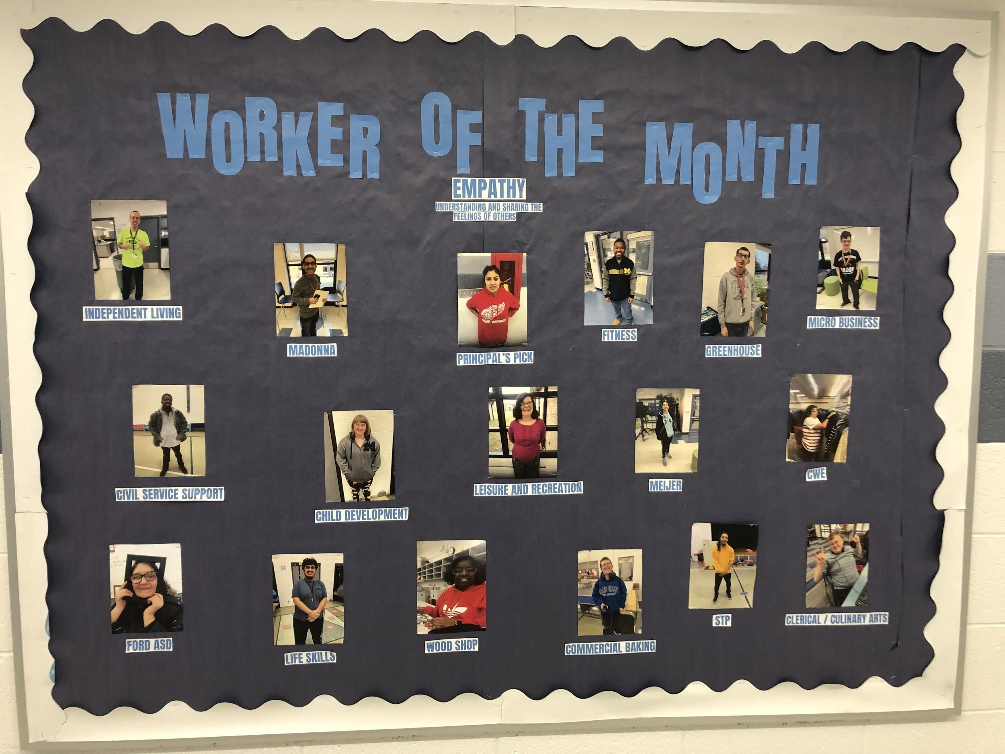
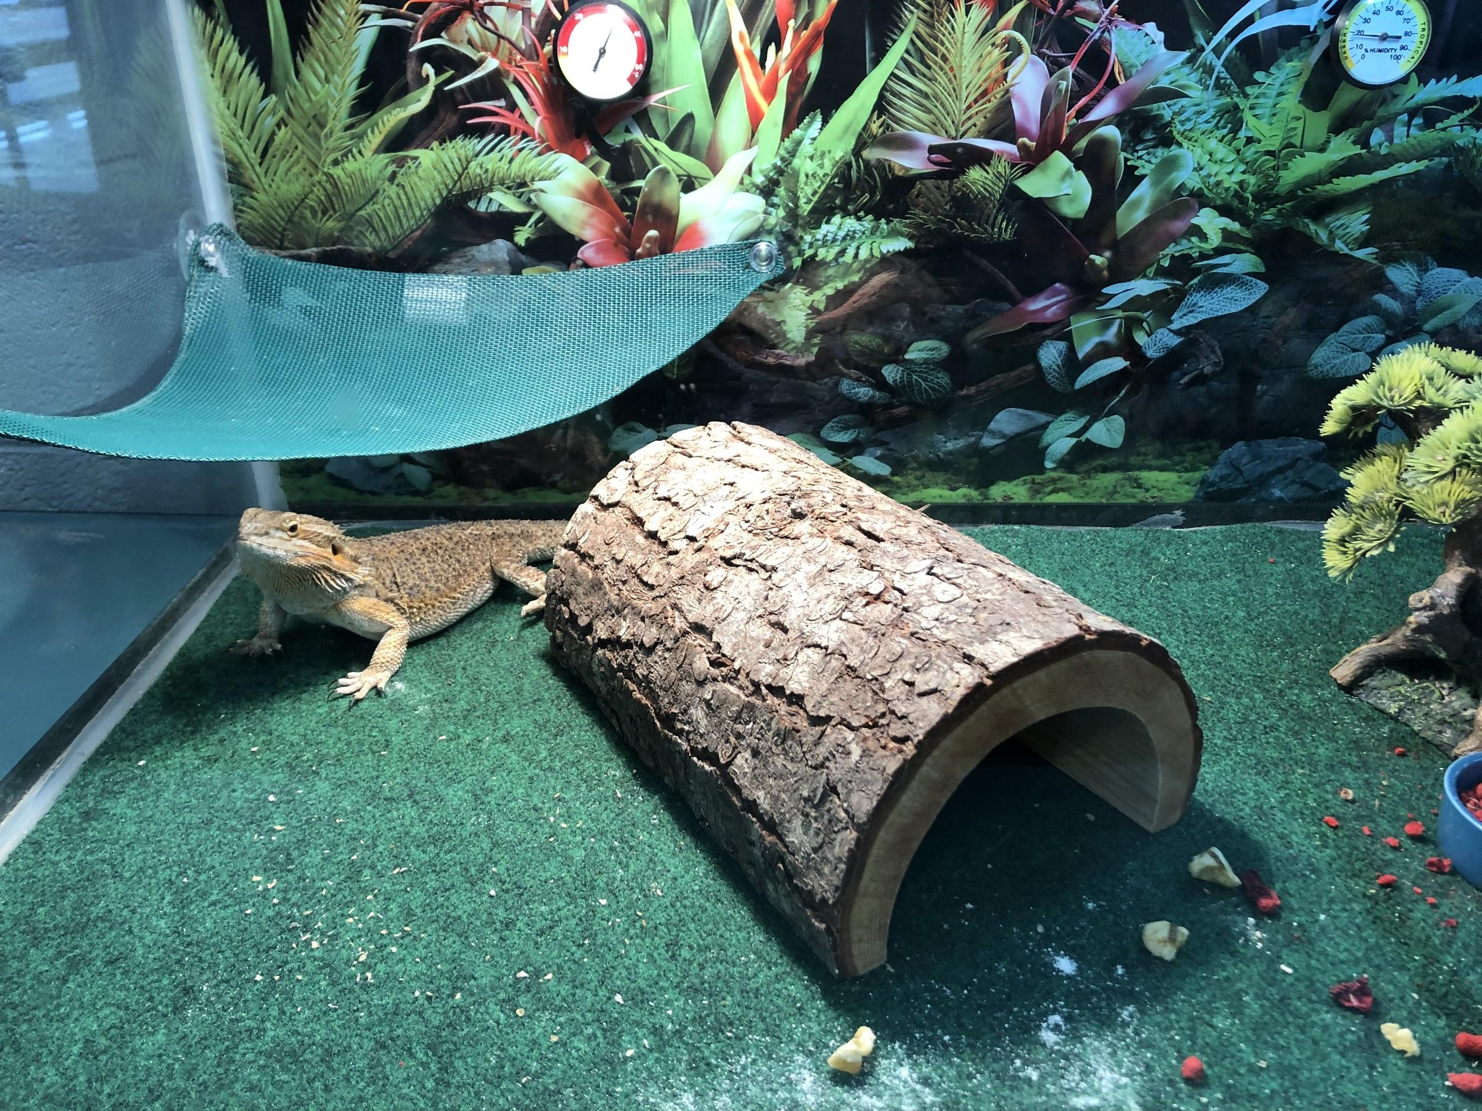
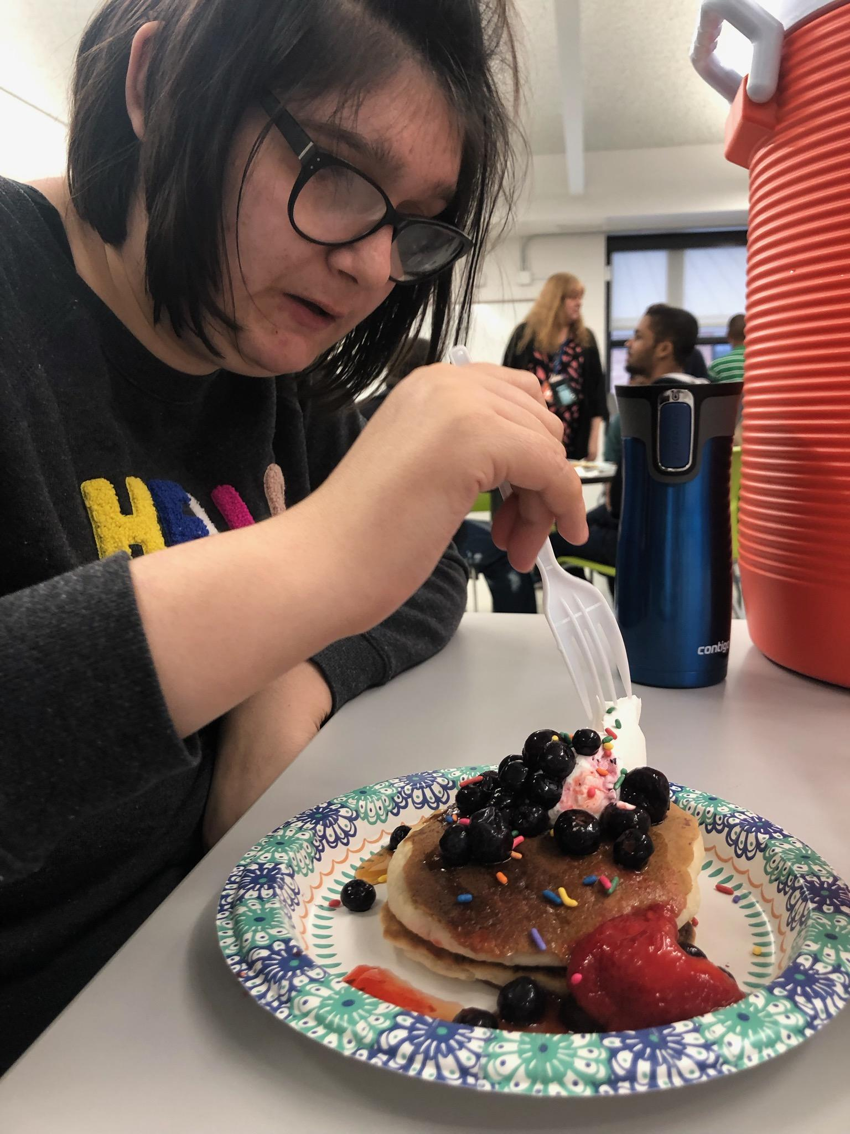
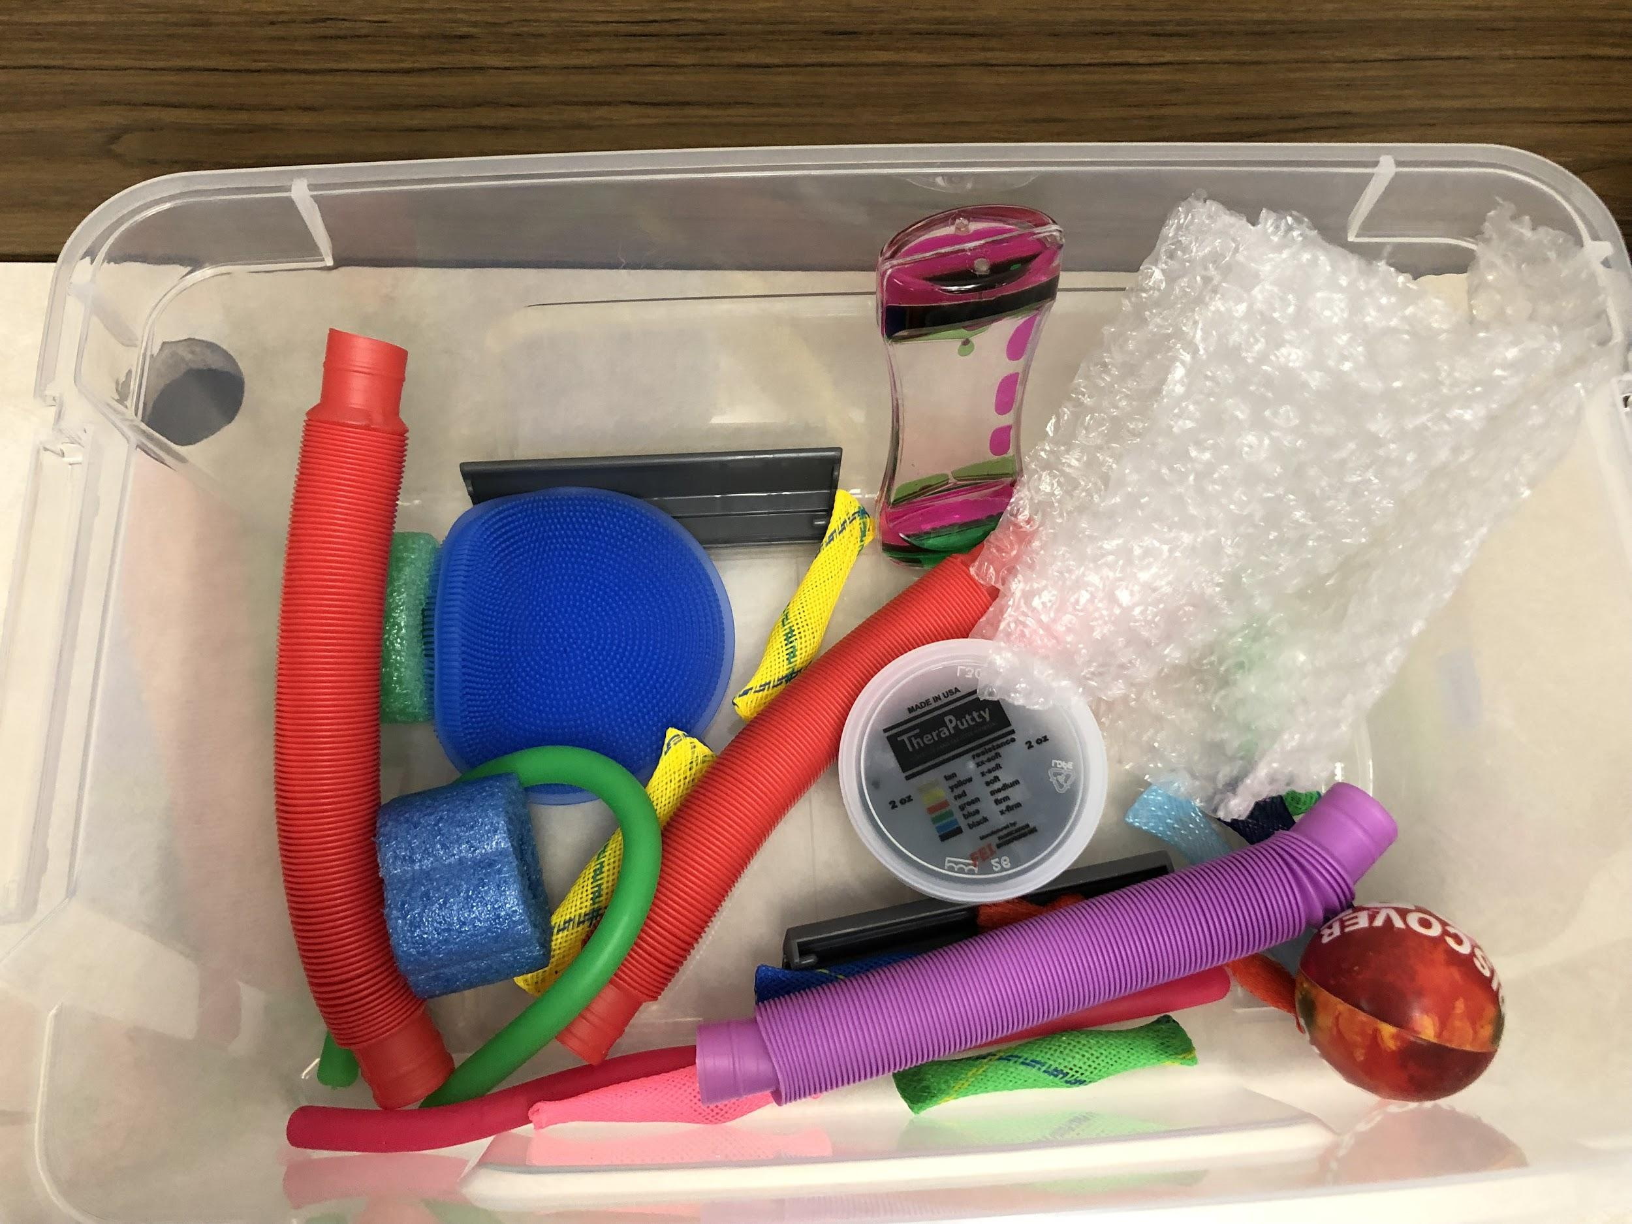
First Year Tier 1 continued...
Worker of the Month (District Character Traits- Respect, Responsibility, Grit, Confidence, Integrity, Empathy, Reflection, Mindfulness)
Cool down kits
Monthly Rewards (example: pancake breakfast, shamrock shakes)
Big rewards (Victor’s Day)

Slide 14
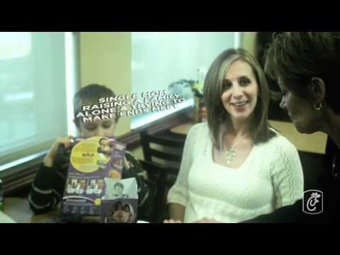
First Year Tier One Continued...
Every Person Has a Story:
Importance of building relationships (greeting, knowing about what’s happening in students’ lives, positive engagement, teachers being the first to handle behaviors, being present through the building, 4:1 positives)
Notes:
Rick

Slide 15
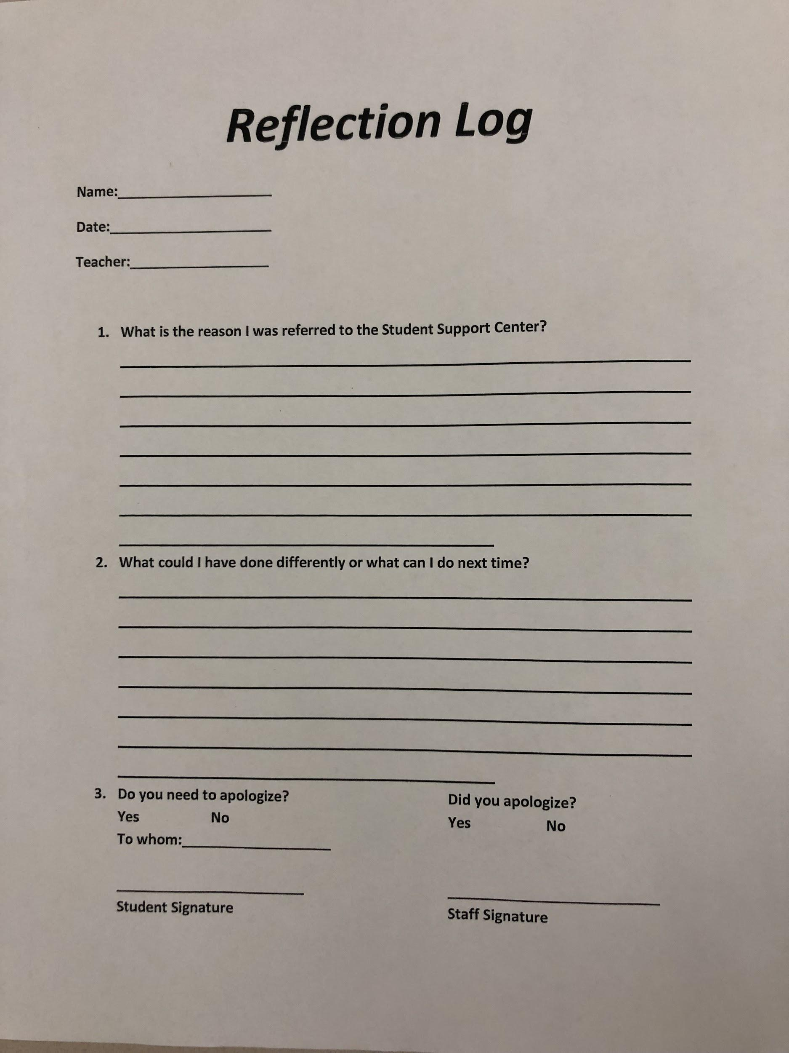
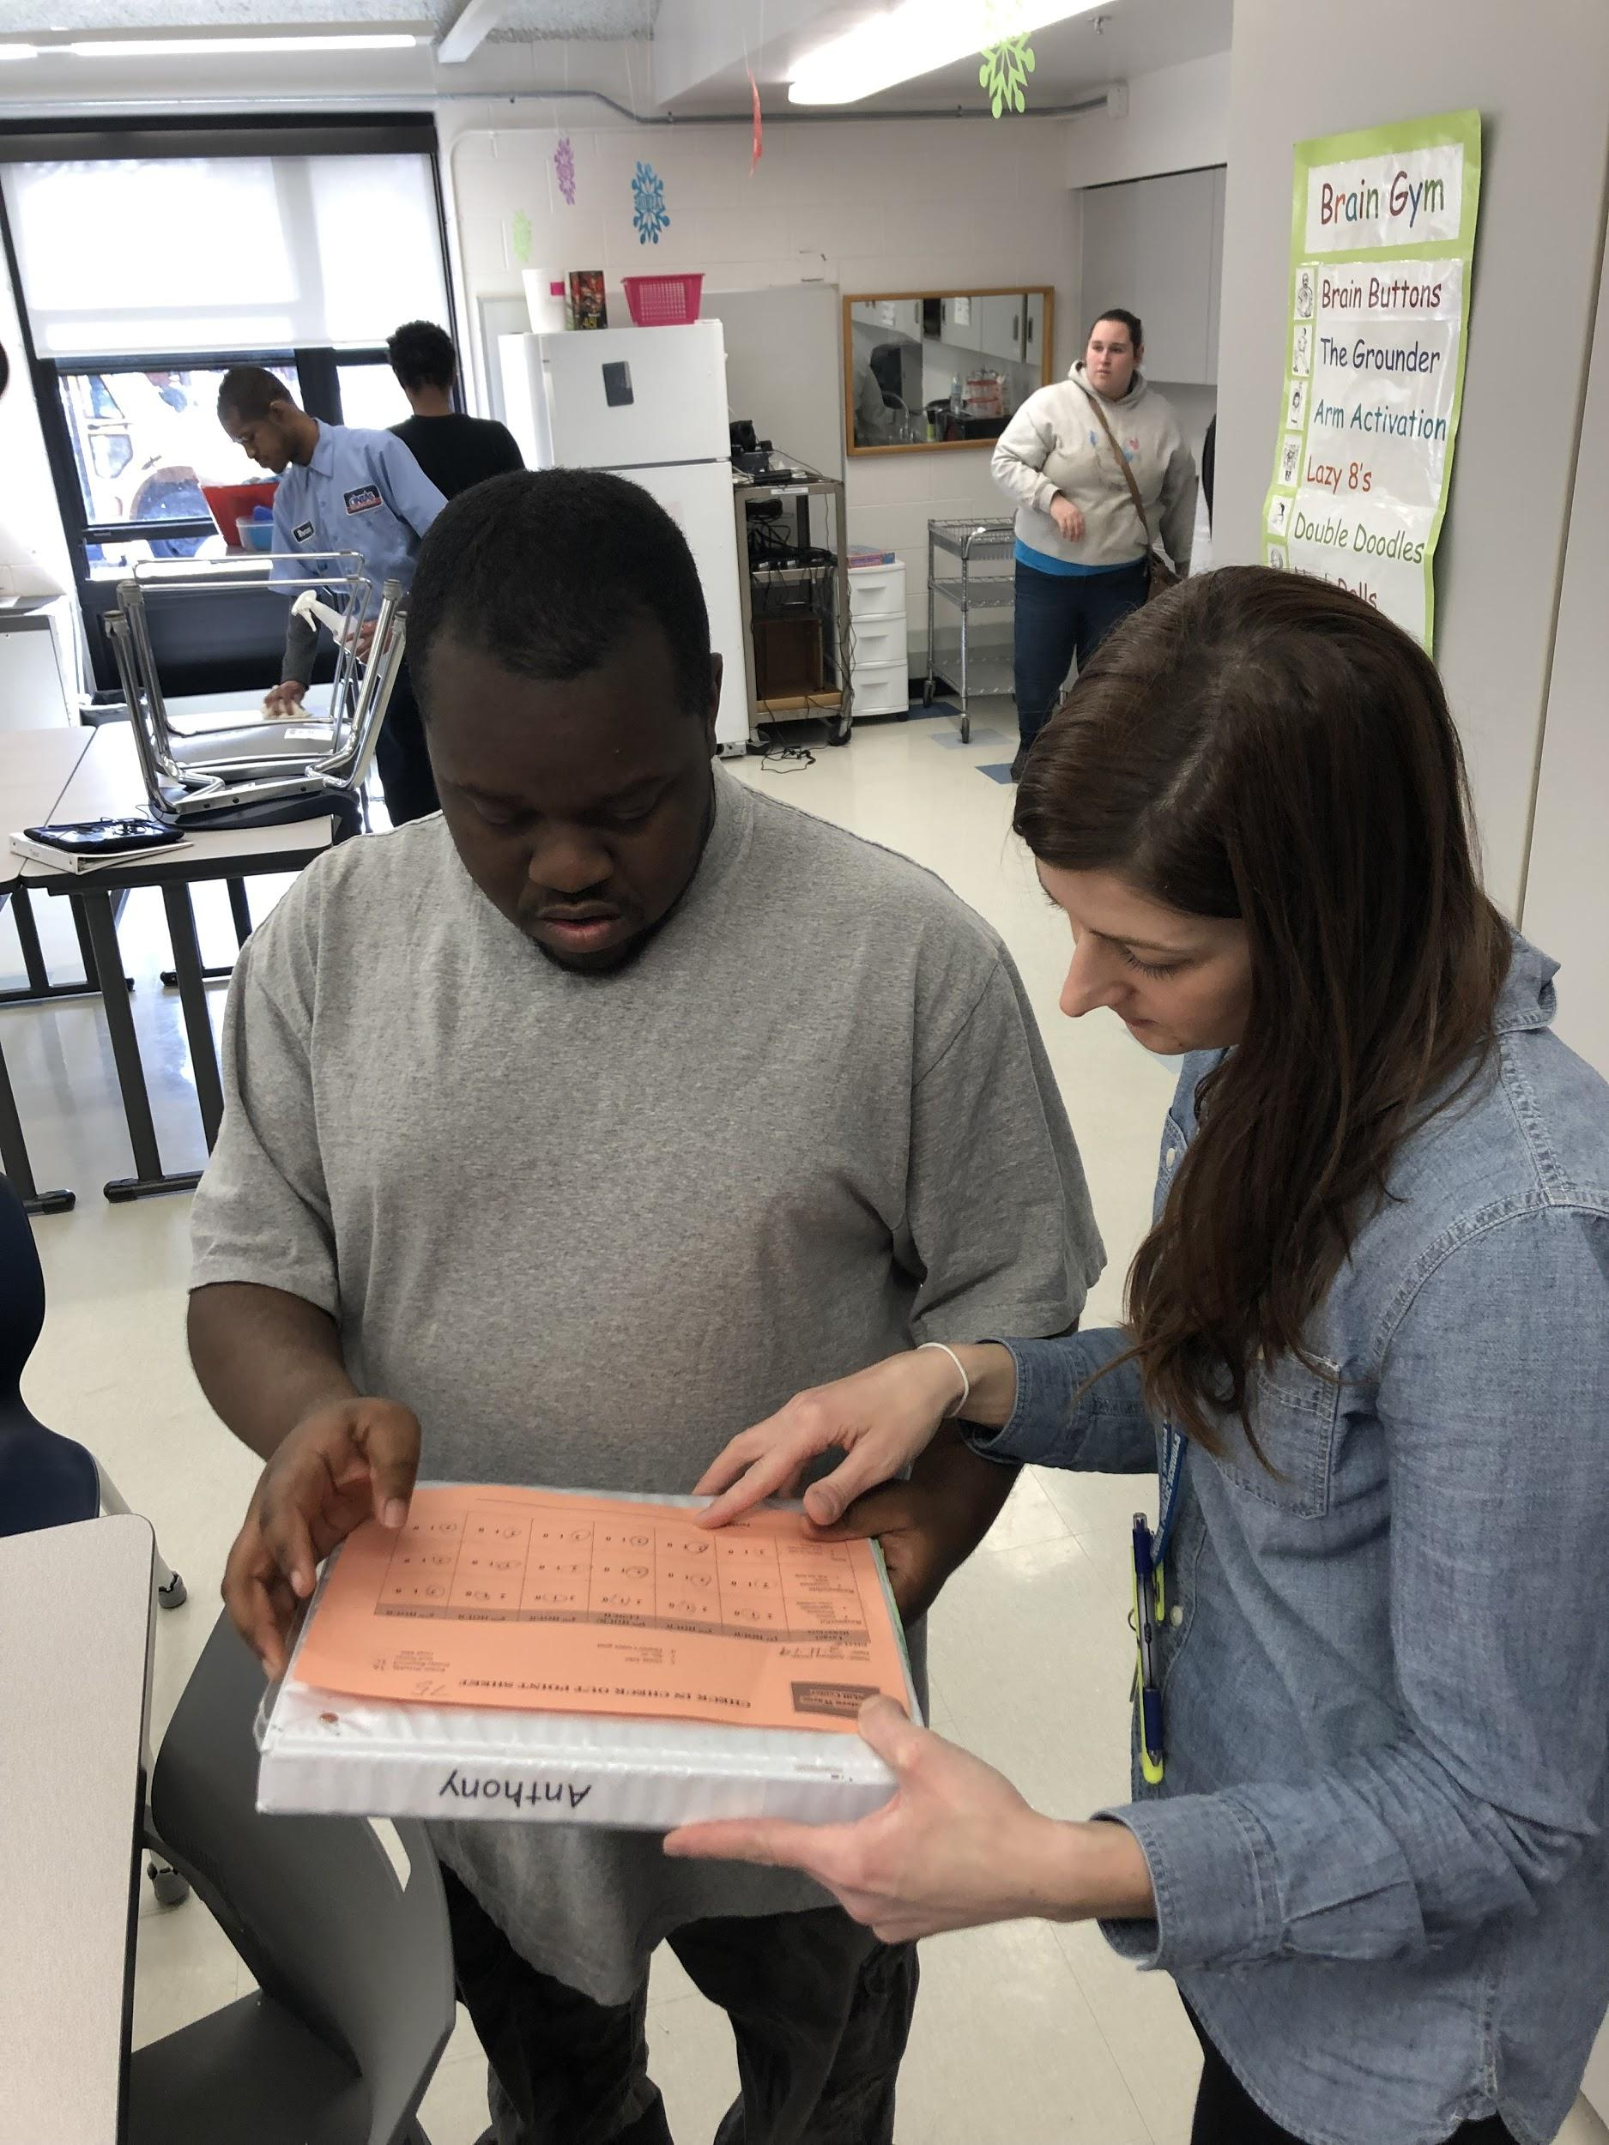
Tier 2
Check in/out
Touch base
Peer to peer mentors
Staff mentors
Women/Men’s club (Tier 1 and 2 students)
Built in breaks
Active supervision by all staff
Built in reward system
EPTs
BIP reviews
Additional rewards
20 Students
Reflection Logs
Community Service
Student Support Center (counseling)
Teach/Practice Replacement Behaviors
Notes:
Picture of Rick with peer mentor, Ashley CICO
Rick

Slide 16
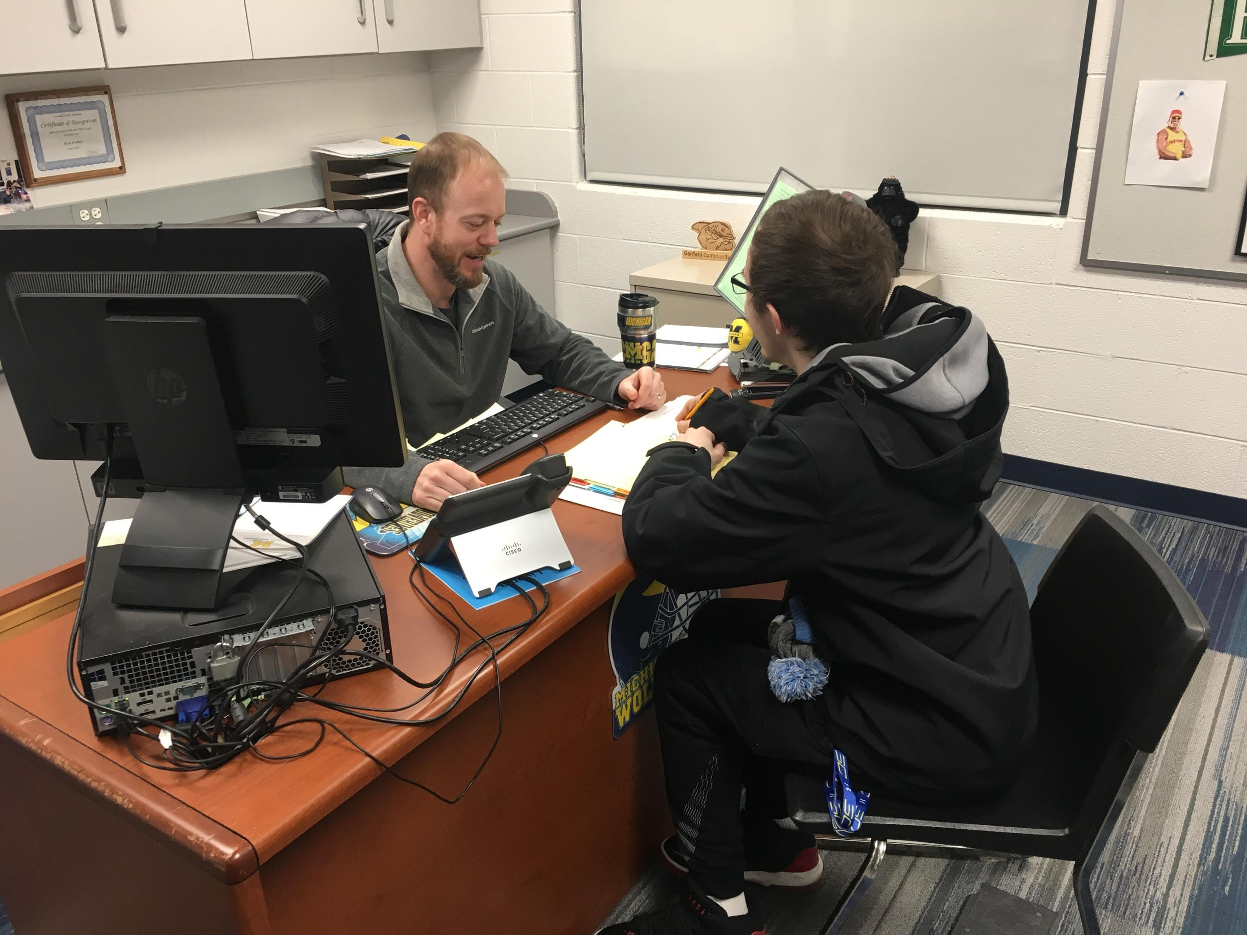
Tier 3
Alternatives to suspension
Check in/Check out
Touch base
Staff Mentor
Peer Mentor
Built in reward system
10 Students
FBA/BIP/BIP reviews
Scatterplots/ABC Logs
Staff switch/class switch/environment change
Additional rewards
Wraparound
Notes:
Rick & Pat

Slide 17
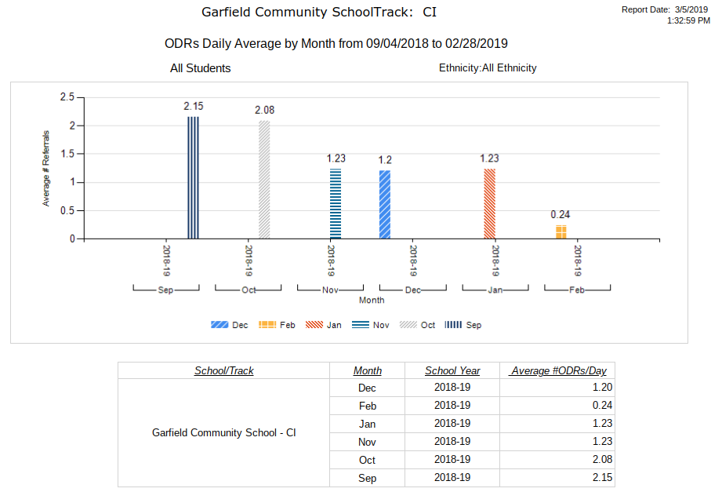
Data

Slide 18
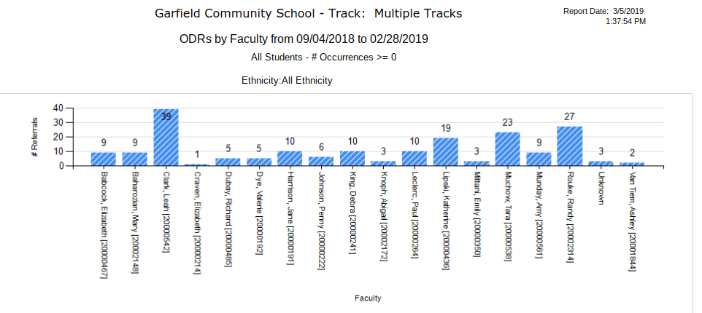

Slide 19
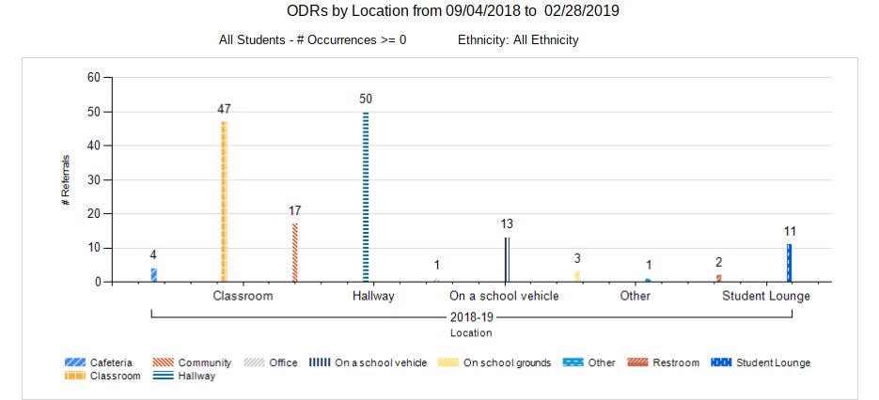

Slide 20
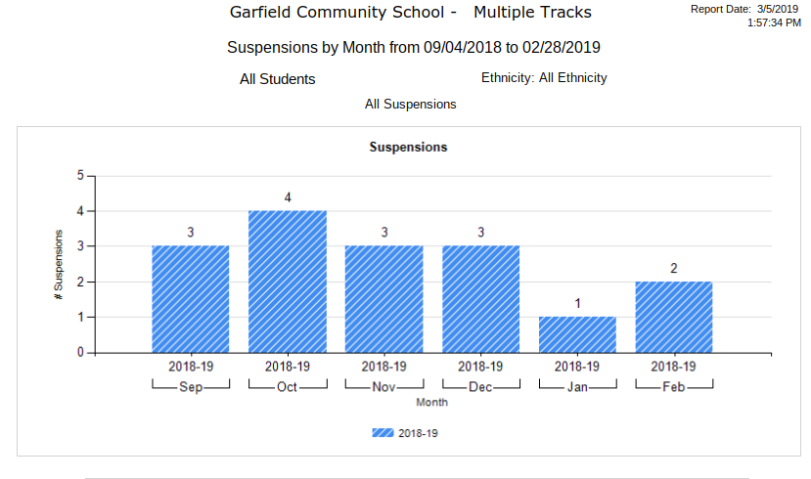

Slide 21
What we’ve learned...
-Use resources from RESA website (PBIS)
-It was helpful to meet with Chris and Karyl for suggestions and clarification
-Determine what data is necessary and most important
-Check in/check out

Slide 22
Advice?
Any advice for us moving forward?

Slide 23
Questions?
Patrick Mies: pmies@livoniapublicschools.org
Rick DuBay: rdubay@livoniapublicschools.org
Leah Clark: lclark2@livoniapublicschools.org
Ashley Van Tiem: avantiem@livoniapublicschools.org

