Slide 1
Implementing the PBiS
Bully Prevention
Program at
Parsons Elementary
Crystal Brown
4th Grade Teacher, Parsons PBiS Team
Gibraltar District PBiS Coach
brownc@gibdist.net.

Slide 2
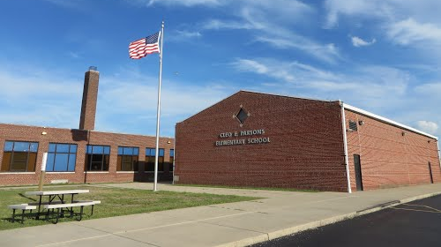
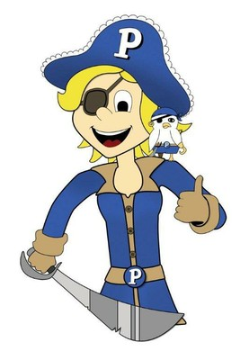
Parsons Elementary
Gibraltar Public Schools
We welcome
about 430
‘Parsons Pirates’
each day, K-5
We’ve been a
Respectful, Responsible, and Safe
PBiS school since 2006
After discussing other Bully Prevention options for years, we started implementing the PBiS Bully Prevention Program last year.

Slide 3
We were drawn to a
Bully Prevention Program…
Data
Our Physical Aggression data was consistently the most prevalent problematic
Fighting and threats were also quite high on a yearly basis
Most of these behaviors happened outside of the classroom

Slide 4
We were drawn to a
Bully Prevention Program…
Teacher/Student Surveys
A surprising number of students reported feeling ‘bullied’ by other students
Several students said teachers ‘did nothing’ about the ‘bullies’
Teachers reported frustration because the behaviors were out of sight… out of our control.

Slide 5
We were drawn to a
Bully Prevention Program…
Team Observations
In correlation with the data, our team meetings were filled with discussions of student aggression on the playground and in the hallways
In watching video surveillance of incidents, we studied student behavior and noticed bystander behavior

Slide 6
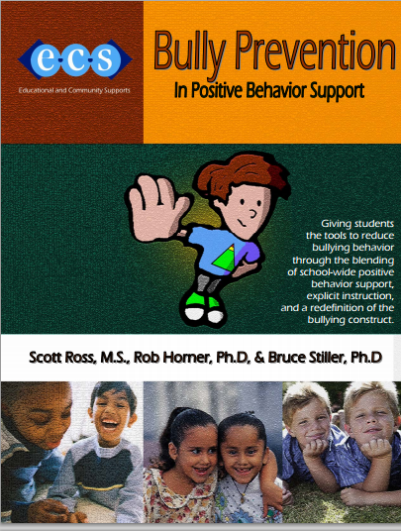
PBiS Bully Prevention…
Consistent
Predictable sequence
Simple
Applicable to many school scenarios
Applicable to victim and aggressor
Empowering to Students

Slide 7
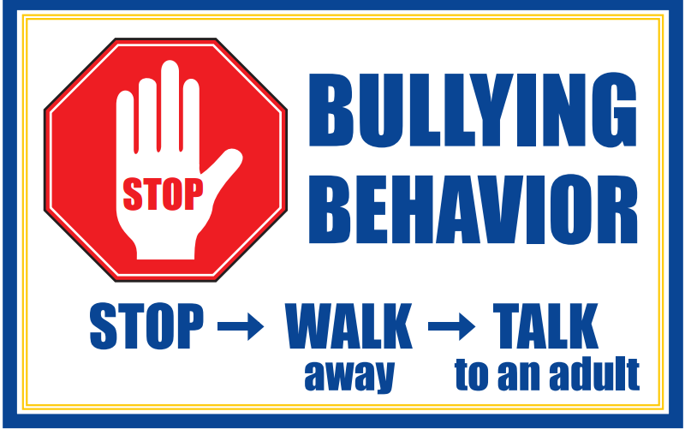

Slide 8
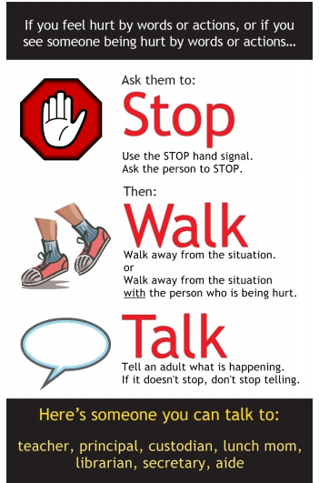
What does
Stop-Walk-Talk mean to
Parsons’
Pirates?

Slide 9
Implementation Strategy
1. Kickoff Skit the First Week of School
      Teachers perform skit
      Principal introduces posters and vocabulary
Bringing it into the Classroom
      Teachers use the Bully Prevention Program to teach lessons
      Reinforce vocabulary in the classroom through lessons and everyday conversation
      Teachers reinforce the BP behaviors and vocabulary with posters throughout the school
      Teachers celebrate Upstanders in the classroom as they happen in real time
3. Student Reenactment Video
      Students perform short skits to highlight how to Stop, Walk, Talk
      Teachers show video to students schoolwide
4. PBiS Ambassadors

Slide 10
PBiS Ambassadors
4th grade students volunteered to be a Parsons Ambassador
After breaking into small groups, students decided upon their classroom audiences throughout the school, K-3
Brainstorming together, students identified a needed focus skill for their age students
Groups discussed how the message/focus skill would be presented
We met during lunch time… either eating or indoor recess
Groups practiced, and practiced, and practiced…
Finally when they were ready, students presented their Ambassador Lesson to their assigned classrooms.

Slide 11
PBiS Ambassadors
Teachers and students enjoyed
the presentation of a Mentor
4th grade students learned a great deal more about the program and the most misunderstood parts because of their preparation.
4th grade Students made connections with smaller students and have been going out of their way to greet and acknowledge them in the hallway

Slide 12
The Future of BP-PBiS at Parsons
Scheduled Principal Sessions…
    Target skills identified for each class
    Teacher follows up lesson with supported activities and consistent vocabulary
Upstanders in History…
    Students identify people in our history who demonstrated ‘Upstander’ characteristics
    Students research and create posters to hang around the school about people in our history who were exceptional models of Upstander behavior

Slide 13
Thank you!
Crystal Brown
Gibraltar Public Schools
Parsons Elementary
4th Grade
brownc@gibdist.net
@brownc_brown

