Slide 1
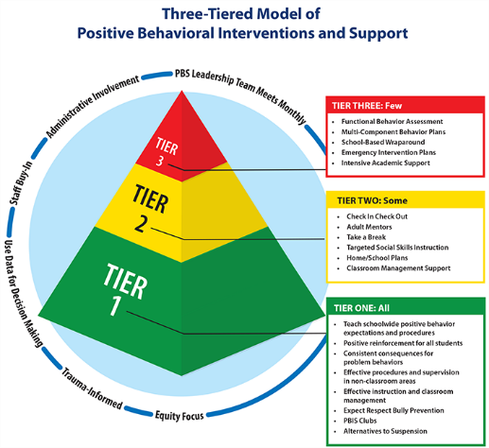
PBIS Data Report
School Name
Month of Report
2023-2024

Slide 2
Analyze Behavior Data by:
ODRs by Month YTD
ODRs by Month Daily Average YTD
Suspensions by Month YTD
Suspension Days Out of School YTD
Suspensions by Month Year to Year
ODRs by Infractions YTD
ODRs by Location YTD
ODRs by Time YTD
ODRs by Student Levels (use for Tier 2/3)
ODRs by Grade Level YTD
ODRs by Gender YTD
ODRs by Faculty YTD
ODRs by Ethnicity
Suspensions by Ethnicity
Risk Ratios by Ethnicity
Suspensions of Student with Disabilities
Penalties by Month (Suspension Alternatives)
Positive Behavior Indicator (not in MiStar – the school selects a positive to track)

Slide 3
ODRs by Month YTD

Slide 4
ODRs by Month Daily Average YTD

Slide 5
Suspensions by Month YTD

Slide 6
Suspension Days Out of School YTD

Slide 7
Suspensions by Month - Year to Year

Slide 8
ODRs by Infractions YTD

Slide 9
ODRs by Location YTD

Slide 10
ODRs by Time YTD

Slide 11
ODRs by Student Levels
(Use ID numbers)

Slide 12
ODRs by Grade Level YTD

Slide 13
ODRs by Gender YTD

Slide 14
ODRs by Faculty YTD

Slide 15
ODRs by Ethnicity YTD

Slide 16
Suspensions by Ethnicity YTD

Slide 17
Risk Ratios by Ethnicity YTD
Review Quarterly

Slide 18
Suspensions of Students with Disabilities YTD

Slide 19
If disproportionality by ethnicity is a concern in your school, complete the following two slides.
What is the targeted sub-group of concern ? ____________________________
What changes to our Tier 1 program need to be made to make it more culturally responsive? _______________________________________________________
How many of the targeted sub-group students receive Tier 2 support? _________________________________________________________________
Specify how many are on each Tier 2 Intervention:
  CICO:
  Adult Mentor:
  Take a Break:
  Home/School Plan:
  Targeted Social Skills:
  High Interest Club:
  Academic Support:
  Homework Help:
  Other:

Slide 20
Providing Tiered Supports to Students with
Multiple Referrals
How many students from the targeted sub-group receive Tier 3 support?____________________________________
Specify how many are on each Intervention
  PBIS plan with FBA:
  On-going counseling:
  Small Group Work:
  School-based Wrap-around:
  Alternatives to Suspension:
  Mental Health Services:
  Court Involvement:
  Other:

Slide 21
Penalties by Month
(Suspension Alternatives)

Slide 22
Positive Behavior Indicators
Your Choice

Slide 23
Tier 2 Summary
How many students are currently on Tier 2 plans?
What number/percentage of those students are showing improvement?
Include students’ individual Check In/Check Out Data Summaries with this report.

Slide 24
Data Analysis
Complete new analysis each month – describe briefly.
How are we doing overall? What positives have been occurring and what are areas of concern? ____________________________
What are the hot spots? Identify most frequent:
  Problem behaviors:
  Students/Groups:
  Grades:
  Attendance concerns:______________________________
  Location: ____________________________________________
  Other:

Slide 25
Data Analysis (cont.)
Describe target interventions to be implemented (based upon the PBIS Team’s review of the data)
Action plan: describe what will be done to implement and evaluate target interventions

Slide 26
Data Analysis (cont.)2
PBIS Team met on what date(s) last month?
PBIS Team will share data with staff when & how?

