Slide 1

Michigan Department of Treasury 529(A) ABLE Saving Accounts

Slide 2

What is the ABLE Act and its history
National ABLE Features
Michigan ABLE Features & Demo
Questions and Answers

Slide 3
The Stephen E. Beck, Jr. Achieving a Better Life Experience (ABLE) Act
Became law December 19, 2014 with overwhelming Congressional support
Created new 529A section of IRS code and authorized tax advantaged saving programs for individuals with disabilities
Enables saving for future, while protecting eligibility for public benefits
Earnings grow TAX FREE if funds used for Qualified Disability Expenses (QDE)

Slide 4
ABLE Account Features
Limit one ABLE account per “eligible individual”
Account owner is the designated beneficiary
Account can be established in any state regardless of residence
Total annual contributions/account federal gift tax limit
    (2018 = $15,000) (Subject to annual IRS changes)
Aggregate contributions state limit for 529 savings accounts
ABLE Assets excluded for Medicaid Eligibility
Medicaid “Claw-back” provisions

Slide 5
ABLE 529 Means-Test Features
ABLE assets are excluded or favorably treated when determining eligibility for most federal and state means-tested benefits
  SSI - First $100,000.00 is disregarded
    - SSI Payments suspended when $100,000 reached
  Medicaid - ALL ABLE assets disregarded
    - Medicaid is first creditor to MiABLE account

Slide 6
Who is Eligible to Open an ABLE 529?
  Individuals who became disabled prior to age 26
  No ABLE account in any other State
  3 methods to prove eligibility:
    Eligible for SSI or SSDI due to disability
    Have a Condition listed on SSA Compassionate Allowances List
    Self Certification

Slide 7
What can ABLE Assets/Funds be used for?
Distributions from MiABLE accounts must be made for “qualified disability expenses” (QDE)
  QDE are costs related to the beneficiary’s blindness or disability
  Are for the benefit of the beneficiary
  Tracking QDE is the responsibility of the designated beneficiary or authorized representative
  Disability Expenses are subject to audit by the IRS &/or SSA

Slide 8
ABLE Fund usage
QDE is meant to be as broad as possible & includes the expenses of everyday living
  Educational Expenses
  Housing
  Transportation
  Employment Training Programs
  Assistive Technology and Personal Support Services
  Health Prevention and Wellness
  Financial Management and Administrative services
  Legal Fees
  End of Life Expenses
Distributions for non-qualified expenses will be subject to tax consequences and may impact eligibility for federal means tested benefits.

Slide 9
Tax Implications/Michigan Features
Federal Taxes: All Distributions for QDE are exempt from taxation. Distributions used for non-QDE are taxable and subject to an additional penalty
State of Michigan: Michigan ABLE contributors can claim up to a $5,000 (single filer) or $10,000 (joint filers) deduction on their Michigan income tax returns
Michigan has highest allowable 529 limit ($500,000.00)

Slide 10
Mi ABLE or Special Needs Trust
“Another Tool in the Tool Belt”
Some benefits specific to MiABLE Accounts:
Cost-Effective
Broader spending power (i.e. housing)
Easy account access/closure
State tax deduction for MiABLE contribution
No federal income tax on earnings or returns to file
Can be established, administered, and owned by individual with disability

Slide 11
Tax Reform
ABLE Implications
Section 11025 (FKA ABLE Financial Planning Act) allows families to rollover savings in a 529 college savings plan into an ABLE account (subject to Annual Maximum Contribution)
Section 11024 (FKA ABLE to Work Act) allows additional contributions the Federal Poverty Level for ABLE beneficiaries who work (Beneficiaries shall maintain adequate records of Income for reporting purposes)
No change to Age requirements in Tax Reform Law of 2017

Slide 12

MiABLE Account Features
6 Investment Options
  5 Target Risk Investment options Ranging from 100% stock to 20% stock
  Various levels of risks & associated costs
1 Bank Money Market (FDIC Insured)
  Includes Visa Debit card Option for QDE purchases
$45 Annual Fee (paid quarterly)
Easy Online Enrollment (Self or Authorized Legal Representative) www.miable.org

Slide 13
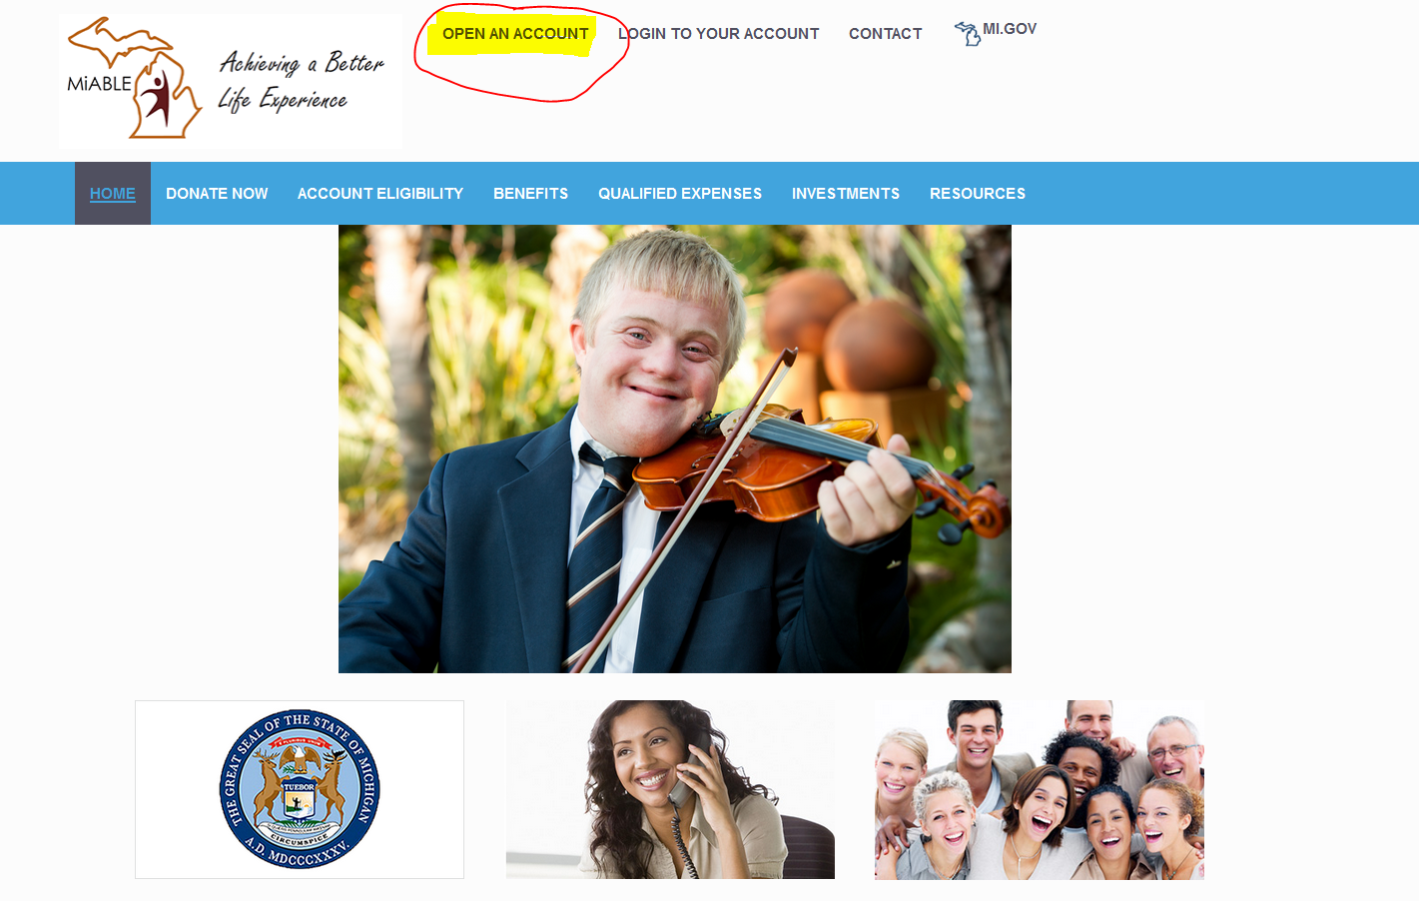

Slide 14
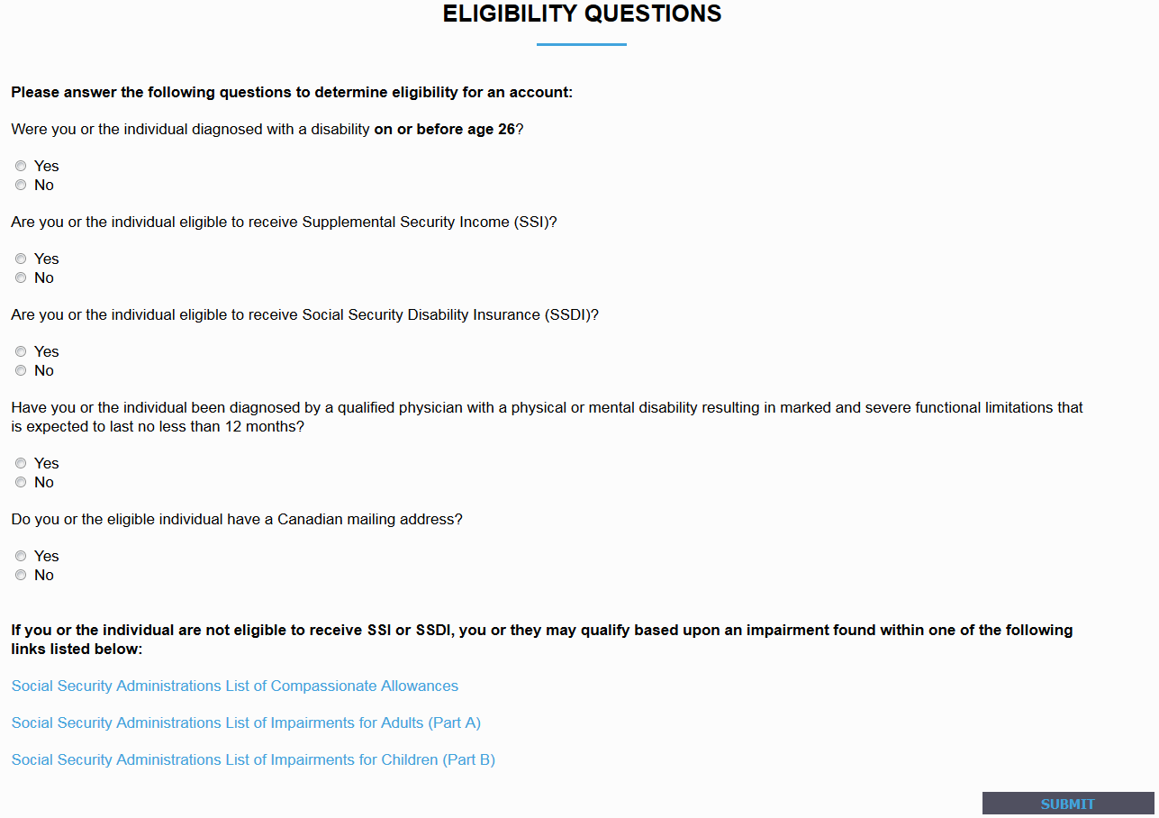

Slide 15
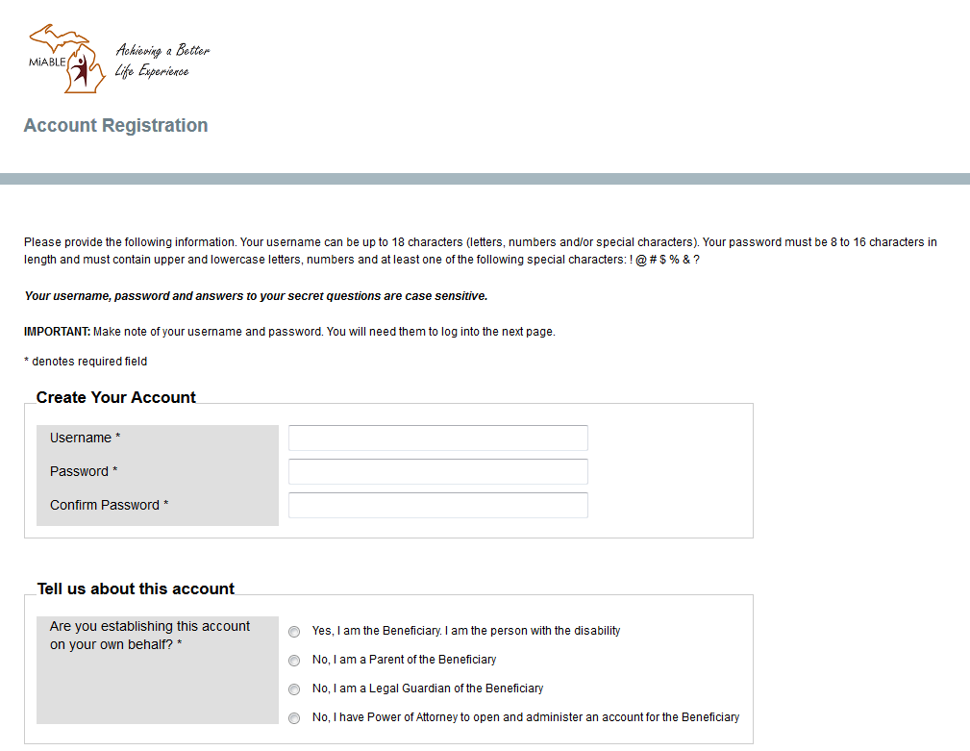

Slide 16
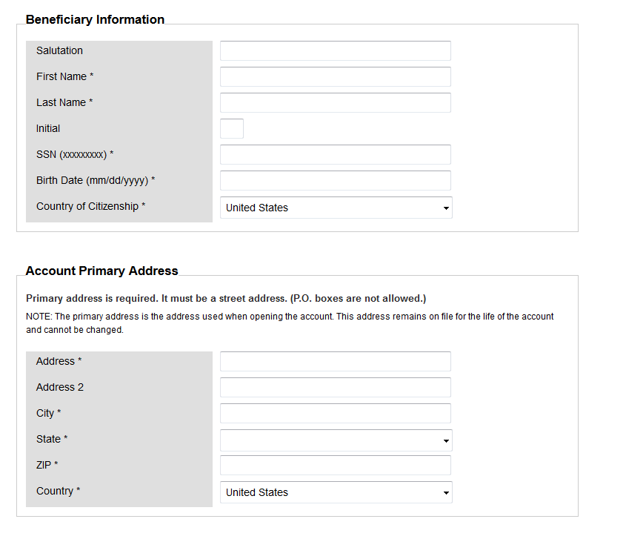

Slide 17
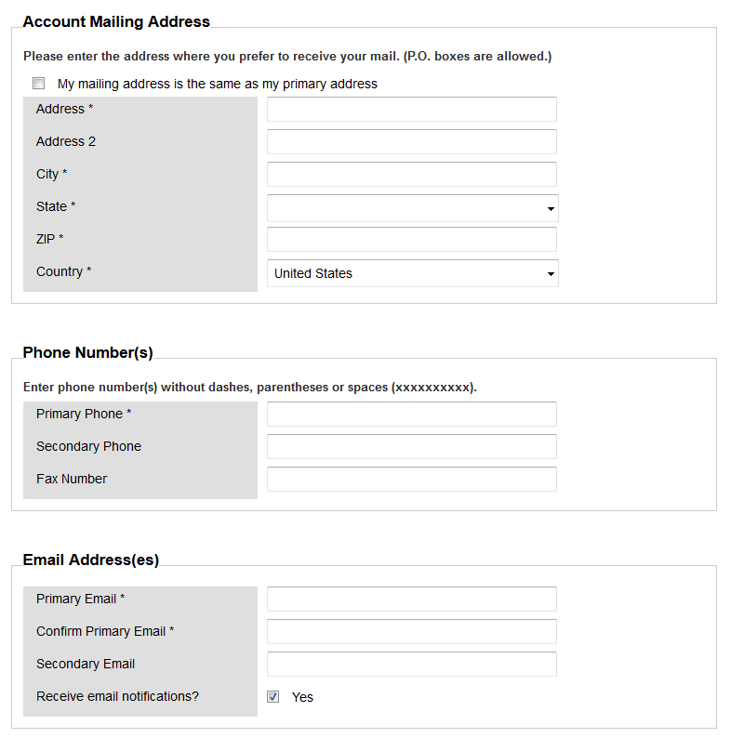

Slide 18
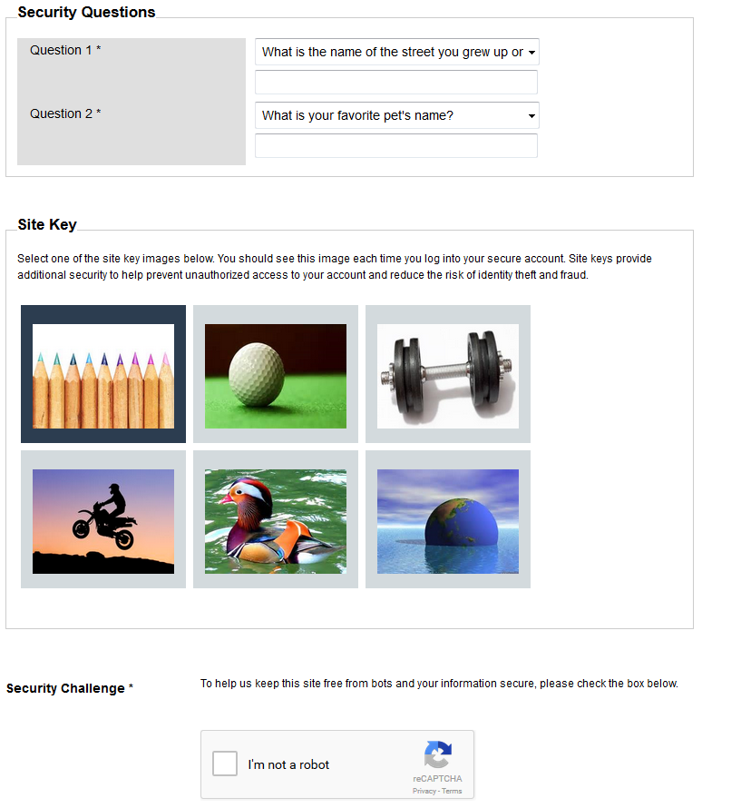

Slide 19
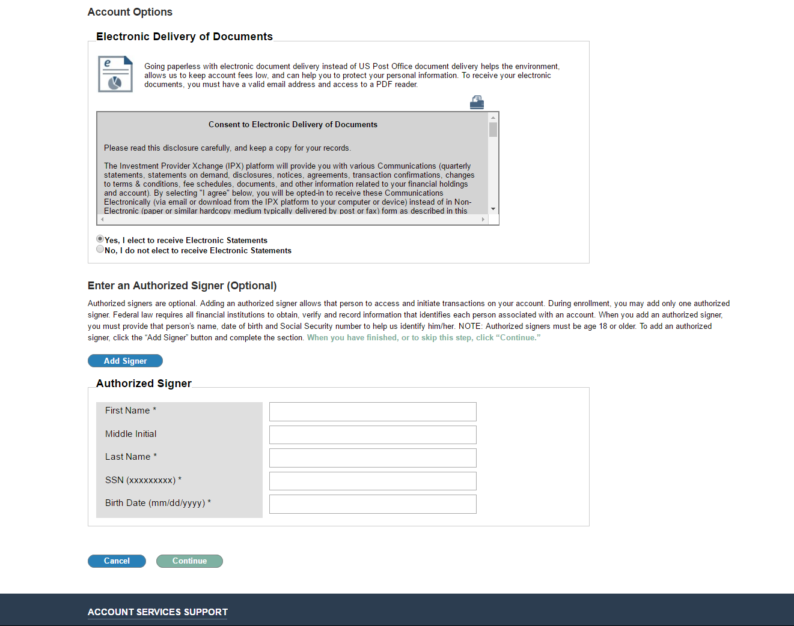

Slide 20
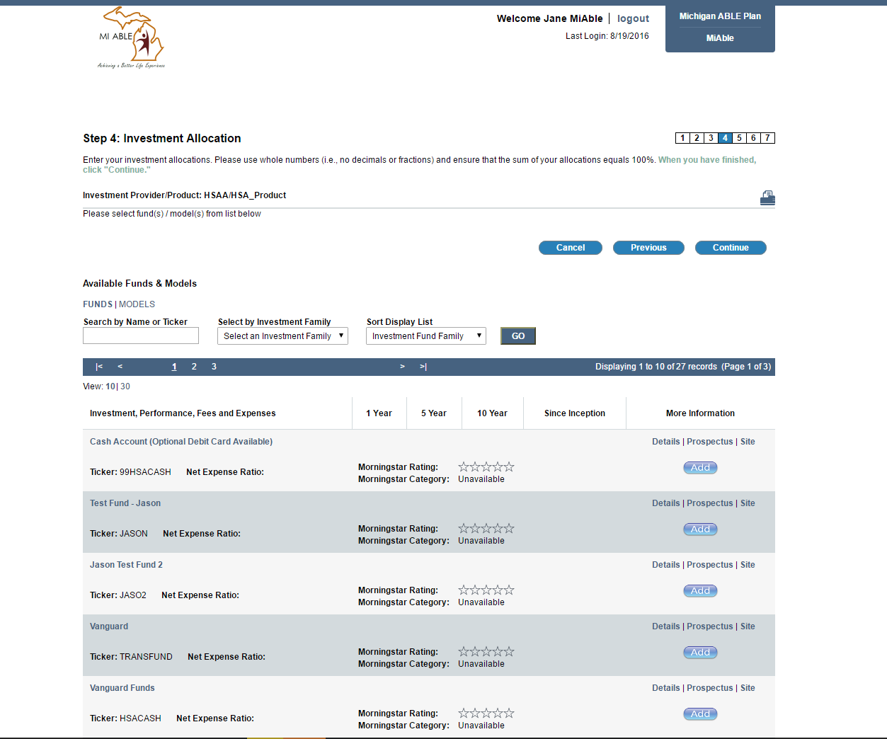

Slide 21
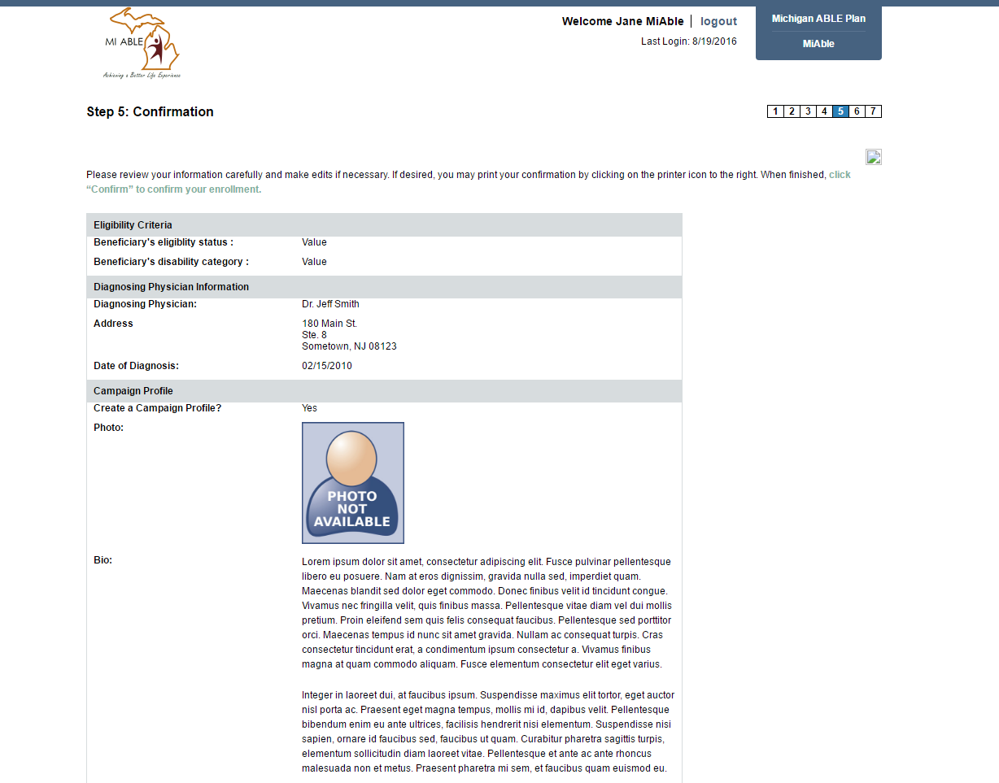

Slide 22
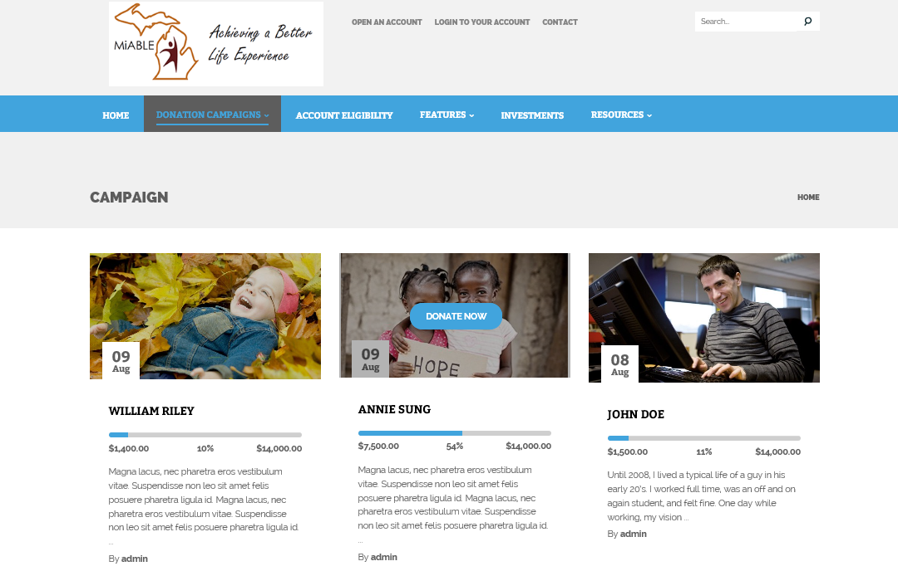
Rotating People

Slide 23
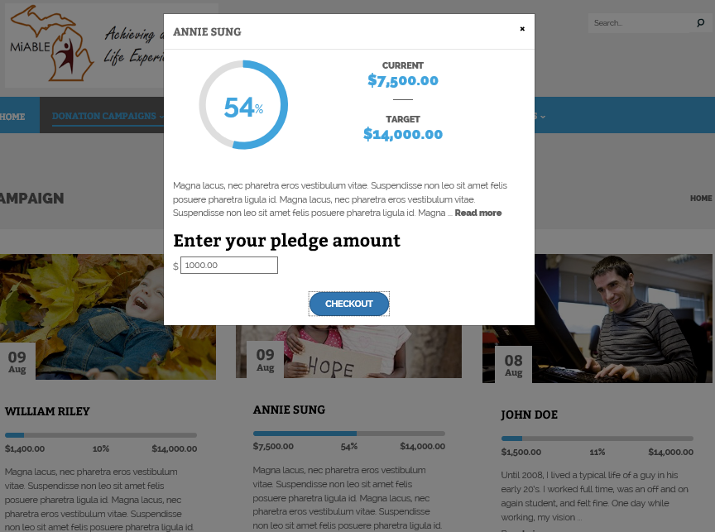

Slide 24
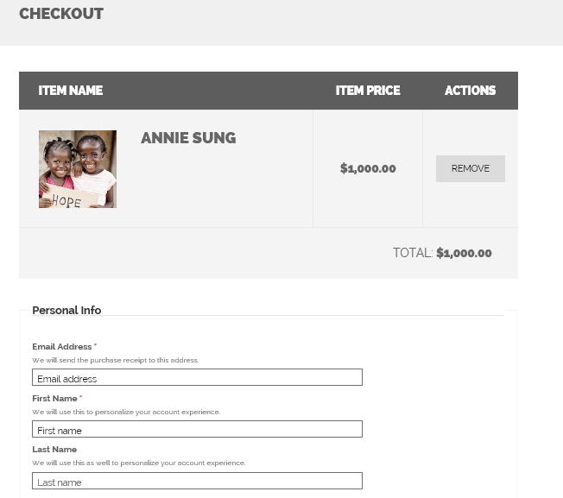

Slide 25
Outreach and Education
MiABLE Outreach is continuing and ongoing
Please send requests for presentations to
MiABLE@michigan.gov
ENROLLMENT www.miable.org
Customer Service 844-656-7225

